Slide 1
UHC Partnership + CAD PHC grant SEARO live monitoring
11 May 2023
Notes:
Good morning and good afternoon,
Welcome to the donors, HQ team and my regional and country colleagues.

Slide 2
Presentation Structure
Introduction (5 min)- HQ
Regional Overview; (20 min)
Overview of the 75th Regional Committee declaration
SEAR PHC Forum
Financial
Country Updates: Myanmar, Sri Lanka, Timor-Leste
India Spotlight (60 min)
India UHC Video
Decentralized activities at sub-national
Assam, Chhattisgarh, Delhi, Gujarat, Jammu & Kashmir, Jharkhand, Kerala, Maharashtra, Orissa, Rajasthan, Tamil Nadu, Uttar Pradesh
Interaction with State focal points
Wrap up and AOB- HQ (5 min)

Slide 3
WHO SEA Region Context
11 Countries are home to a quarter of the world’s population
Prior to pandemic (and economic crises)
Positive progress toward UHC
Increase in UHC Service Coverage Index and decline in OOP
GPW 13: 110 mill. of 270 million additional people projected to benefit from UHC from SEAR countries
Dual Shock
Health impact
Socio-economic impact: Rise in educational poverty; income poverty
Decades of progress in poverty alleviation, service delivery jeopardized
Pop growth, rise of NCDs, injuries, rapid urbanization, climate change, health emergencies, pockets with high rates of extreme poverty
RC 74 Ministers of Health Declaration
Once in a century opportunity to enable PHC-oriented Transformation
SEA Regional PHC Strategy

Slide 4
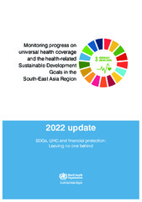
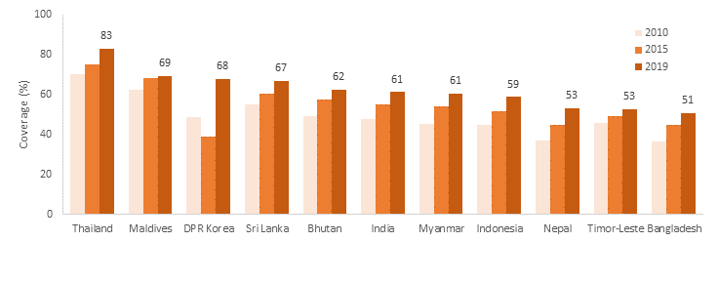
Changes in UHC service coverage index, 2010-2019
Notes:
SEARO publishes Annual Report on Monitoring progress towards universal health coverage (UHC) and the health-related Sustainable Development Goals (SDGs).
The regional average for the UHC essential health services index was 61% in 2020 compared with 49% in 2010. The figure shows the improvements in service coverage across Member States from 2010 to 2020.

Slide 5
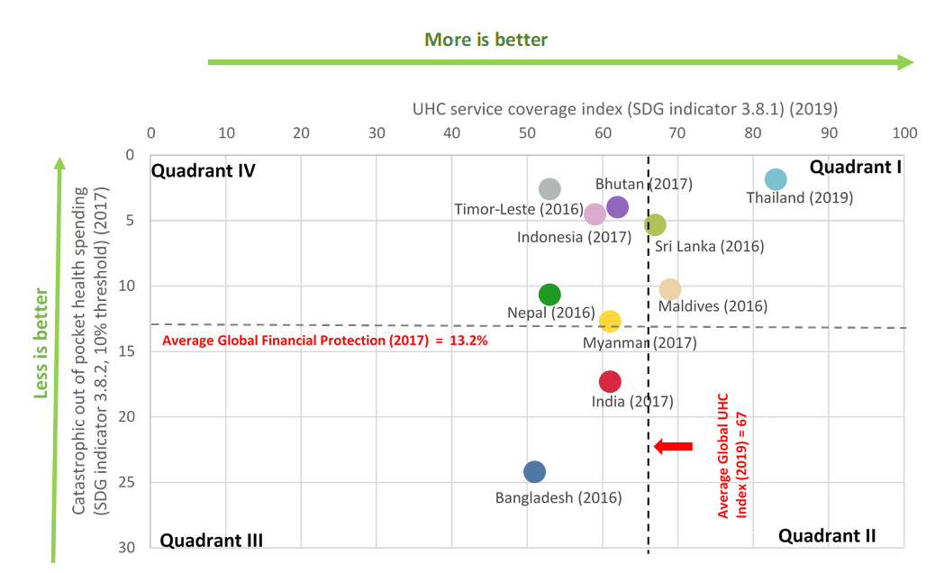
Health service coverage and financial protection in SEAR, 2017
Source: WHO Global Health Observatory accessed 5 May 2022. Note: Dashed lines represent global incidence for each indicator based on Global incidence of catastrophic health spending (2017) =13.2% and UHC coverage index (2019) = 67%
Notes:
Catastrophic health expenditure (SDG 3.8.2) is used to report on financial protection. Although 7 countries of the region have catastrophic spending incidence less than the global median, it is still quite high. Infact the OOPE is highest in the region, while public spending on health is the lowest in SEAR.
In the Region, household spending on medicines is the main driver of financial hardship due to health spending.

Slide 6
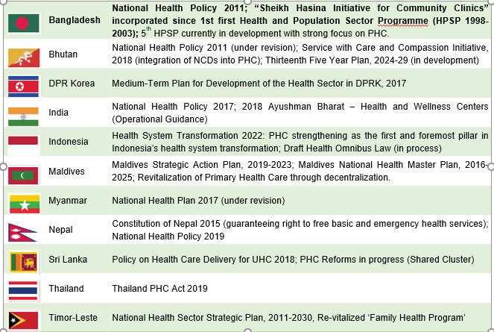
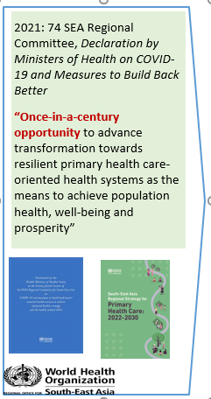
PHC Policy Directions in WHO SEA Region
Notes:
Catastrophic health expenditure (SDG 3.8.2) is used to report on financial protection. Although 7 countries of the region have catastrophic spending incidence less than the global median, it is still quite high. Infact the OOPE is highest in the region, while public spending on health is the lowest in SEAR.
In the Region, household spending on medicines is the main driver of financial hardship due to health spending.

Slide 7
2022 RC 75 Resolution, Enhancing Social Participation in Support of Primary Health Care and Universal Health Coverage
Member States Endorsed the SEA Regional PHC Strategy
(Select) Actions for WHO
To establish a regional knowledge and experience sharing-mechanism on PHC through mobilizing expertise from development, implementation and academic partners
To provide technical support to Member States in enhancing social participation, community engagement and empowerment and convene a Regional Consultation on Social Participation.
Notes:
We fulfilled this Ask from the WHO.

Slide 8
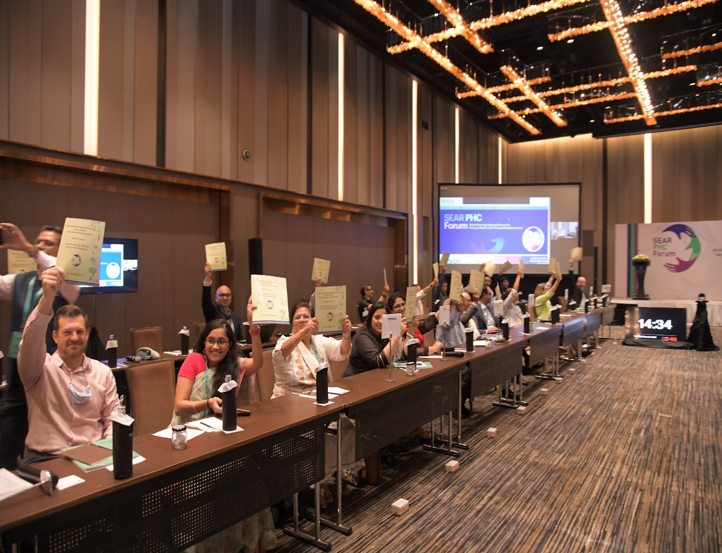
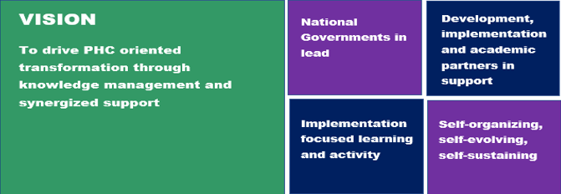
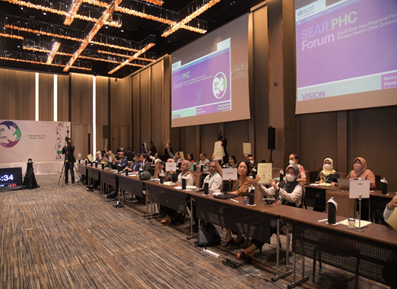
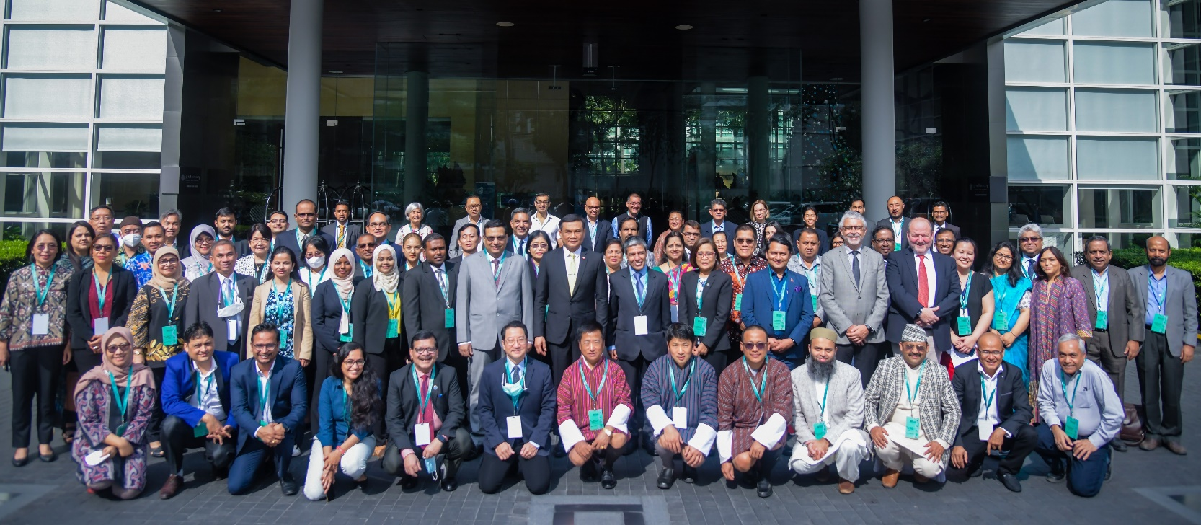
South-East Asia Regional Forum for PHC-oriented Health Systems launched in November 2022
Capturing Learning, Fostering Synergy, Driving Action

Slide 9
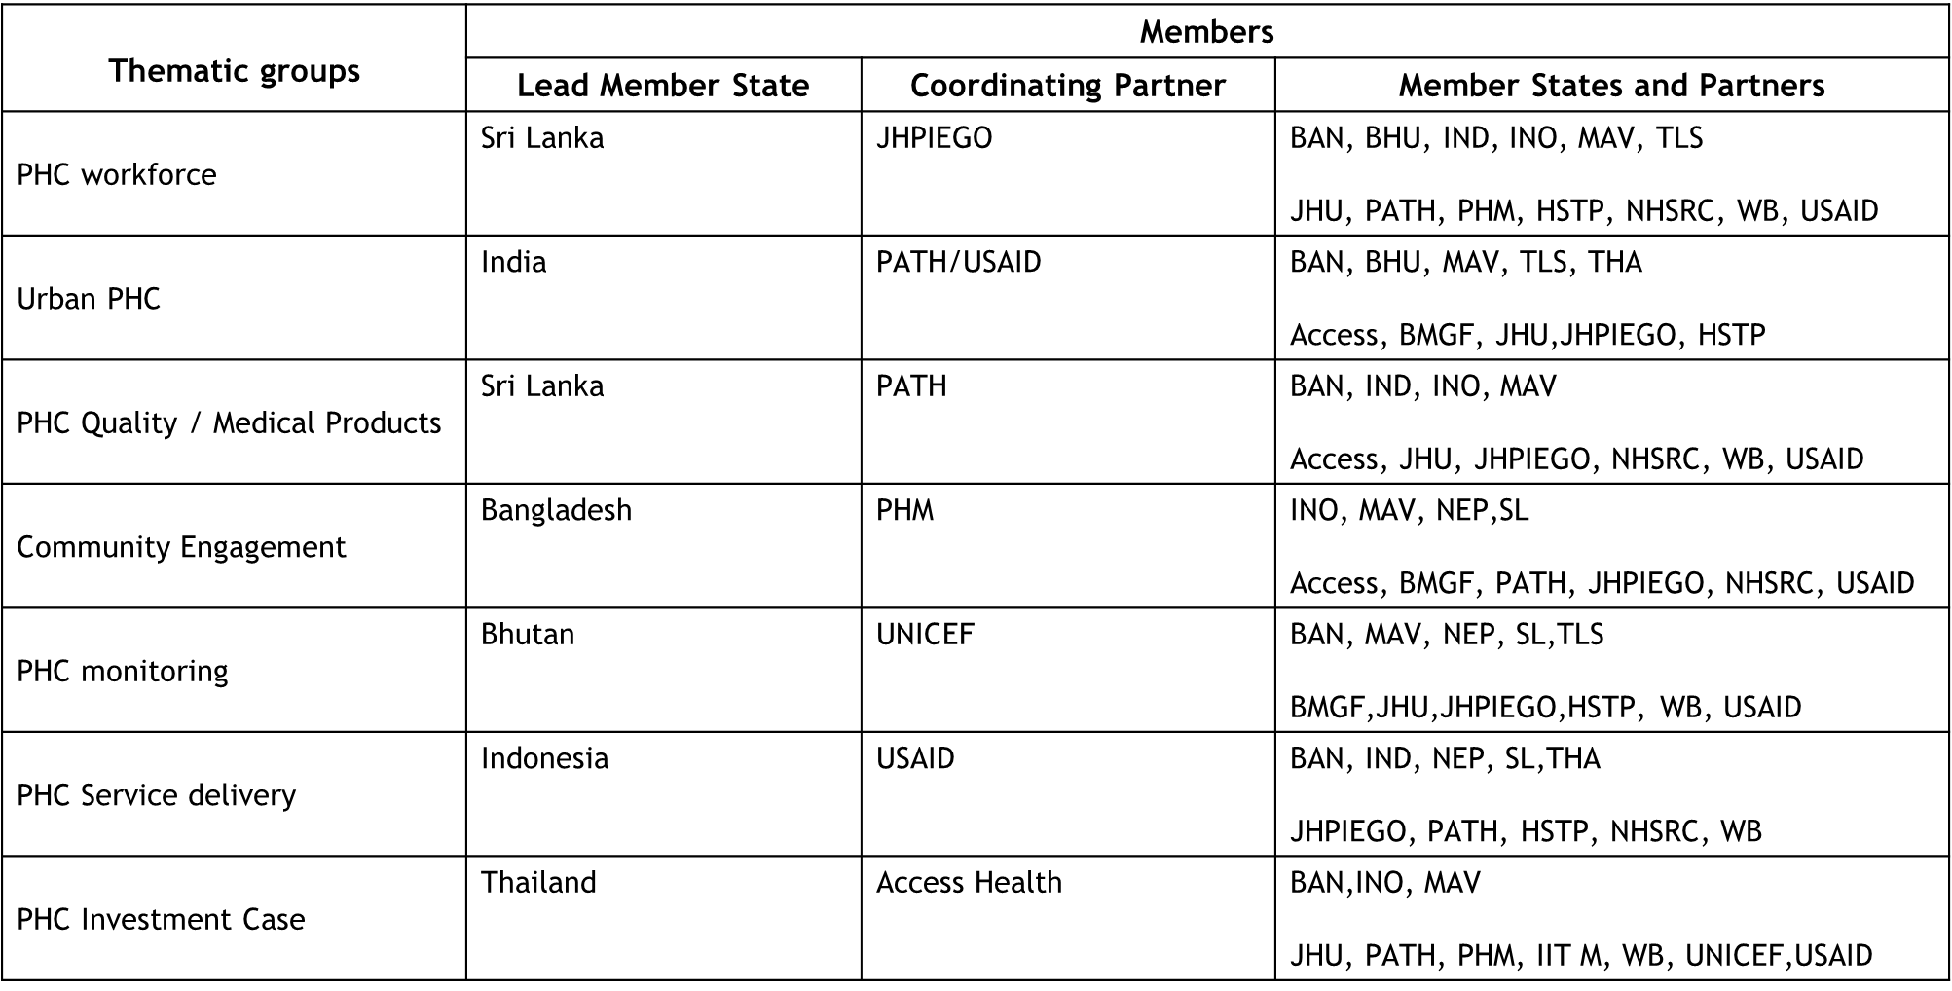
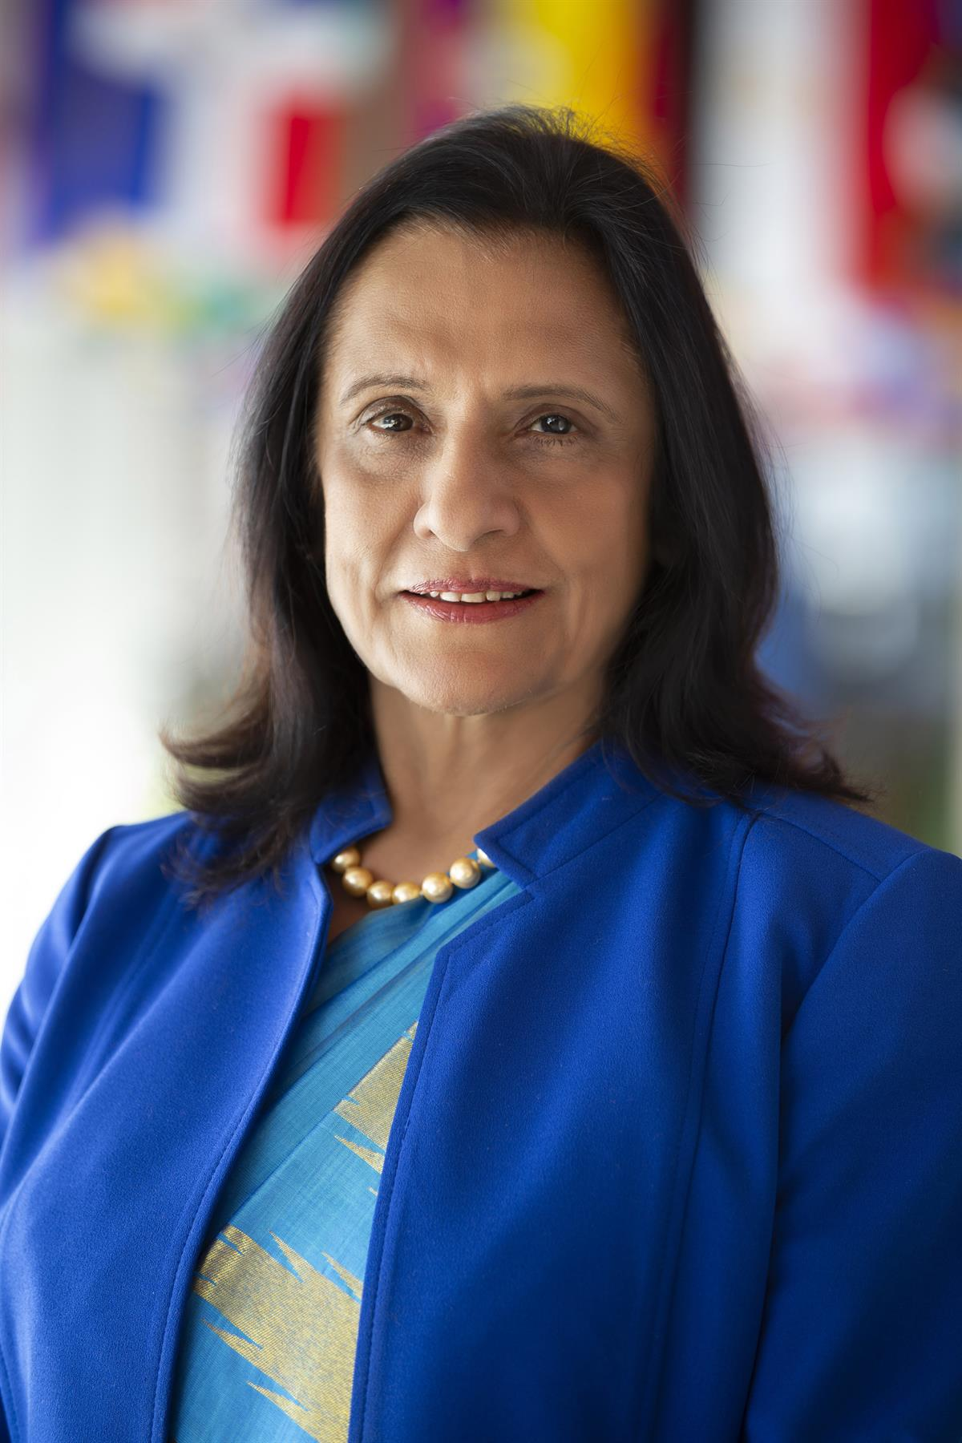
Thematic Working Groups
Together, we must be steered by shared learning, synergy and action, focused not just on the ‘what’, but the ‘how’. No more can there be ships in the dark, moving roughly together, but never quite reaching port.
Dr. Poonam Khetrapal Singh, Regional Director, WHO SEA Region
Notes:
We fulfilled this Ask from the WHO.

Slide 10
Regional overview – HR & Financial

Slide 11
UHC-P + Canada-PHC Fund Regional overview – HR
India | Indonesia | Myanmar | Sri Lanka | Timor-Leste | RO
13 State consultants | 1 NPO HSS (2023) | P5 HS + 2 NPO | P5 HS + 2 NPO | P5 HS | P5/P6 HS (partial)
Notes:
Key HSS focal point both in WCOs and RO are supported by UHC-P.
Activities: PHC country case studies, development of Regional PHC strategy were supported by the UHC funding at the Regional Level.

Slide 12
UHC-P Regional overview – Financial information (2022 & 2023)
2022
2023
UHC P
UHC P
Distributed to | Amount | Received
BANGLADESH | 650,000 | 14.4.2023
INDIA | 685,108 | 14.4.2023
INDONESIA | 348,500 | 2.3.2023
NEPAL | 100,000 | 2.3.2023
MYANMAR | 0 | 2.3.2023
TIMOR LESTE | 243,365 | 2.3.2023
SEARO | 653,610 | 2.3.2023
TOTAL | 2,680,583
Distributed to | Amount | Received
INDIA | 592,371 | Carry over from 2021
MYANMAR | 155,747 | Carry over from 2021
 | 500,000 | 28.12.2022
TIMOR LESTE | 233,000 | 17.8.2022
 | 277,500 | 28.12.2022
TOTAL | 1,758,618
CAD PHC
CAD NEW PHC
Distributed to | Amount | Received
SRI LANKA | 790,751 | Carry over from 2021
SEARO | 188,673 | Carry over from 2021
TOTAL | 979,424
Distributed to | Amount | Received
SRI LANKA | 357,359 | 6.5.2023
SEARO | 216,365 | 6.5.2023
TOTAL | 573,724

Slide 13
Country Updates
Myanmar, Sri Lanka, Timor-Leste

Slide 14
Myanmar, UHC P: progress
Myanmar Challenge:
UNCT principle to limit engagement with de-facto authority with exception of COVID-19 and humanitarian response; travel restrictions; unstable security situation; inflation/currency depreciation
Key Activities Conducted
Delivery of essential services to rural and remote areas through engagement (strategic purchasing) from private hospitals, professional associations and local/international NGOs.
Initiated landscape analysis of PHC actors currently active in Myanmar
Conducted HRH data triangulation, including organization of NHWA focused workshop with professional associations and councils, to understand HRH situation (and plan for future HRH Strategy Revision)
Engaged overseas doctors to provide virtual training to hospital staff on Covid-19 case management
In collaboration with partner agencies, develop curricula and supported training of community volunteers for home-based care and COVID-19 response.

Slide 15
Sri Lanka, Canadian PHC: progress and plans
Sri Lanka Context: Economic crisis, Demographic/Epidemiological Transition
Key Activities Conducted
Technical analysis of health system efficiency, with focus on HRH and Service Delivery, in context of economic crisis
Consultation on health financing options for Sri Lanka
Procurement of equipment for the National Medicines Quality Assurance Laboratory (to inspect contamination in pharmaceutical products)
Procurement of HPV DNA test kits to expand cervical cancer screening programme
Major Planned Activity
Establishing the Policy Center for PHC at MOH supported by local/international academia
Study tours, fellowships and conferences planned in conjunction with launch

Slide 16
Timor-Leste, UHC-P: progress and plans
Area | TA provided (2022-23) | Next steps (2023-24)
Service delivery | Co-developed the ESP for secondary and tertiary care Conducted situational analysis on ‘Fleet management’ TA to establish ‘Critical Care Units’ in all secondary care hospitals | TA to support ‘implementation’ of ESP for primary care TA to make ‘critical care units’ fully functional TA to make ‘skill labs’ fully functional
HRH | Drafted the National Training Policy (health sector) Conducted a forecasting exercise for clinical specialists | Focus on pre- and in-service competency building
Health financing | Conducted NHA 2018-21 TA and advocacy to significantly raise pro-health taxes Conducted a study on barriers to budget execution | TA for competency building for the new ‘HF Unit’
Health Information | TA for strengthening HMIS (DHIS-2) Developing an online HRH information system TA to integrate disease surveillance and CDS in to HMIS | Strengthen Hospital Information Systems; CRVS; ICD-11; CoD
Medicines | Developing the National NEDL Revising the (1) National NEML and (2) Standard Treatment Guidelines Strategy and business options for National Medical Store: completed | NHA on medicines expenditure Policy dialogue on reducing stock-outs
Governance | TA for strengthening NRA TA for re-vitalizing the national Community Health Worker program Developing the National Health Research Strategy | TA to implement NHSSP priorities, incl. CHW program Continue WCO Convening role for partnerships (DP + MoH)
Quality | Production of ‘standards’ for public health facilities Developing the 5-year strategy for the Cabinet for Registration and Licensing | Finalize National IPC strategy Modernize waste management (Climate-friendly)

Slide 17
Country Spotlight
India

Slide 18
Regional Reflection
UHC P & CAD-PHC Grants
Critical Health System-focused grants for Region
Enabled Region and Country Offices to support/drive PHC-focused reorientation at national/sub-national level
Flexible approach allows need-based response
Challenges
Need and opportunity to support PHC/UHC acceleration is significant (push from Member States)
Support to WHO SEA Region remains lowest (ie 2.6% of 2021 UHC P distribution to WHO Regions)
EU commitment for continued support is highly welcome; however negotiation time resulted in delayed funding receipt.
Opportunity
Greater engagement of UHC P donors at country/regional level

Slide 19
Questions and answers

Slide 20
Wrap up and AOB

Slide 21
Thank You

