Slide 1
NOVEL CORONAVIRUS (COVID-2019)
POINTS OF ENTRY (POE) SIMULATION EXERCISE

Slide 2
Agenda
Part 1:
08:45 Registration
09:00 Introduction
09:10 Exercise Objectives and how to play
09:15 Table-top Simulation
10:45 Coffee break (15 min)
11:00 Table-top Simulation
12:30 Hot-wash
13:00 Close part 1
13:00 Lunch
Part 2:
09:00 Re-cap
09:15 Gaps analysis & action planning (group work)
10:30 Coffee break (15 min)
10:45 Action planning continued (group work)
11:30 Consolidation in plenary session
12:00 Wrap up and next steps
12:30 Closing
Notes:
ADJUST THE TIMING BASED ON YOUR OWN AGENDA BUT MAKE SURE YOU KEEP ENOUGH TIME FOR PART 2. THIS IS THE MOST ESSENTIAL PART OF THE SIMEX!!!
2

Slide 3
What is a Table-Top Exercise (TTX)?
A tabletop exercise (TTX) is an exercise that uses a progressive simulated scenario, together with series of scripted injects, to make participants consider the impact of a potential health emergency on existing plans, procedures and capacities.
A TTX simulates an emergency situation in an informal, stress-free environment.” -WHO Exercise Manual, 2017
Notes:
A table-top exercise is an exercise that uses a progressive simulated scenario, together with series of scripted injects, to make participants consider the impact of a potential health emergency on existing plans, procedures and capacities. A TTX simulates an emergency situation in an informal, stress-free environment.
The purpose of a TTX is to strengthen readiness to manage a health emergency, through facilitated group discussions.
A TTX can be used to:
Develop or review a response plan  
Familiarize participants with their roles and responsibilities
Identify and solve problems through a facilitated and open discussion.
3

Slide 4
Design & Purpose
Exercise Design
Based on the “COVID-19 Strategic Preparedness and Response Plan (SPRP)” and designed for national level operational stakeholders, involved in public health emergency preparedness or response.
Purpose
Through facilitated group discussion, the exercise aims to examine and strengthen your existing plans, procedures and capabilities at the main airport (POE), to manage an imported case of COVID-2019.
Notes:
The “WHO monitoring response implementation checklist for 2019-nCoV” should have been printed and distributed to all participants.
Tell participants, it is in their reference documents.
4

Slide 5
General objectives of the TTX
General Objectives
Share information on the progress of your preparation, including response capabilities, plans and procedures to identify and respond to an imported case of COVID-2019 in your country.
Identify areas of interdependence between health actors and other sectors
Conduct gap analysis based on the COVID-19 Strategic Preparedness and Response Plan (SPRP)
Develop an action plan to enhance your level of readiness, based on the SPRP

Slide 6
Specific objectives of the TTX
Review the operation management process for a suspected case of COVID-2019
Confirm arrangements for notification, coordination and internal communications before and after the confirmation of a COVID-2019 case.
Confirm procedures related to the management of a suspected cases before and after laboratory confirmation.
Review plans to clarify lines of accountability (roles & responsibilities) and communication to enable a timely, well-coordinated and effective response.
Review the requirements of public health laboratories and funding
Review risk and media communications plans.

Slide 7
Exercise management team
Roles
Facilitation: (xxxxx)
Rapporteurs: (Group note takers)
Observers: (All partners)

Slide 8
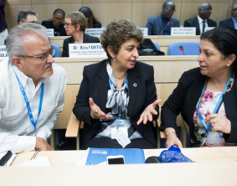
Rules of the TTX
Not an individual test
Respect the views of others
Respond as you would in real life and allow others to do likewise
Use your existing plans, guidelines and regulations to inform your responses
Focus on solutions

Slide 9
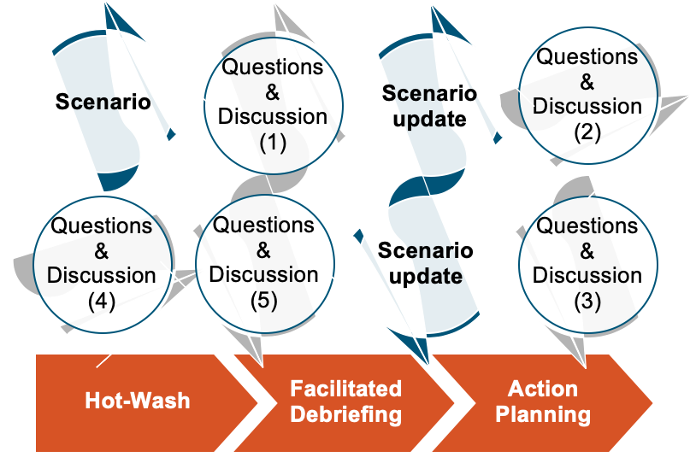
Table-Top Exercise: How to Play
This is a closed exercise, designed just for you.
The facilitators will guide you through a series of discussions focused on an imported case of
COVID-2019
We are all
here to learn

Slide 10
Questions
ANY
QUESTION
BEFORE
WE START

Slide 11
NOVEL CORONAVIRUS (COVID-2019)
HEALTH
EMERGENCY
PREPAREDNESS SIMULATION EXERCISE

Slide 12
Scope and target participants
Suspected case on board flight
Actions in flight, transit and at airport in case of suspected case
Some actions and follow up by country beyond POE
Target participants for the TTX are all stakeholders at POEs mainly representatives from port health, surveillance officers, airlines, airport authorities etc.

Slide 13
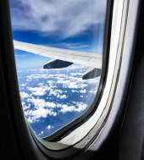
Scenario
SIMULATION ONLY
While in-flight a 58-year old man starts experiencing the following symptoms: high fever, cough and difficulty breathing. The man is returning home to [XXX Insert Location] from a 5-day business trip in “INSERT REGION”, a COVID-19 affected region. The flight final destination is [YOUR airport], in [YOUR LOCATION] and is expected to arrive in another 1 hours.
Based on his symptoms and recent travel history in a COVID-19 affected region, the man is concerned about COVID-19 and notifies the flight crew.
Notes:
One hour time frame allows for rapid preparation. At one hour out an aircraft will be unlikely or unable to divert to another airport unless it is very close by. Some discussion may focus on the best nearby location to divert to.

Slide 14
Session 1
Questions for discussion
What are your immediate priority actions as a team?
What documents need to be completed at this stage?
Who should be informed, when and how? Who does this? Illustrate on flip chart.
Does the suspect need to be isolated in-flight. If so, where to and how?
What Infection Prevention and Control measures would you put in place for this suspected traveler or close-contacts?
Who will do it, are they trained?
What IPC materials do you have?
Based on your answers above, list your strengths and weaknesses.
30 mins

Slide 15
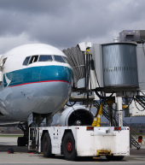
Scenario update
SIMULATION ONLY
Upon landing, the flight crew notifies the port health authorities that a symptomatic COVID-19 suspect is on-board.
Flight itinerary; “AFFECTED AREA” – final destination [YOUR LOCATION] via [Secondary Location (optional – add for complexity)]. 30 people disembarked at SECONDARY which is a tourist destination. Flight was fueled and cleaned at SECONDARY.
The flight being full, the crew moved passengers and placed the sick passenger at the rear of the aircraft as required by standard aviation procedure. They administered oxygen and moved some passengers to crew seats and some to business class.
The plane and crew are on turn around to their next destination and are keen to avoid delays.

Slide 16
Session 2
Questions for discussion
What plans, procedures and resources would you activate at this point?
Which stakeholders will be engaged, why and how?
How do you disembark the plane: crew, passengers and luggage?
What IPC measures will you take? What standards will be used for decontamination?
Does the suspect need to be further evaluated or isolated in the airport or another location? If so, how, by whom, and where?
Are there any other considerations regarding the other passengers, crew, and immediate use of the plane
How and what will you communicate to the suspect’s family waiting in the lobby?
Based on your answers above, list your strengths and weaknesses.
30 mins

Slide 17
Session 3
Questions for discussion
Who needs to be informed or notified of the suspect case within your country and outside? How will this be done? Use flip chart.
Do you have isolation points at your POE? Are they adequate; separate toilets not for public, beds and IPC materials etc.
How do you monitor/follow up the flight passengers after leaving the airport? Will you quarantine the passengers?
What information do you need to collect and when? What tools will you use? Who needs this information?
Based on your answers above, list your strengths and weaknesses.
15 mins

Slide 18
Session 4
Questions for discussion
How will you confirm whether the suspect has COVID-19 or another respiratory virus like influenza?
Which laboratory will conduct the test? Does this lab have the appropriate equipment, including PPE?
How long will confirmation take?
Will you send for international confirmation?
Is COVID-19 a national notifiable disease?
Who needs to be informed of the results and how will it done?
Based on your answers above, list your strengths and weaknesses.
15 mins

Slide 19
Break
Coffee Break (15min)

Slide 20
Scenario update
SIMULATION ONLY
After 2 hours in isolation, the man is transferred and admitted to [LOCAL hospital] for management and the lab report confirms a positive test for COVID-19.
Surveillance officers instructed all passengers and crew from the flight to remain at home and avoid close-contact with others for a 14-day monitoring period. The crew are concerned as they are from 6 different nationalities and would like to return to their home countries.
Within 2 weeks, the following contacts living in different parts of YOUR COUNTRY tested positive for COVID-19: 6 fellow passengers, 1 air hostess, 1 nurse, 1 airplane cleaner and 1 immigration officer
Secondary transmission is evident. The public is nervous, socio media is spreading rumours of multiple confirmed COVID-19 cases and deaths within the country. Journalists have requested a statement from your team.

Slide 21
Session 5
Questions for discussion
In your country and POE;
What actions would be triggered by this new event information?
How would this event be coordinated and managed?
Where would the funding come from to implement the response?
What support would you request from WHO and other partners?
Based on your answers above, list your strengths and weaknesses.
30 mins

Slide 22
Session 6
Questions for discussion
In the country and at the POE
Who will be leading on risk communication for this event?
What communication needs to take place and to whom? E.g. airlines, other departments at POE etc.
What is your strategy for media communication?
What is the mechanism for rapid clearing of timely and transparent communication messaging and materials?
How will information and communication be coordinated across Ministries and partners, and across different levels of the government?
Based on your answers above, list your strengths and weaknesses.
30 mins

Slide 23
ENDEX

Slide 24
Hot-Wash
Initial feedback from the participants
Notes:
This is NOT about how good the exercise was or how people enjoyed it. This is a HOTWASH session to bring initial reactions to the problems posed.

Slide 25
Summary &
Next Steps
Part II:
GAP analysis: Focus group discussion to review readiness checklist
Action planning
Participants evaluation form
Notes:
ADJUST THE TIMING BASED ON YOUR OWN AGENDA BUT MAKE SURE YOU KEEP ENOUGH TIME FOR PART 2. THIS IS THE MOST ESSENTIAL PART OF THE SIMEX!!!
25

Slide 26
Agenda part 2
Part 2:
09:00 Re-cap
09:15 Strengths & Gaps analysis (group work)
10:30 Coffee break (15 min)
10:45 Action planning (group work)
11:30 Consolidation in plenary session
12:00 Wrap up and next steps
12:30 Closing

Slide 27
WHO checklist for COVID-2019
The “ COVID-19 Strategic Preparedness and Response Plan (SPRP)” outlines the measures to be taken at country level to contain the virus and will be updated with further measures as and if the epidemiological situation changes.
It will enable the targeted improvement of specific capacities.
This information will help national authorities to
identify main gaps
perform risk assessments and
plan for response and control actions.

Slide 28
Strengths and gaps analysis
Review strengths & gaps
75 mins
TASKS:
In groups, divide a piece of paper into three sections.
Review the Readiness Checklist, your plans and notes from your TTX
Discuss and write your points in each of the sections to answer:
What worked well? (Achievements)
What was challenging? (Challenges)
Recommendations? (and prioritize, to identify your top 3)
Check assumptions
Propose ideas to enhance your systems, plans & Procedures
ACTION PLAN
Note: the action plan will be done in the next session

Slide 29
Break
Coffee Break (15min)
Notes:
Break down in groups.
Prioritisation of findings into actions
Action
Reason why a priority?
Who is responsible for the action?
What resources are required?
By when?
Each group rapporteur to provide a 5 minute summary of the findings of the group.
29

Slide 30
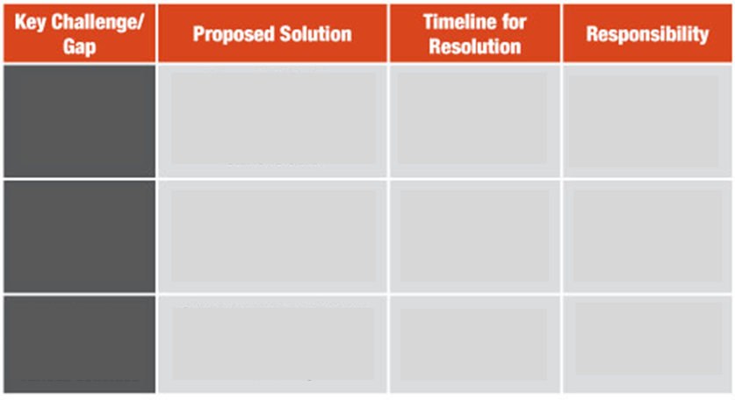
Action Plan
45 mins
Notes:
Break down in groups.
Prioritisation of findings into actions
Action
Reason why a priority?
Who is responsible for the action?
What resources are required?
By when?
Each group rapporteur to provide a 5 minute summary of the findings of the group.
30

Slide 31
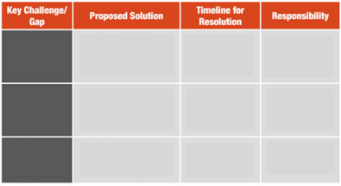
Consolidation
Notes:
Break down in groups.
Prioritisation of findings into actions
Action
Reason why a priority?
Who is responsible for the action?
What resources are required?
By when?
Each group rapporteur to provide a 5 minute summary of the findings of the group.
31

Slide 32
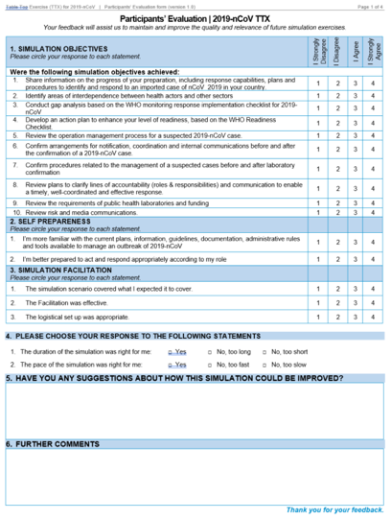
Participants’ feedback form
Your feedback will assist us to maintain and improve the quality and relevance of future simulation exercises.
5 mins
Notes:
Break down in groups.
Prioritisation of findings into actions
Action
Reason why a priority?
Who is responsible for the action?
What resources are required?
By when?
Each group rapporteur to provide a 5 minute summary of the findings of the group.
32

Slide 33
Next steps and wrap up
NEXT STEPS
Notes:
Break down in groups.
Prioritisation of findings into actions
Action
Reason why a priority?
Who is responsible for the action?
What resources are required?
By when?
Each group rapporteur to provide a 5 minute summary of the findings of the group.
33

Slide 34
THANK YOU!
For SimEx technical support,
please contact your WHO country office or regional office focal point:
INSERT CONTACT DETAILS HERE
WHO RESSOURCES
WHO
2019-nCoV
Emergency
webpage
More
information
on
coronavirus
Scan or Click
Scan or Click

