Slide 1
Joint Risk Assessment
at the Human-Animal-Environment Interface
MODULE 3

Slide 2
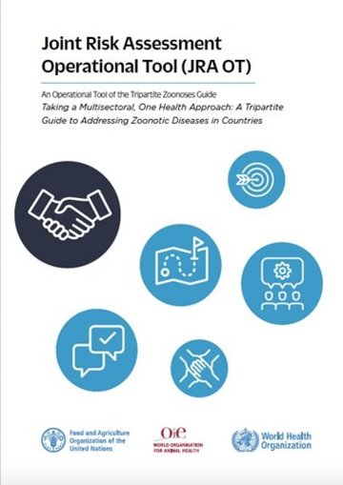
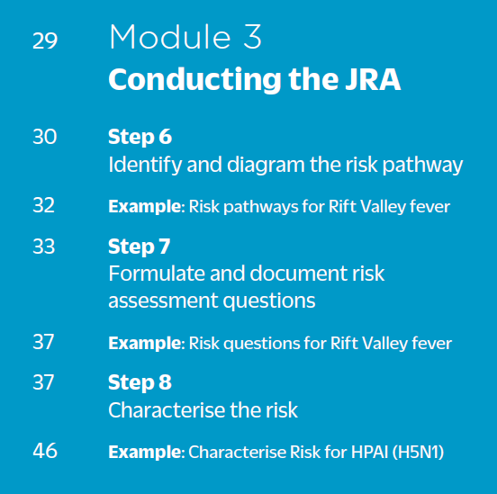
Table of contents

Slide 3
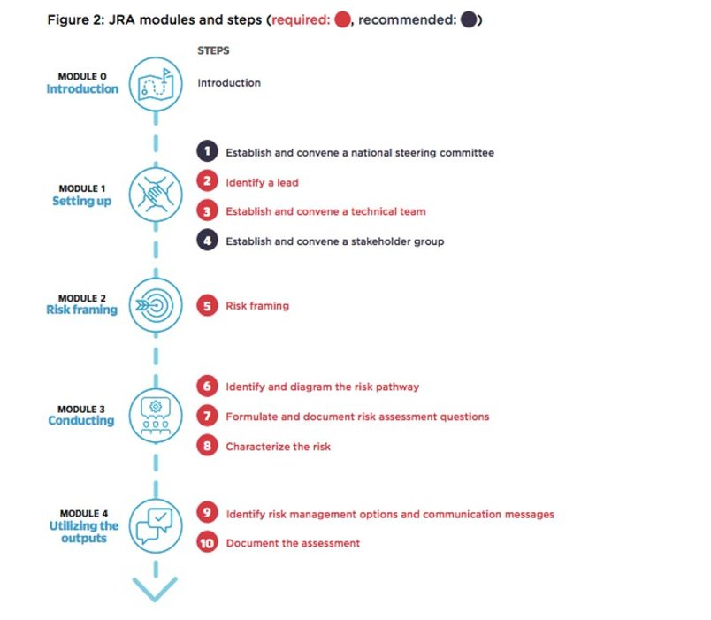
JRA modules & steps
You are here

Slide 4
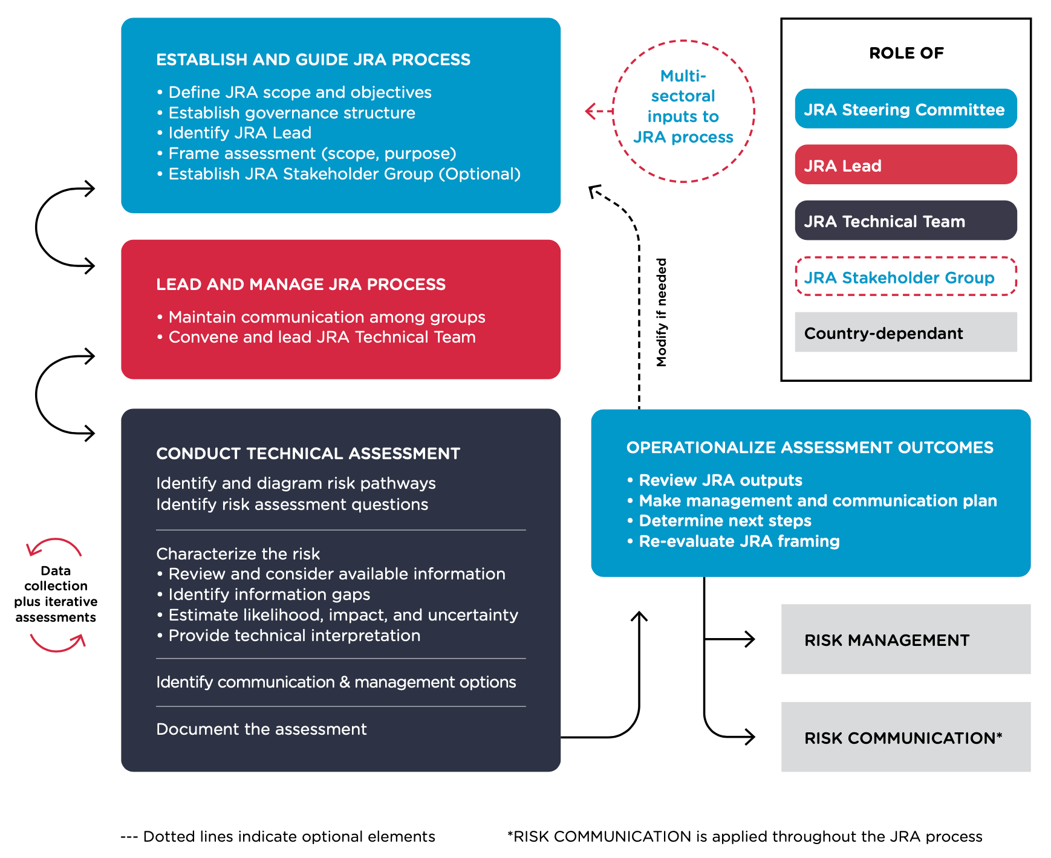
Roles & responsibilities
Module 3

Slide 5
Step 6: Identify & diagram risk pathways
JRA OT, p. 30-32
This step relies on two key stages:
Identification of all points and processes in the risk pathways from each possible hazard source
Elaboration of the final pathway diagram
It is important to consider all potential risk pathways. You will see that having a comprehensive diagram of pathways is crucial in formulating the risk questions.
Performed by JRA technical team

Slide 6
Identify risk pathways
Step 6.1, p. 31
The logical sequence of movement of the hazard from its source until it infects a host of interest:
Entry into country
Infection of animals
Spread in animals
Infection of humans
Spread in humans
Spread back to animals

Slide 7
Diagram risk pathway
Step 6.2, p. 31

Slide 8
Diagram risk pathway
Step 6.2, p. 31
Helps identify sources of pathogen and formulate risk questions
Facilitates understanding and communication about risks
Helps identify intervention points for risk management

Slide 9
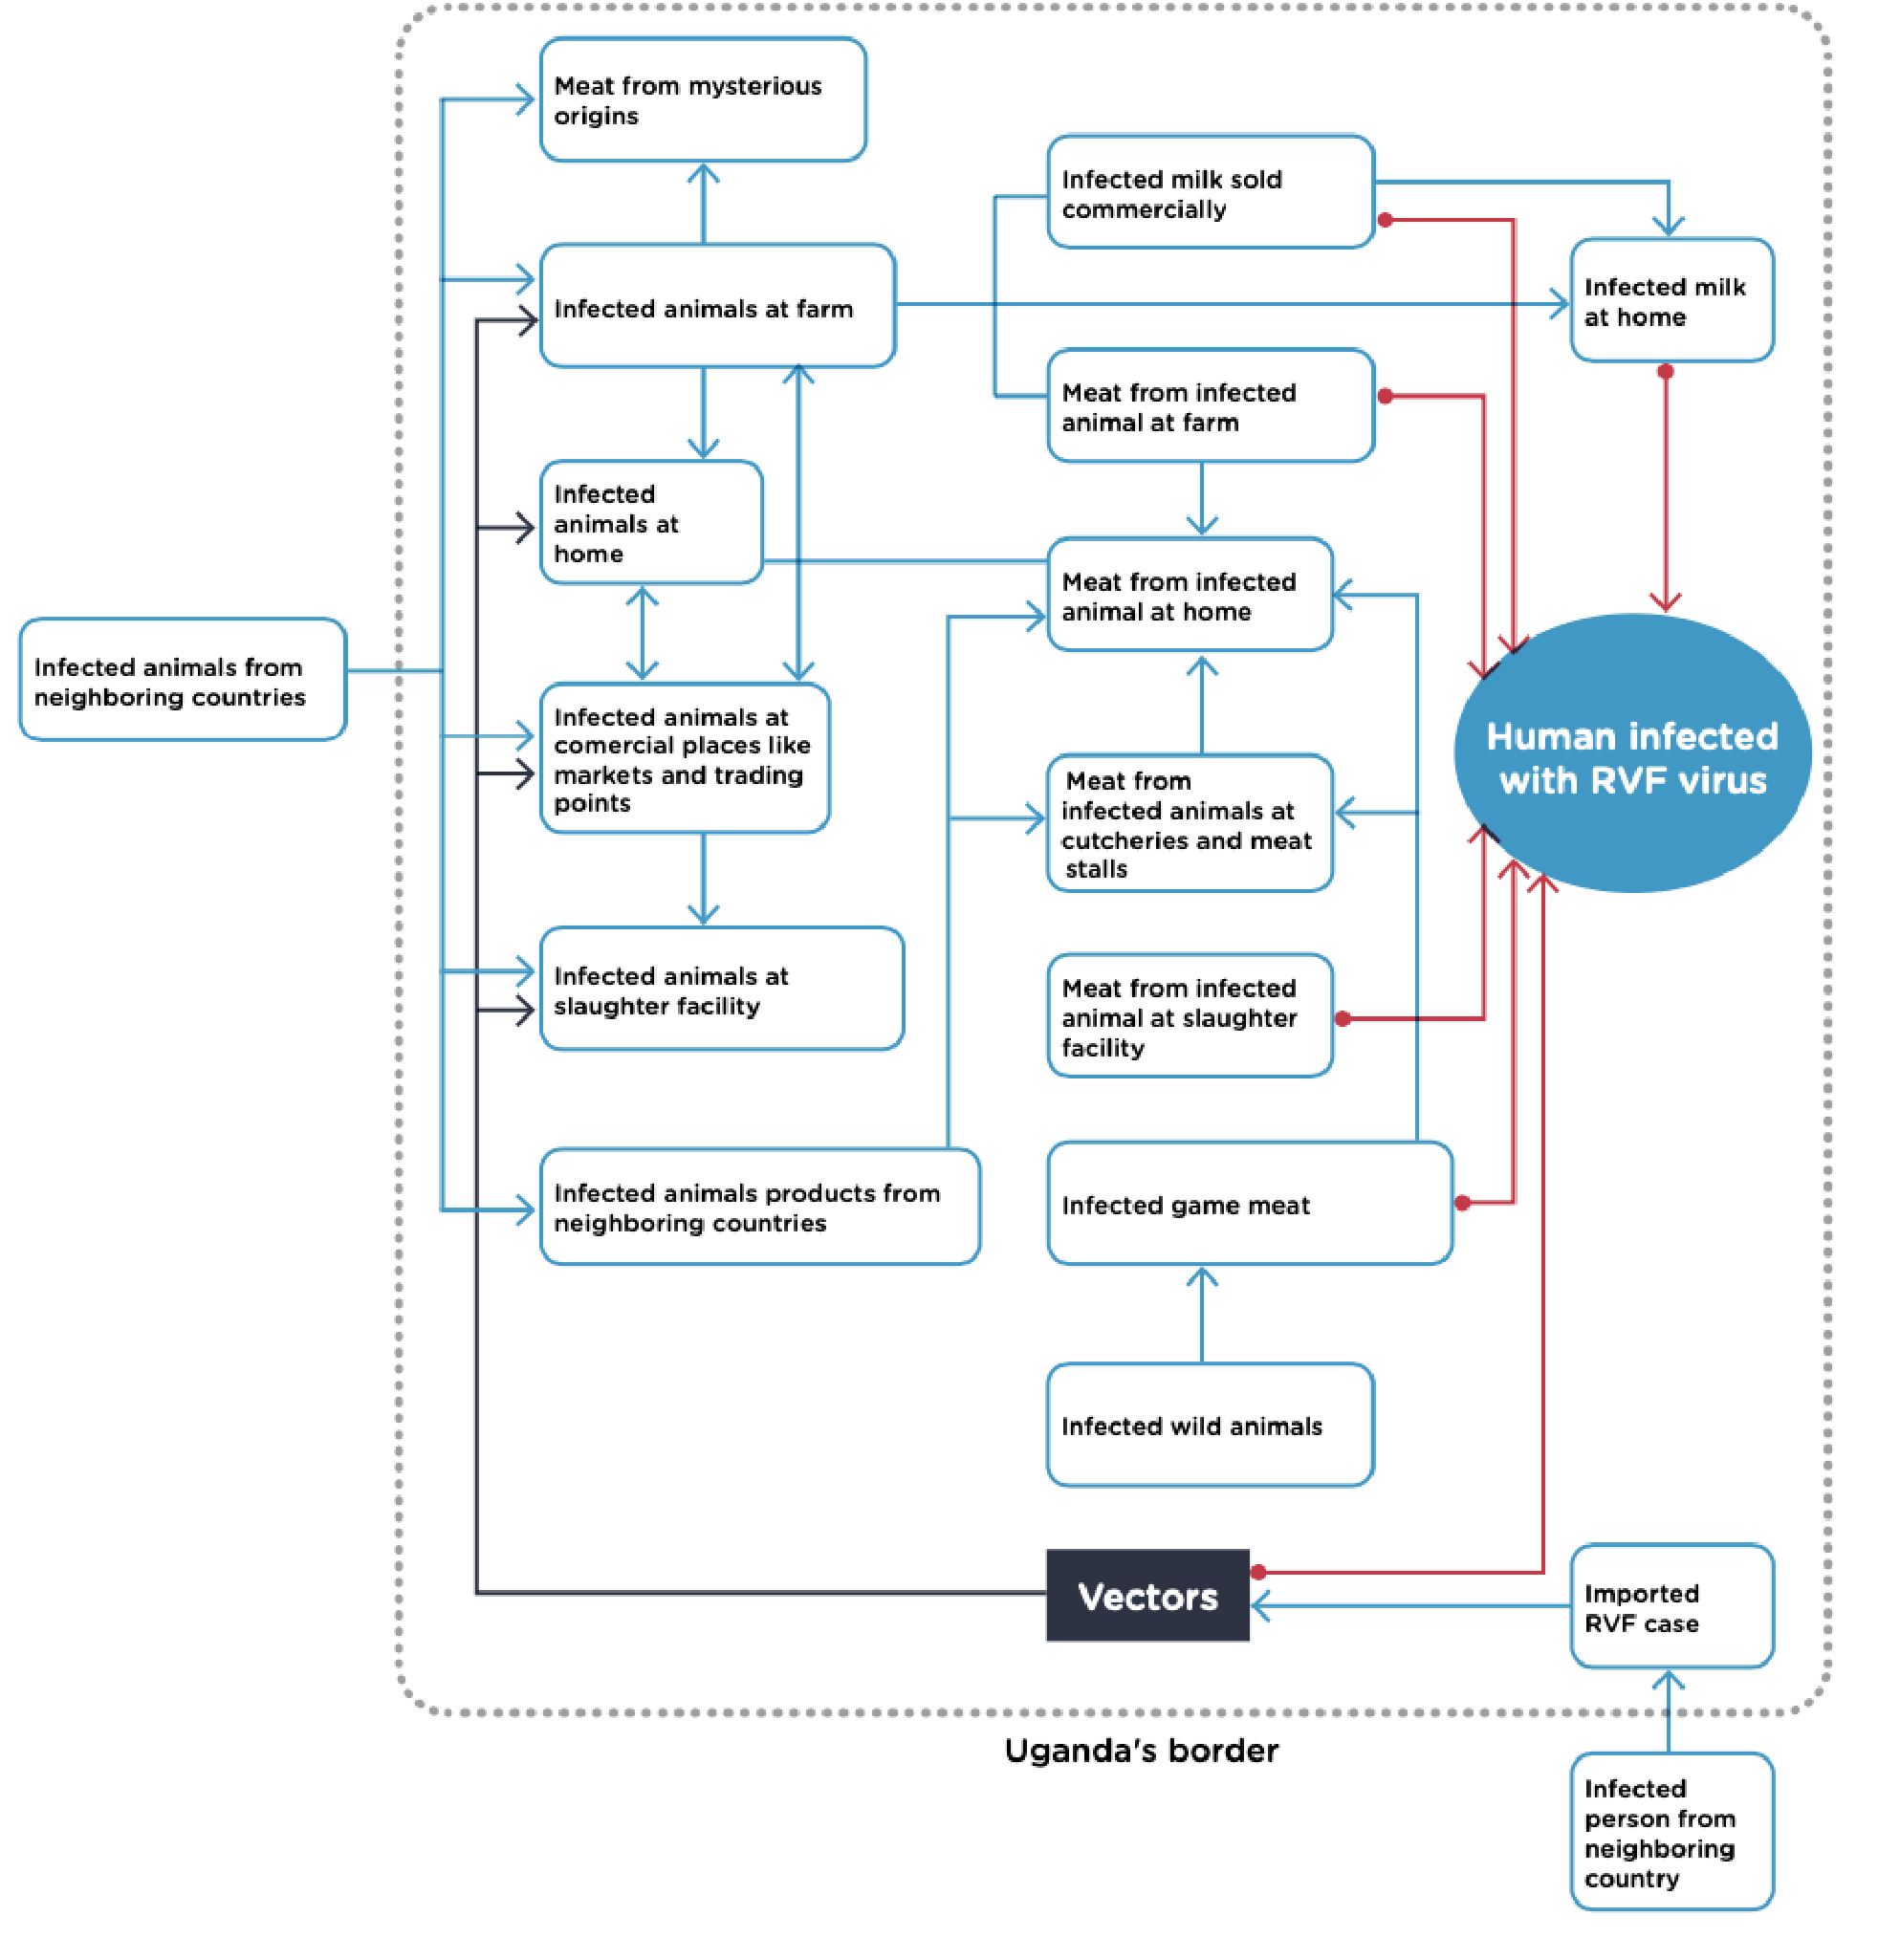
Risk path diagram
Turn to the example in the JRA OT: Figure 6, p. 32
Possible pathways for Rift Valley Fever virus in Uganda
We'll take a closer look at an example pathway for avian influenza on the next slide!

Slide 10
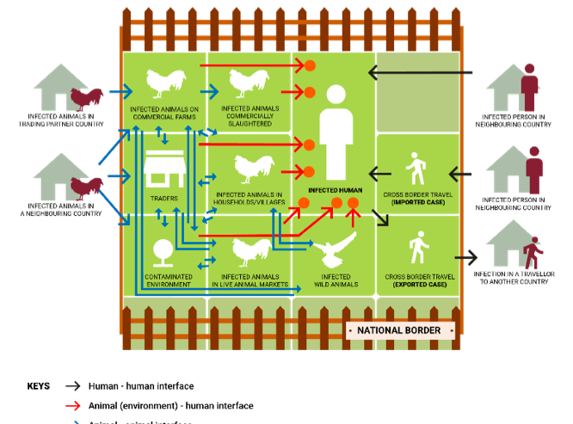

Slide 11
A couple questions:
Let’s look at some example sources of avian influenza virus introduction and spread
Live bird trade
Products/ fomites
Humans
Wild Birds
Question 1: Which of these sources should NOT be included in a JRA risk assessment question?
Question 2: When would it be okay to include a non-interface risk assessment question?

Slide 12
Always consider the wider scope!
The answer to both questions is: we must always consider the wider scope
Live bird trade
Products/ fomites
Humans
Wild Birds
Some concerns that are NOT specifically at the interface may still provide important context for the JRA
For example, information on the poultry value chain, even if it seems to involve only the animal component, can still support understanding pathogen introduction and spread and opportunities for human exposure
These concerns may already be addressed during sector specific assessments, and the resulting outcomes and data can be brought to the JRA discussion

Slide 13
Always consider the wider scope!

Slide 14
Step 7: Formulate and document risk questions
Risk assessment questions, pp. 33-36
Formulate the questions
Check the questions
Document the questions
Performed by JRA technical team

Slide 15
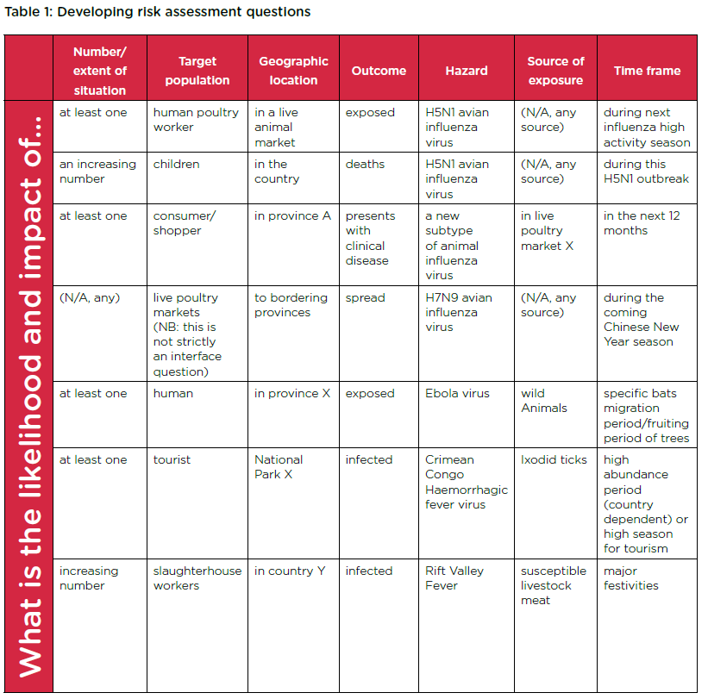
7.1 Formulate appropriate questions
Step 7.1, p. 33-35
Guided by the risk framing
Focus on risk pathways crossing human-animal-environment interface
Risk questions direct the focus during the assessment
Formulated by JRA technical team
Agreed upon with JRA steering committee​

Slide 16
7.1 Formulate appropriate risk questions
Step 7.1; Figure 7, p. 34
Starting with: What is the likelihood and impact of…
Specific, relevant, time-bound

Slide 17
7.2 Check the risk questions
Step 7.2, p. 36; Annex F for report template, p. 64-70
Non risk assessment questions may still be important to discuss or answer
Often these are:
Epidemiological questions
Situation assessment questions
They fill data gaps, provide backgroung or give understanding
p.36
Record formulated questions in report template​ (Annex F)

Slide 18
Step 8: Characterise the risk
p. 37-46; Annex F for report template, p. 64-70
For each risk assessment question:
Examine associated risk pathway
Estimate likelihood, impact and assign uncertainty
Record rationale and key information in report template (Annex F)
Important: If lacking information, try to estimate likelihood and impact accurately, then assign high uncertainty
Performed by JRA technical team

Slide 19
8.1 Review available information
Step 8.1, p. 37-39
Before meeting, JRA lead requests technical team to compile and share relevant information
Use expert opinion where appropriate
Use information about a similar event / hazard to support assessment
Make assumptions

Slide 20
8.2 Identify information gaps
Step 8.2, p. 39
May be done in parallel to step 8.1 when missing information is identified​
Identify all gaps
Document all missing or insufficient-quality key information in report template
Collect missing data before next iteration of assessment
Repeat JRA when new relevant information becomes available

Slide 21
8.3 Estimate likelihood
Step 8.3.1, p. 40-41
How likely is it that this situation will occur?
Table 2: Criteria to estimate likelihood

Slide 22
8.3 Assign uncertainty for likelihood
Step 8.3.2, p. 41
How unsure is it that this likelihood estimate is true?​
Assess separately for each likelihood
Based on:
quantity of available information
quality and source of available information
technical team expert opinion

Slide 23
8.3 Assign uncertainty for likelihood
Step 8.3.2, p. 41
Table 3: Criteria to estimate level of uncertainty
How unsure is it that this likelihood estimate is true?

Slide 24
8.3 Estimate impact
Step 8.3.3, p. 42-43
How bad will it be if this situation occurs?
May assess at different levels
Population
Local or national
International
Impacts may be direct or indirect
Impacts are often linked
Prioritise impacts most relevant to the national framing scope
Pick up the highest impact level for your assessment

Slide 25
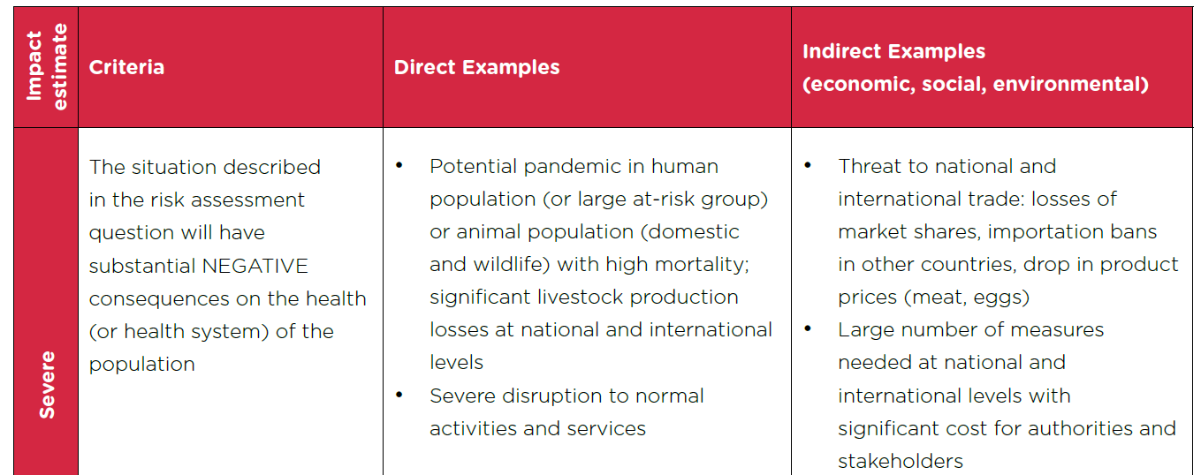
8.3 Estimate impact
Step 8.3.3, p. 42-43;
Four impact estimates: Negligible, Minor, Moderate, and Severe
Table 4: Criteria to estimate impact

Slide 26
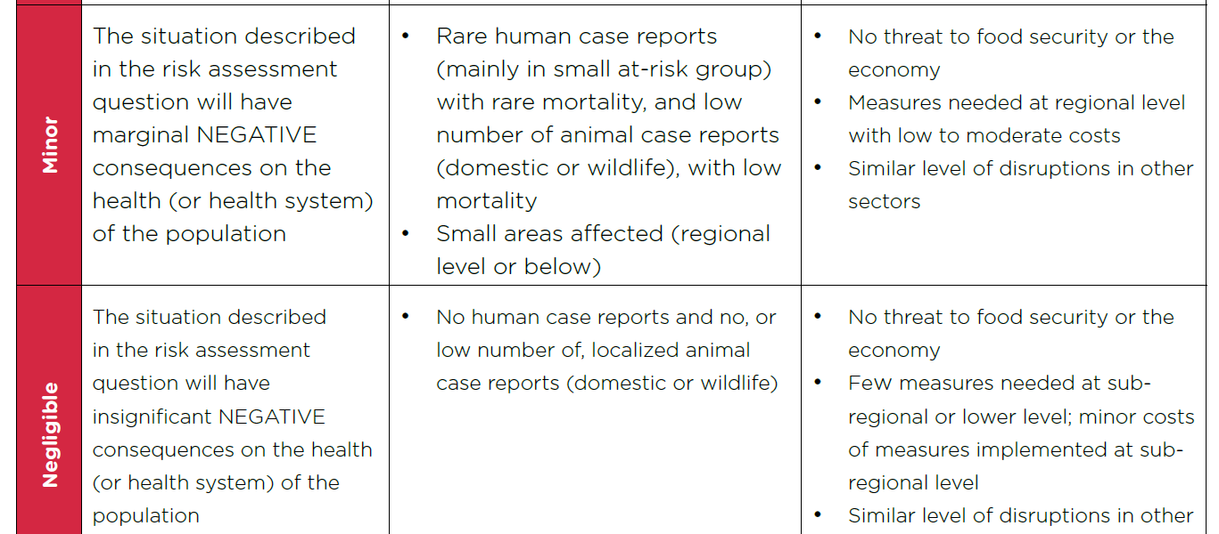
8.3 Estimate impact

Slide 27
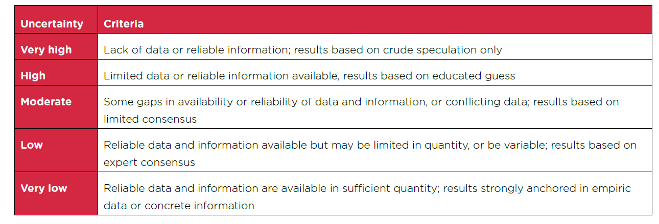
8.3 Assign uncertainty for impact
Step 8.3.4, p. 44
Table 3: Criteria to estimate level of uncertainty, p. 41
How unsure is it that this impact estimate is true?

Slide 28
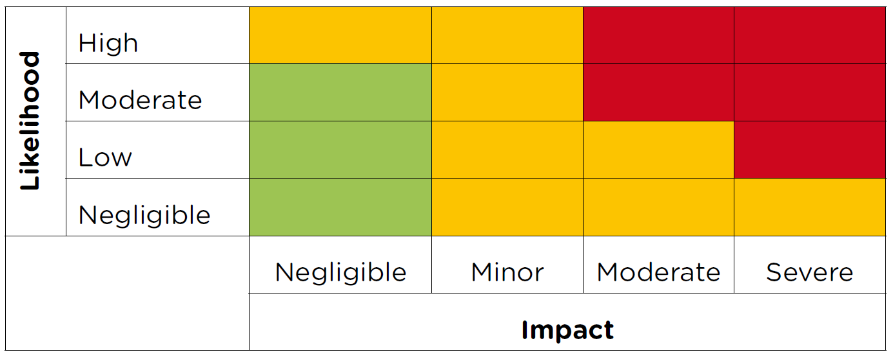
8.4 Plot estimates
Step 8.4, p. 44-45
Figure 8: Risk matrix, p. 44
Done for each risk assessment question
Helps link risk to potential risk management options
Estimates are NOT combined
x
Example

Slide 29
8.5 Technical Interpretation
Step 8.5, p. 45
A qualitative technical interpretation
For each risk assessment question
May be the ONLY thing decision makers read
Possibly include an overall technical brief to summarise:
Risk assessment questions and key assumptions
Likelihood and impact estimates with uncertainty levels
Justifications
Critical management / communication options
Example of a technical interpretation, p. 46

Slide 30
8.5 Technical interpretation
Step 8.5, p. 46
The JRA technical team assessed the likelihood and impact of at least one human in the Lake Tonka Region being exposed to HPAI (H5N1) from infected backyard ducks in the next three months, and concluded that the likelihood and impact are both moderate. This conclusion assumed that there is the possibility of importation of infected poultry from affected neighbouring countries because there is no inspection occurring at border points.
The moderate likelihood estimate is based on data available concerning birds migrating to the country from affected countries, as well as numerous published studies on research conducted in other countries, which found live bird markets, similar to those present, to be high risk for disease transmission. The moderate impact estimate for HPAI (H5N1) incursion is based on estimating economic losses due to loss of poultry stock and consumer confidence, unavailability of human vaccines, high human case fatality rate, and the country’s reliance on poultry as a food source, conversely weighed against lack of human-human transmission demonstrated in other countries. Experts felt the latter point lowered the impact compared to other potential disease events. The uncertainty for both estimates is low due to the availability of reliable information. Although only a limited quantity of information comes from within the country, there is extensive research on the disease in several neighbouring countries...[continues in the tool with risk management and risk communication options]

Slide 31
Questions?

Slide 32
Thank you!
More information on the TZG project
OIE webpage: www.oie.int/en/for-the-media/onehealth/controlling-health-risks/national-collaboration/
WHO webpage: www.who.int/initiatives/tripartite-zoonosis-guide
FAO webpage: www.fao.org/animal-health/en/

