Slide 1

Joint Risk Assessment
at the Human-Animal-Environment Interface
MODULE 4

Slide 2


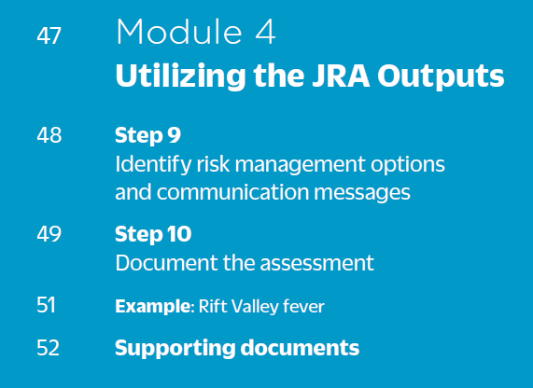
Table of contents

Slide 3
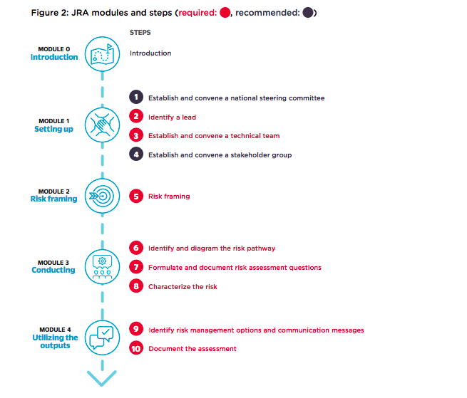
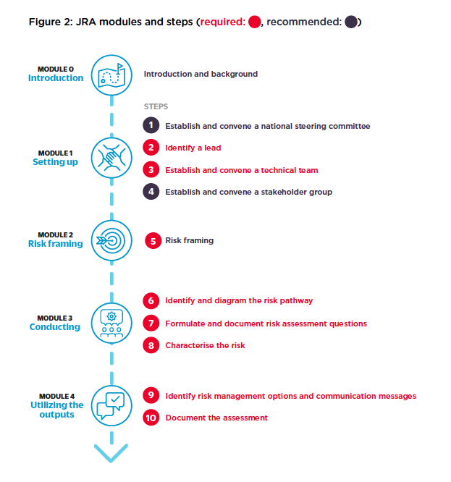


JRA modules & steps
You are here

Slide 4
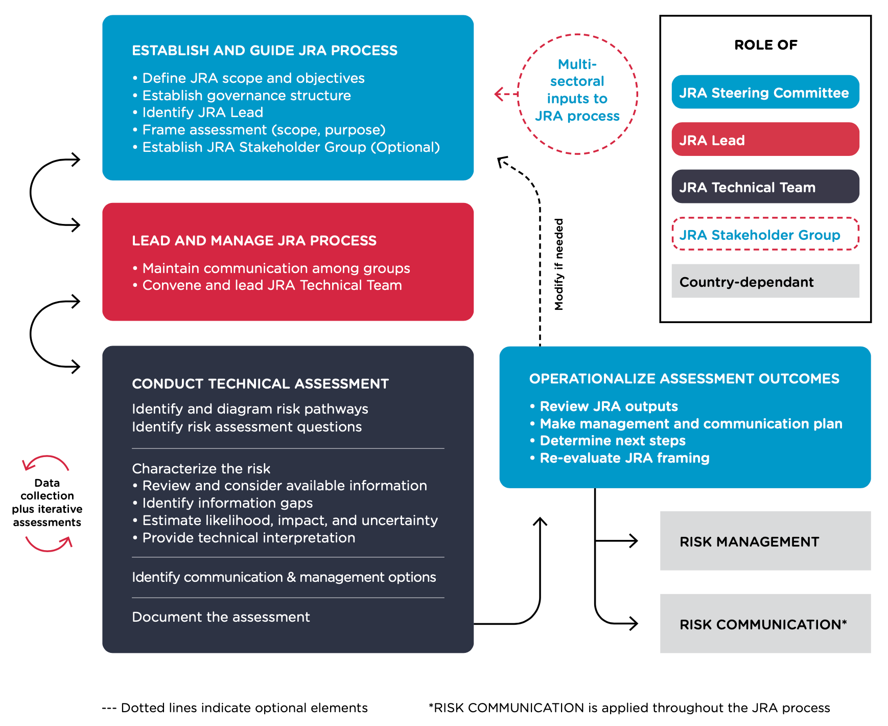
Roles & responsibilities
Module 4

Slide 5
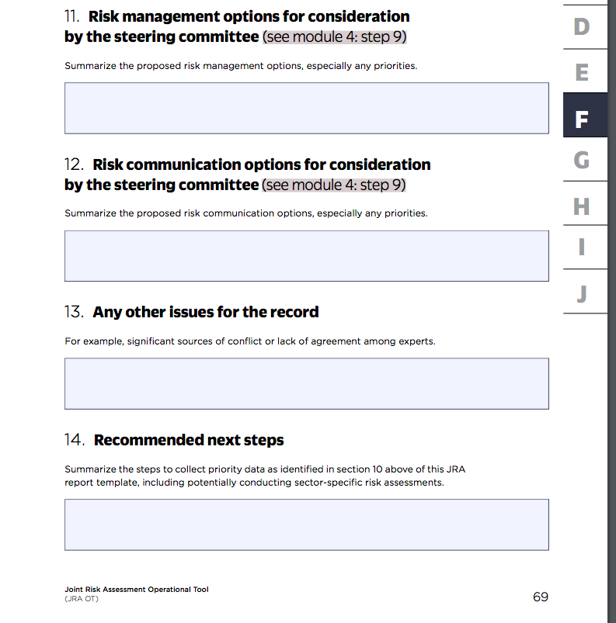
Annex F,
p. 64-70

Slide 6
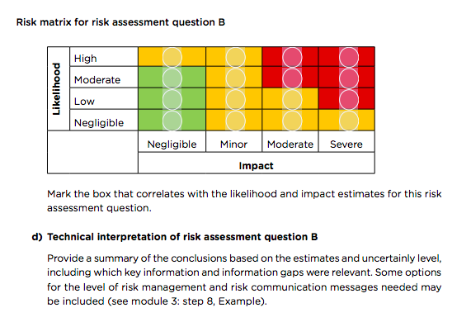
Step 9: Risk management options & communication messages
JRA OT, p. 48
Use evidence from the risk assessment to propose risk management and communications options for consideration
  Identify and document options in the final report template
  Describe evidence-base and technically justify recommendations with pros and cons
  Prioritise options based on feasibility (time required, technical and financial resourcing, political will)
Note: If representatives from the steering committee are unable to attend the final workshop day, the JRA lead shares documented options with them
Completed by the JRA technical team

Slide 7
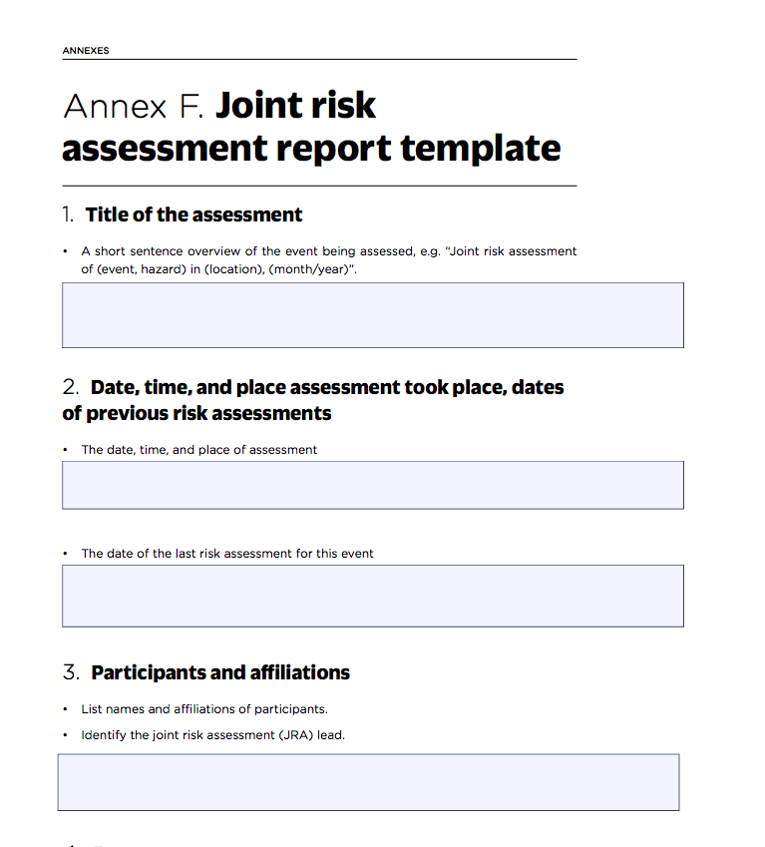
Step 10: Document the Assessment
JRA OT, p. 49
Completed by the JRA technical team

Slide 8
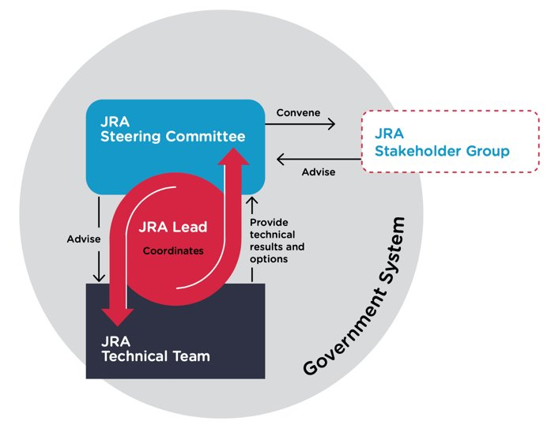
Informing JRA stakeholders
Now that recommendations are recorded, the JRA lead and steering committee communicate with the stakeholder group. This ensures they are informed of risk management options and can be involved in implementation.

Slide 9
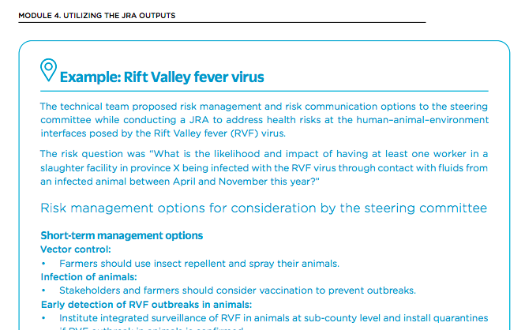
Informing JRA stakeholders
JRA OT, p. 51
Remember, the more specific and actionable the recommendations, the more likely that the JRA Steering Committee and Stakeholder Group can operationalise JRA results.

Slide 10

Planning for next steps
Congratulations!
You finished the 10-step JRA method. Now use the JRA system to repeat JRAs as needed for existing hazards or mobilize quickly in an emergency. Be sure to inform the JRA lead and steering committee about how you see the JRA being used in the future.

Slide 11
Questions?

Slide 12

Thank you!
More information on the TZG project
OIE webpage: www.oie.int/en/for-the-media/onehealth/controlling-health-risks/national-collaboration/
WHO webpage: www.who.int/initiatives/tripartite-zoonosis-guide
FAO webpage: www.fao.org/animal-health/en/

