Slide 1
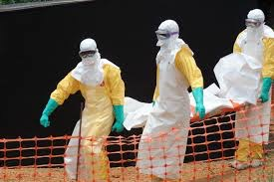
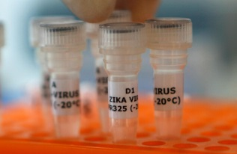
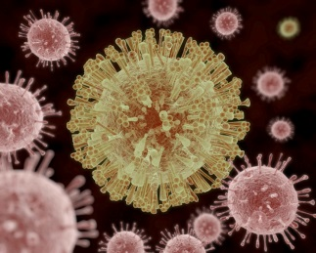
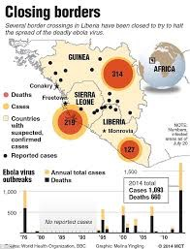
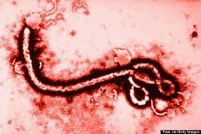
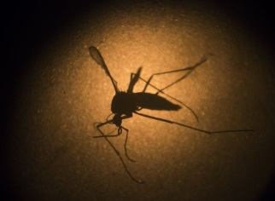


TTX 14
Generic TTX Slide bank
(title)
Tabletop Exercise
Country XXX
Day, Date, Time

Slide 2
Agenda
0900 Welcome (WR & MOH)
0910 Introductions & scene-setting (WHO facilitator)
0925 Overview of the emergency response plan (MOH)
0935 TTX Setup (WHO facilitator)
0940 TTX session 1 (Activation)
1020 Coffee break (10 min)
1030 TTX session 2 (Response management)
1115 TTX session 3 (Partner coordination)
1200 Coffee break (10 min)
1210 GAP analysis (WHO facilitator)
1350 Feedback & way forward (WHO facilitator)
1300 ENDEX/Lunch
Notes:
This is a 4hr TTX in the morning –
It is not recommended to run this exercise on a Monday or Friday, or the day before or after a public holiday.
Ideally, run this exercise in the morning when people are fresh.
The participants should be limited to the actual people that would be expected to manage (coordinate) the response at the national level. The more realistic the audience the more people will buy into the exercise. Duplication of roles, alternates observing and non-participation by critical staff positions could handicap the exercise.
The venue should be the EOC, conference room, boardroom or other appropriate meeting venue.
If we expect people to be easily distracted, an off-site location is recommended.
Serving lunch is highly recommended to ensure people stay until the end and to encourage informal networking event after the exercise. Relationship building is critical for the success of any plan and team building/ ice breakers can be used depending on the audience.

Slide 3

Notes:
Welcome by the WR and Most senior Government Official
This may include a prayer, depending on the cultural context.

Slide 4

Introductions
Notes:
Introduction by the facilitation team,
Each person in the room to introduce themselves and define their function at the table.
(Recommend Name taggs/ functions & Table Tags for places around the table)
Helps the facilitation team and the chair person manage the room.

Slide 5
Why do we run simulation exercises?
Notes:
Highlighting the benefits of testing plans, practicing when no-lives are at stake and importantly that this is a safe learning environment.

Slide 6
Insert definition of a TTX or overview of exercise types
Notes:
Highlighting the benefits of testing plans, practicing when no-lives are at stake and importantly that this is a safe learning environment.

Slide 7
TTX purpose & objectives
Purpose
To discuss the national government response plan to
respond to a health emergency.
Specific objectives
Review the emergency response structures (IMS, EOC etc.), including lines of communication and accountability
Identify areas of interdependence between key functions, resources and partners
Identify strengths and weaknesses of the emergency response plan, tools and mechanisms
Familiarise participants with their roles and responsibilities in an emergency response.
Notes:
To discuss, review and practice our plan – to find the gaps and ensure we are ready for the next emergency

Slide 8

MOH
RESPONSE PLAN OVERVIEW
Notes:
Work with the MOH to get them to present a short overview of the response plan.
Plan outline
Leadership model
Planning Assumptions
Risks

Slide 9
WHO
RESPONSE PLAN OVERVIEW
Notes:
Work with the MOH to get them to present a short overview of the response plan.
Plan outline
Leadership model
Planning Assumptions
Risks

Slide 10

TTX process
Narrative
Discussion questions
Recommendations and refinements
Notes:
This Public Health Emergency Table Top (TTX) Simulation exercise is a tool that has been developed to assist Governments, Humanitarian Country Teams and partners in the process of preparing plans and policies with the intention of being able to mitigate the effects of a future health emergencies. The TTX Simulation is based on the depiction of an emergency situation (xx pandemic) which is used as the basis for a detailed discussion guided by the exercise facilitator. During the TTX, there are no "real" actions carried out. The participants (based on their standard function) explain and discuss among themselves how they would react to the scenario, without being required to execute those actions. Prior to starting the TTX, it is desirable that all participants have a basic knowledge about any specific organisational and national response plans in place.
Scenario Adapted to the Country - The simulation package consists if a scenario which is broken down into three episodes. For each episode, there are then a series of specific injects and questions to lead the discussion process. In order to provide a realistic context for the simulation, the scenario and relevant inject package must be adapted the country specific context, and incorporate the following elements:
Nature of the groups presences and activities
Group structure
National scenarios and plans
Impact on livelihoods, travel, communities, health services, security
National response including key containment and mitigation actions likely to take place
Media response
Regional and international responses
Impact on vulnerable groups
This adaptation is essential for the success of the exercise; this is what makes the simulation ‘real’ to participants and makes the simulation effort worthwhile.
The facilitators are responsible for adapting the simulation materials; this should be done in close collaboration of a WHO or CDC country representative (an epidemiologist if possible) in order to ensure accurate technical input relevant to the country.

Slide 11
Exercise design
Participants
Exercise team
Facilitators
Technical advisors
Support staff
Narrative and problem statements
3 sessions with a question to be discussed
Accept the scenario, do not fight the scenario
Debrief
Notes:
The TTX Simulation is run by a Lead Facilitator, this person will be responsible for the adaptation of the materials to the national context, the delivery of the package and subsequent de-briefing.
Co-Facilitators
Technical experts for the response plan and hazard.
Scribe to capture comments and give input for the debrief.
The support of an Admin Assistant is also useful for a number of practical tasks before and during the simulation.
Role of the facilitators
In addition to ensuring the smooth running of the simulation and de-briefing, the task of the facilitator is to assist the participants in achieving the stated objectives of the simulation. To this end, the facilitator will not provide direct answers to questions raised or identified by the participants. Rather he/she will encourage a robust discussion by all participants while at the same time maintaining the overall flow of the simulation.

Slide 12
How to play
Rules
Use your plans, guidelines and regulations to inform your responses
Play your self
Work as a team
Focus on solutions
Remember
The purpose of this tabletop exercise is to familiarize you with the emergency response system. The exercise is not to test or evaluate individual participants.
Notes:
Participant role
There are no ‘role plays’; each participant is required to be themselves based directly on the functions each of you are responsible for in your organisation. Respond as you would for any emergency.
Every participant has a vital role to play in identifying problems and strengths within the system, in particular as it relates to their roles and functional areas. Participants must therefore feel safe and be encouraged to highlight any strengths, gaps, opportunities and make recommendations on ways that the system can be improved.

Slide 13
Session 1
SIMULATION ONLY
To: xx
Date: xx
Subject: IMPORTANT xx xxx
Importance: High
SIMULATION ONLY
Notes:
(Insert updated case example as per your scenario)

Slide 14
Tasks (30 min)
What is the current situation?
Should the response plan be activated?
Who is the designated incident commander?
What resources do you have available? (actual)
What immediate actions will you take now?
(example ideas)
Notes:
“Break the ice by beginning with a general question directed at one or two high-ranking officials or to the group as a whole. Later, other problem statements or messages can be addressed to other individuals or organizations.”
- Is the plan used? What tools are there to guide the process?

Slide 15

Tea break (10 min)
Notes:
We start promptly – in 10 min
Tea and coffee is served.
Toilets are ->

Slide 16
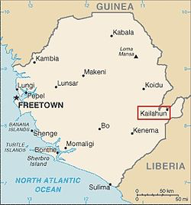
Session 2
SIMULATION ONLY
Update: case information
xx
SIMULATION ONLY
Notes:
(Insert updated case example as per your scenario)
Progression of the scenario – more specific case information received from the team in the field.

Slide 17
Tasks (30 min)
Instructions - You are the IMT
Questions (as a team)
What is the current situation?
What further information do you require?
Establish the priorities, specific objectives and reponse strategy (strategic response plan)
(example ideas)
Notes:
Extra
How are decisions being communicated and coordinated?
What tools are there to guide the process?
“The response actions should be directly related to the response strategy (specific objectives)”
Record the key decisions, any critical dependencies, gaps and recommendations.
Does the plan need to be updated or further refined?

Slide 18
Session 3
Update: case information (+x hrs)
Notes:
(Insert updated case example as per your scenario)

Slide 19
Tasks (40 min)
Instructions - You are the IMT
Questions
What is the current situation?
What resources could partners provide?
What coordination arrangements are in place for partners?
(example ideas)
Notes:
Extra
What decision do you need to make at this stage?
Depending on how the group is working, possibly instruct the team to role-play the coordination meeting. How would the room be setup, who would lead the meeting?
Record the key decisions, any critical dependencies, gaps and recommendations.
Does the plan need to be updated or further refined?

Slide 20
Tea break (10 min)

Slide 21

Debrief
Notes:
Review Gaps and proposed ideas-> Action Plan
Action planning - Are all functions prepared to respond?
Review of the days process.
Summarise the challenges and recommendations identfied by the participants.
Clarify any points and ensure concrete recommendations, soluations or wayforward agreed.
E.g.
Is the plan suitable for your needs?
What are the dependencies in the plan?
What are the critical points of failure in your plan?
What additions or changes to the current plan do you need?

Slide 22

Notes:
Please complete this short survey to capture your opinions on the exercise? (1 pager, 3 min)
The success of a tabletop exercise is determined by feedback from participants and the impact this feedback has on the evaluation and revision of policies, plans, and procedures.
Hand out – One page Survey Questionaire
Yes/ NO?
Did the TTX achieve its objectives?
Did this TTX help you in your role?
Did this activity meet your expectations?
Open questions?
What (training activity, equipment or other ?) would enable you to be better prepared to respond?
Which TTX session was most useful? Why?
How can we improve this exercise?

Slide 23
Thank you
Notes:
I NEED A BETTER WHO LOGO.
We will type up your comments and recommendations into a Post-exercise report and share will all the participants.
We are available to support you in enhancing the response plan.
Thank you for your time today.

