Slide 1




NOVEL
CORONAVIRUS
(COVID-19)
HEALTH
EMERGENCY
PREPAREDNESS
SIMULATION EXERCISE
COUNTRY NAME
Date and location

Slide 2
Agenda
Part 1:
08:45 Registration
09:00 Introduction
09:10 Exercise Objectives and how to play
09:15 Table-top Simulation
10:45 Coffee break (15 min)
11:00 Table-top Simulation
12:30 Hot-wash
13:00 Close part 1
13:00 Lunch
Part 2:
09:00 Re-cap
09:15 Gaps analysis & action planning (group work)
10:30 Coffee break (15 min)
10:45 Action planning continued (group work)
11:30 Consolidation in plenary session
12:00 Wrap up and next steps
12:30 Closing
Notes:
ADJUST THE TIMING BASED ON YOUR OWN AGENDA BUT MAKE SURE YOU KEEP ENOUGH TIME FOR PART 2. THIS IS THE MOST ESSENTIAL PART OF THE SIMEX!!!

Slide 3


Latest WHO Situation Report
The situation is evolving rapidly.
Let’s have a look at
the latest WHO SitRep.
Notes:
The situation is evolving rapidly.
Get the information from the lastest WHO sit rep.
If you click on the image it will take you to the WHO Sit Rep web page
You can also provide printout copies
Resource:
https://www.who.int/emergencies/diseases/novel-coronavirus-2019/situation-reports

Slide 4
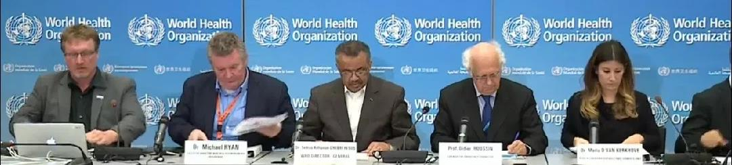
Statement from the IHR (2005) Emergency Committee
To all countries
It is expected that further international exportation of cases may appear in any country. Thus, all countries should be prepared for containment, including active surveillance, early detection, isolation and case management, contact tracing and prevention of onward spread of COVID-19 infection, and to share full data with WHO.
Statement on the second meeting of the International Health Regulations (2005) Emergency Committee regarding the outbreak of novel coronavirus (COVID-19). Geneva, 30th January 2020
Notes:
WHO Technical advice is available here:
https://www.who.int/emergencies/diseases/novel-coronavirus-2019
Countries should place particular emphasis on reducing human infection, prevention of secondary transmission and international spread and contributing to the international response though multi-sectoral communication and collaboration and active participation in increasing knowledge on the virus and the disease, as well as advancing research.

Slide 5
What is a Table-Top Exercise (TTX)?
A tabletop exercise (TTX) is an exercise that uses a progressive simulated scenario, together with series of scripted injects, to make participants consider the impact of a potential health emergency on existing plans, procedures and capacities.
A TTX simulates an emergency situation in an informal, stress-free environment.”
-WHO Exercise Manual, 2017
Notes:
A table-top exercise is an exercise that uses a progressive simulated scenario, together with series of scripted injects, to make participants consider the impact of a potential health emergency on existing plans, procedures and capacities. A TTX simulates an emergency situation in an informal, stress-free environment.
The purpose of a TTX is to strengthen readiness to manage a health emergency, through facilitated group discussions.
A TTX can be used to:
Develop or review a response plan  
Familiarize participants with their roles and responsibilities
Identify and solve problems through a facilitated and open discussion.

Slide 6
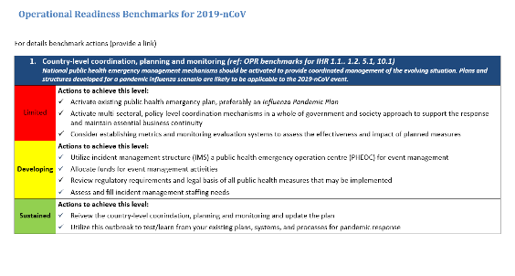
Design & Purpose
Exercise Design
Based on the “COVID-19 Strategic Preparedness and Response Plan (SPRP)” and designed for national level operational stakeholders, involved in public health emergency preparedness or response.
Purpose
Through facilitated group discussion, the exercise aims to examine and strengthen your existing plans, procedures and capabilities to manage an imported case of COVID-19.
Notes:
The “WHO monitoring response implementation checklist for COVID-19” should have been printed and distributed to all participants.
Tell participants, it is in their reference documents.

Slide 7
General objectives of the TTX
General Objectives
Share information on the progress of your preparation, including response capabilities, plans and procedures to identify and respond to an imported case of COVID-19 in your country.
Identify areas of interdependence between health actors and other sectors
Conduct gap analysis based on the COVID-19 Strategic Preparedness and Response Plan (SPRP)
Develop an action plan to enhance your level of readiness, based on the SPRP.

Slide 8
Specific objectives of the TTX
Review the operation management process for a suspected case of COVID-19.
Confirm arrangements for notification, coordination and internal communications before and after the confirmation of a COVID-19 case.
Confirm procedures related to the management of a suspected cases before and after laboratory confirmation.
Review plans to clarify lines of accountability (roles & responsibilities) and communication to enable a timely, well-coordinated and effective response.
Review the requirements of public health laboratories and funding
Review risk and media communications plans.

Slide 9
Exercise managent team
Roles
Facilitation: (insert name/s)
Rapporteurs: (insert name/s)
Observers: (if applicable)

Slide 10
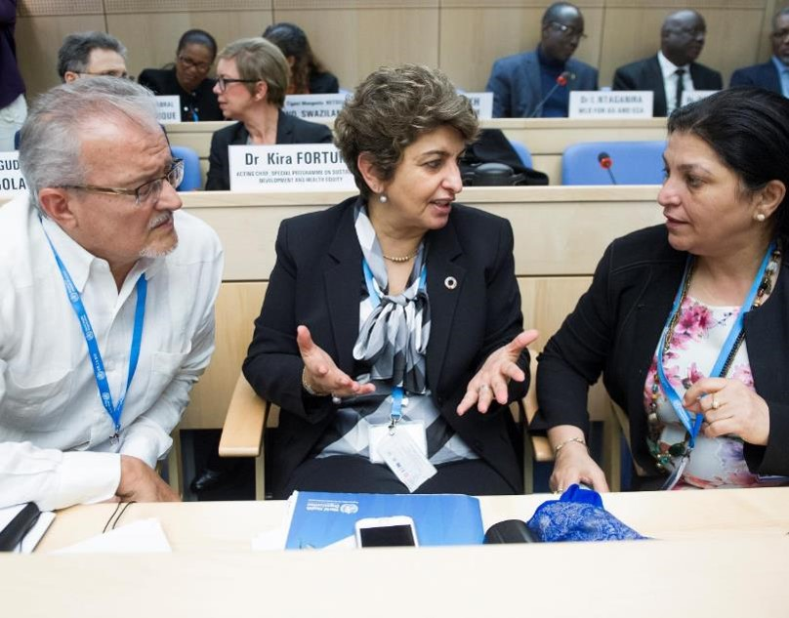
Rules of the TTX
Not an individual test
Respect the views of others
Respond as you would in real life and allow others to do likewise
Use your existing plans, guidelines and regulations to inform your responses
Focus on solutions

Slide 11
Table-Top Exercise: How to Play
This is a closed exercise, designed just for you.
The facilitators will guide you through a series of discussions focused on an imported case of
COVID-19
We are all
here to learn
Scenario
Questions & Discussion (1)
Scenario update
Questions & Discussion (2)
Questions & Discussion (4)
Questions & Discussion (5)
Scenario update
Questions & Discussion (3)
Hot-Wash
Facilitated Debriefing
Action Planning

Slide 12

Questions
ANY
QUESTION
BEFORE
WE START

Slide 13
NOVEL
CORONAVIRUS
(COVID-19)
HEALTH
EMERGENCY
PREPAREDNESS
SIMULATION EXERCISE
COUNTRY NAME
Date and location

Slide 14
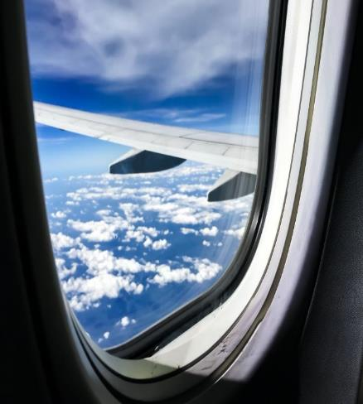
Scenario
SIMULATION ONLY
A man is brought into [sub-national primary health care facility], in [City name] by his family with a high fever, cough and difficulty breathing.
He lives in [city] and has just returned home from a business trip to China. Based on his symptoms and his recent travel history, the man (58 years old) is suspected of having COVID-19.

Slide 15

Session 1
Questions for discussion
Who should be informed, when and how?
What plans, procedures and resources would you activate at this point?
Does the patient need to be transferred to another hospital. If so, where to and how?
What Infection Prevention and Control measures would you put in place for this patient?
30 mins

Slide 16
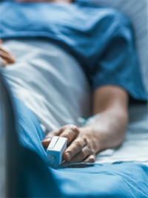
Scenario update
SIMULATION ONLY
The man apparently only developed symptoms 2 days after his return from meetings in China. He did not have any local travel companions on his business trip , which included time in Beijing and Shanghai. His return flight home was routed via [regional hub], where he spent 6 hours in the transit lounge and upon arrival at [PoE, with entry screening] he did not have a fever.
Total contacts identified since symptoms are 15, including the examining doctor and nurses, whom initially admitted to him at the hospital, his immediate family and some local office colleagues.

Slide 17
Session 2
Questions for discussion
What are your immediate priority actions?
What additional information do you require?
Would you notify WHO about this suspected case?
Who manage and conduct the monitoring and testing of the contacts?
30 mins

Slide 18
Session 3
Questions for discussion
How will you confirm whether the patient has COVID-19 or influenza?
    Which laboratory will conduct the test? Does this lab have the appropriate equipment, including PPE?
    How long will confirmation take?
    Will you send for international confirmation?
    Is COVID-19 a national notifiable disease?
Who needs to be informed of the results?
30 mins

Slide 19

Break
Coffee Break
(15min)

Slide 20
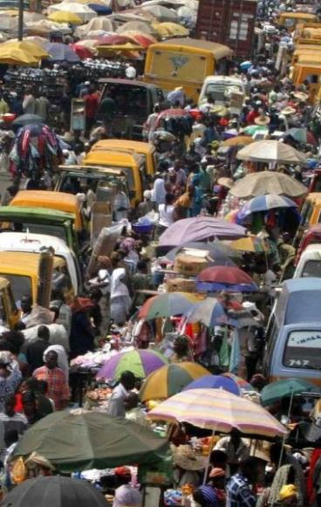
Scenario update
SIMULATION ONLY
The lab report confirms a positive test for COVID-19 for the man. The man’s condition worsens and is critical. Six of the contacts being monitored, including the man’s wife and three nurses and a doctor have also tested positive for COVID-19.
In addition, 3 separate clusters of a total of 63 lab confirmed cases have been admitted in health care facilities in [capital city], [another city] and [another city].
Domestic transmission is evident. The public is nervous, and the media is looking for a statement and to comment on rumors of multiple confirmed cases within the country.

Slide 21
Session 4
Questions for discussion
What actions would be triggered by this new event information?
How would this event be coordinated and managed?
Where would the funding come from to implement the response?
What support would you request from WHO and other partners?
30 mins

Slide 22
Session 5
Questions for discussion
Who is leading on risk communication for this event?
What communication needs to take place? To whom?
What is your strategy for media communication?
  What is the mechanism for rapid clearing of timely and transparent communication messaging and materials?
  How will information and communication be coordinated across Ministries and partners, and across different levels of the government?
30 mins

Slide 23

Hot-Wash
Initial feedback from the participants on the TTx

Slide 24

Summary &
Next Steps
Part II:
GAP analysis: Focus group discussion to review readiness benchmarks
Action planning
Participants evaluation form

Slide 25

Agenda part 2
Part 2:
09:00 Re-cap
09:15 Strengths & Gaps analysis (group work)
10:30 Coffee break (15 min)
10:45 Action planning (group work)
11:30 Consolidation in plenary session
12:00 Wrap up and next steps
12:30 Closing
Notes:
ADJUST THE TIMING BASED ON YOUR OWN AGENDA BUT MAKE SURE YOU KEEP ENOUGH TIME FOR PART 2. THIS IS THE MOST ESSENTIAL PART OF THE SIMEX!!!

Slide 26
COVID-19 SPRP
The “ COVID-19 Strategic Preparedness and Response Plan (SPRP)” outlines the measures to be taken at country level to contain the virus and will be updated with further measures as and if the epidemiological situation changes.
It will enable the targeted improvement of specific capacities.
This information will help national authorities to
identify main gaps
perform risk assessments and
plan for response and control actions.

Slide 27
Strengths and gaps analysis
Review strengths & gaps
75 mins
TASKS:
In groups, divide a piece of paper into three sections.
Review the Readiness Checklist, your plans and notes from your TTX
Discuss and write your points in each of the sections to answer:
  What worked well? (Achievements)
  What was challenging? (Challenges)
  Recommendations? (and prioritize, to identify your top 3)
Check assumptions
Propose ideas to enhance your systems, plans & Procedures
ACTION PLAN
Note: the action plan will be done in the next session

Slide 28
Break
Coffee Break
(15min)

Slide 29
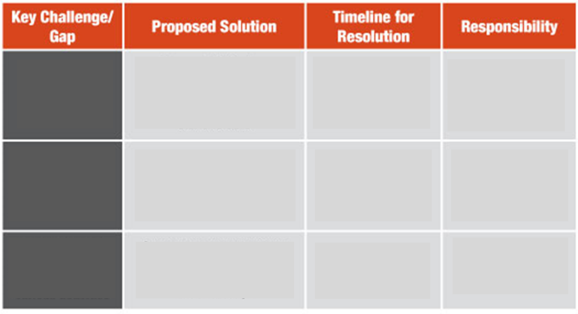

Action Plan
45 mins
Notes:
Break down in groups.
Prioritisation of findings into actions
Action
Reason why a priority?
Who is responsible for the action?
What resources are required?
By when?
Each group rapporteur to provide a 5 minute summary of the findings of the group.

Slide 30

Consolidation
Notes:
Break down in groups.
Prioritisation of findings into actions
Action
Reason why a priority?
Who is responsible for the action?
What resources are required?
By when?
Each group rapporteur to provide a 5 minute summary of the findings of the group.

Slide 31

Participants’ feedback form
Your feedback will assist us to maintain and improve the quality and relevance of future simulation exercises.
5 mins
Notes:
Break down in groups.
Prioritisation of findings into actions
Action
Reason why a priority?
Who is responsible for the action?
What resources are required?
By when?
Each group rapporteur to provide a 5 minute summary of the findings of the group.

Slide 32

Next steps and wrap up
NEXT STEPS
Notes:
Break down in groups.
Prioritisation of findings into actions
Action
Reason why a priority?
Who is responsible for the action?
What resources are required?
By when?
Each group rapporteur to provide a 5 minute summary of the findings of the group.

Slide 33


THANK YOU!
For SimEx technical support,
please contact your WHO country office or regional office focal point:
AFRO: stephenm@who.int
EMRO: SAMHOURID@who.int
EURO: schmidtt@who.int ; rashforda@who.int
PAHO: andragro@paho.org
SAERO: htikem@who.int
WPRO: PAPOWITZH@who.int ; katom@who.int
WHO RESSOURCES
WHO
COVID-19
Emergency
webpage
More
information
on
coronavirus
Scan or Click
Scan or Click
Notes:
Break down in groups.
Prioritisation of findings into actions
Action
Reason why a priority?
Who is responsible for the action?
What resources are required?
By when?
Each group rapporteur to provide a 5 minute summary of the findings of the group.

