Slide 1
Joint Risk Assessment
at the Human-Animal-Environment Interface
MODULE 0

Slide 2
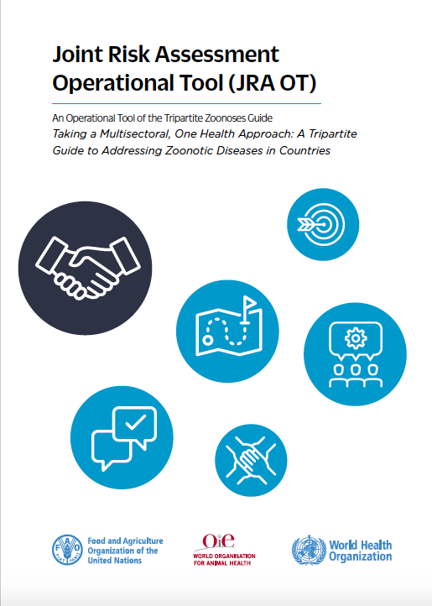

Slide 3
Key Principles for Joint Risk Assessment

Slide 4
Why do we need Joint Risk Assessment?
The reality: Technical staff from different sectors, assessing the same hazard, will generally estimate risk differently.
Example Risk Assessment Question:
What is the likelihood of a zoonotic influenza infecting a person and infecting an animal?
Animal Health Sector Assessment:
Human Health Sector Assessment:

Slide 5
Zoonotic diseases require a joint approach to risk assessment

Slide 6
Why?
All relevant stakeholders are required to fully understand hazards arising at the interface
When all relevant sectors are at the table they can:
Collectively evaluate where and why risk exists
through expertise and data gathered from each sector
Minimise unintended impacts
by understanding and addressing the perspectives and needs from each sector

Slide 7
Can we just use existing risk assessment tools, jointly?
Joint methods and approaches are required to fully understand hazards arising at the interface
While sector-specific risk assessment methods are similar, they...
Can be operationally different
Have evolved to meet the needs of specific sectors
Do not directly align to support expertise and data gathering from many sectors
Cause confusion when sectors have differing approaches to foundational risk assessment principles such as risk pathways, impact, uncertainty versus confidence, and more

Slide 8
Introducing the Joint Risk Assessment (JRA OT)

Slide 9
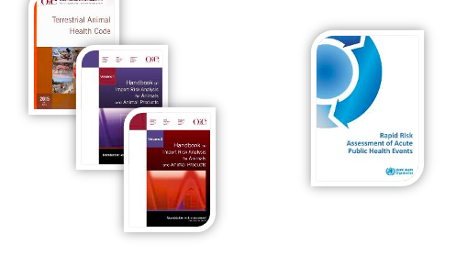
Builds from existing tools and resources available across the Tripartite

Slide 10
A standard Tripartite (FAO-OIE-WHO) operational tool
JRA OT allows technical staff to conduct joint qualitative risk assessments at the national or subnational level
A 10-step method for assessing risk at the human-animal-environmental interface:
Qualitative
Assessment of a single hazard (e.g. health event or priority zoonotic disease)
Uses existing technical knowledge and available data
Can be iteratively repeated and updated
Ensures science-informed / evidence-based risk management and communication
Does NOT replace sector-specific risk assessments

Slide 11
Values and integrates sector-specific risk assessments into the JRA
Information from sector-specific risk assessments inform the JRA and vice versa
Animal health sector
Sector specific assessment
Sector-specific risk assessments are required to manage unique risks related to each sector, including:
Sector-related risk assessment questions
Sectoral context, perspectives, priorities, and mandates
Multiple sectors
Joint risk assessment
Human health sector
Sector-specific assessment

Slide 12
Benefits of the JRA OT
Creates a national structure and approach for conducting JRAs at the national or subnational levels
Identifies joint hazards
Involves all relevant sectors in technical risk assessment
Allows decision makers to implement evidence-based approaches for risk management and communication
Fosters regular communication among sectors
Identifies missing information and knowledge gaps

Slide 13
Questions?

Slide 14
Background: Technical Development & Pilot of the JRA OT

Slide 15
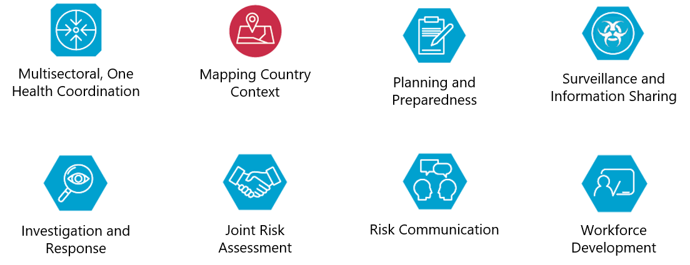
It all started with the Tripartite Zoonoses Guide (TZG)
Taking a Multisectoral, One Health Approach:
A Tripartite Guide to Addressing Zoonotic Diseases in Countries
Provides key principles and technical guidance

Slide 16
Three Operational Tools (OTs) in development
Taking a Multisectoral, One Health Approach:
A Tripartite Guide to Addressing Zoonotic Diseases in Countries

Slide 17
JRA OT tevelopment Timeline
Iterative development, implementation, and evaluation
Technical Area Working Group
JRA OT Technical Workshop, October 2017
In country pilots and iterative improvement, 2018-2020
JRA OT finalisation meeting, February 2020
UN technical translations, September 2020
Cleared for publication by the Tripartite, October 2020
First virtually facilitated JRA OT, October 2020

Slide 18
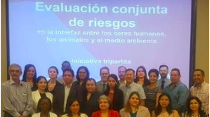
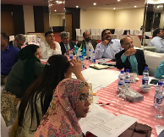

Slide 19
JRA Country Pilots

Slide 20
Hazards assessed during pilot workshops
Some hazards selected for pilots:
Rabies
Zoonotic influenzas
Rift Valley Fever
Leptospirosis
Equine encephalitis
Haemorrhagic Fevers
Anthrax

Slide 21
JRA workshop agenda
An Example Agenda for a 3-day workshop
Example: Day 0 of the agenda
National Facilitator Training
Example: Day 1 of the agenda
Introduction to JRA Modules & Steps
Example: Day 2 of the agenda
JRA Exercise: Conducting the JRA in Working Groups
Example: Day 3 of the agenda
Presentation of results
Next steps for One Health coordination/ Future JRAs

Slide 22
Questions?

Slide 23
Introduction to the 10-step JRA Method

Slide 24
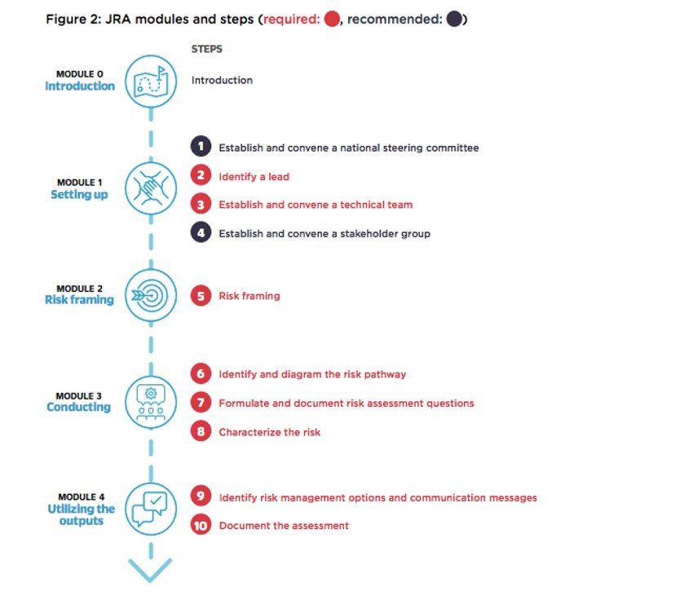
JRA modules & steps
The 10 steps of the JRA OT are divided into four modules (Figure 2)
Figure 2 highlights modules & steps that are recommended vs required.

Slide 25
Module 0
MODULE 0
Introduction

Slide 26
Module 1
MODULE 1
Setting up
1
Establish and convene a national steering committee
2
Identify a lead
3
Establish and convene a technical team
4
Establish and convene a stakeholder group

Slide 27
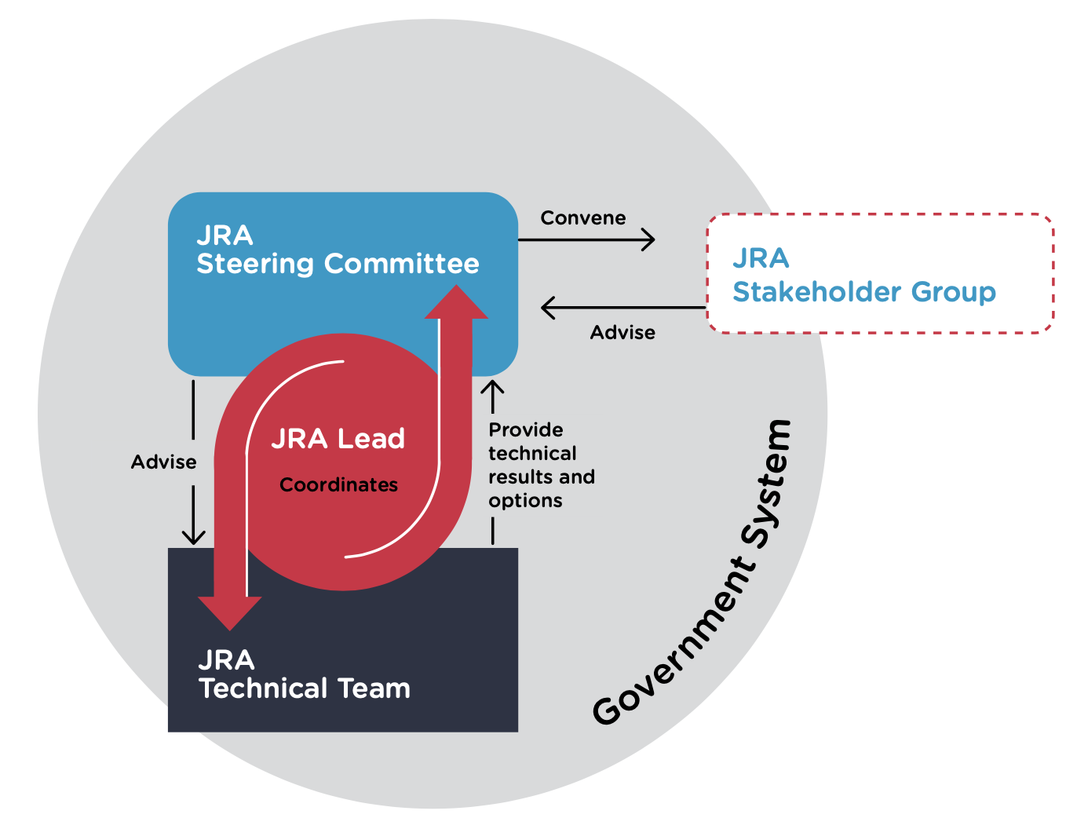
Setting up JRA
The JRA Organizational Structure Figure 2

Slide 28
Module 2
MODULE 2
Risk framing
5
Risk framing

Slide 29
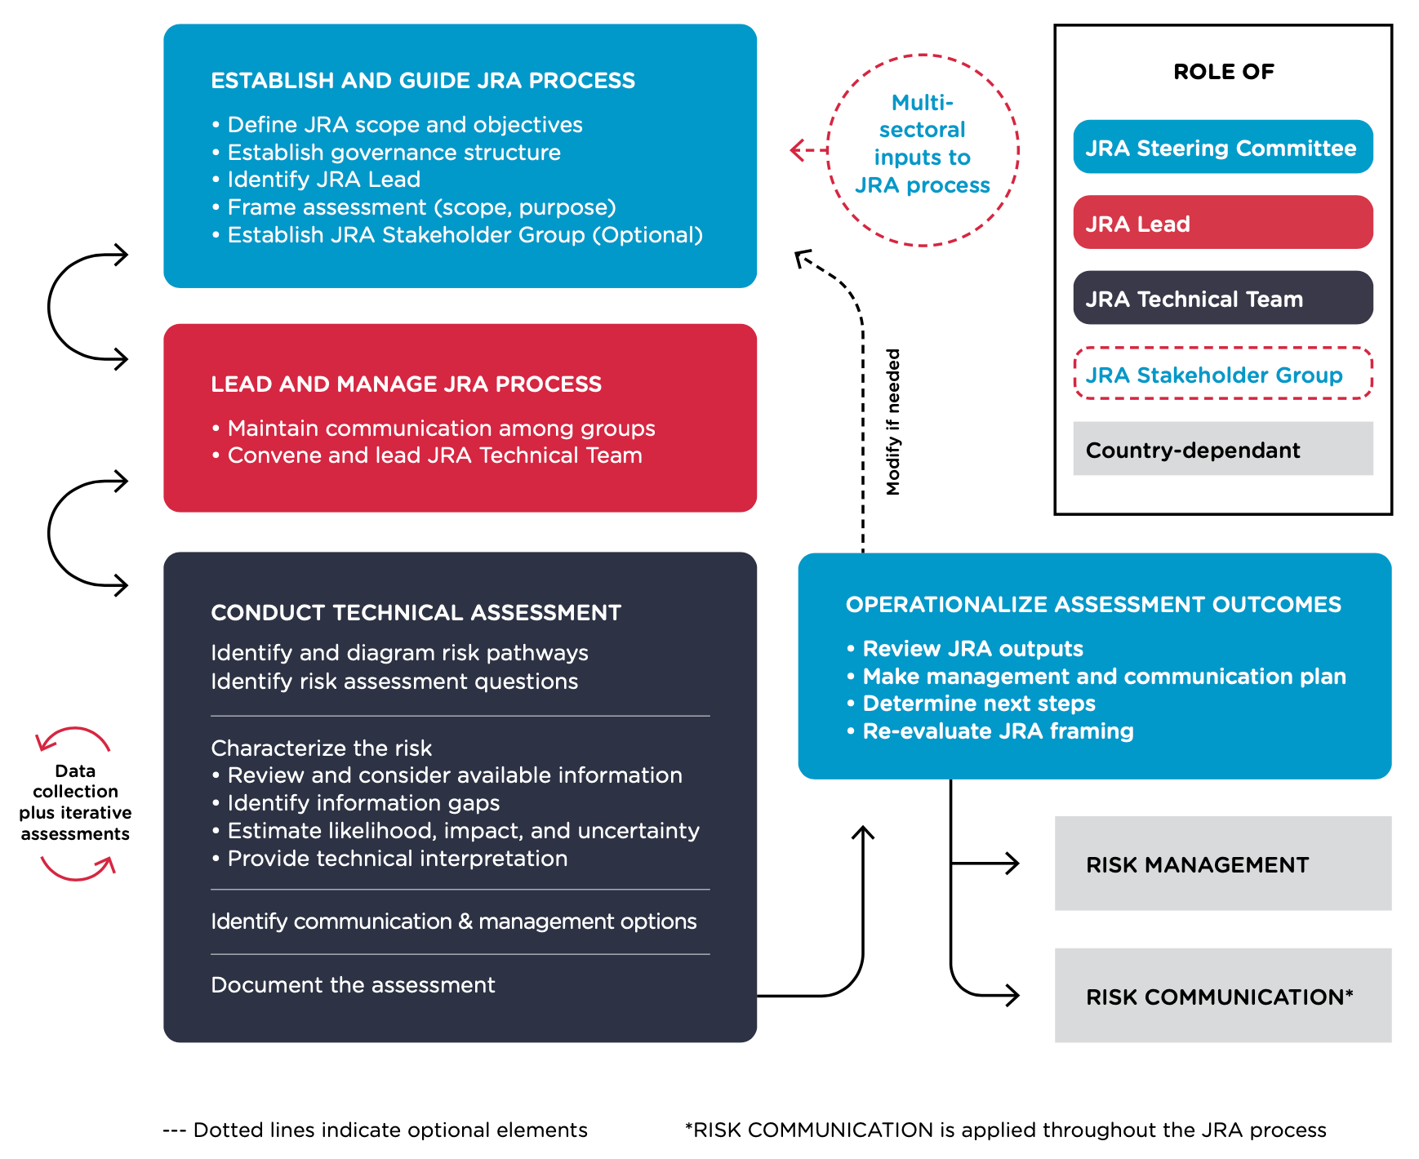
Roles & responsibilities
Modules 1 & 2

Slide 30
Module 3
MODULE 3
Conducting
6
Identify and diagram the risk pathway
7
Formulate and document risk assessment questions
8
Characterise the risk

Slide 31
Roles & responsibilities
Module 3

Slide 32
Module 4
MODULE 4
Utilizing the outputs
9
Identify risk management options and communication messages
10
Document the assessment

Slide 33
Roles & responsibilities
Module 4

Slide 34
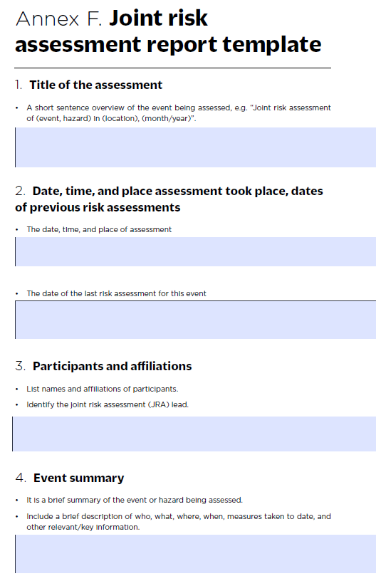
Reporting
Annex F JRA Report template, p. 64-70

Slide 35
Enhancing the JRA
The JRA functions optimally when all are available:
Relevant Sector Engagement
Political Will
Access to Information
Risk Assessment Capacity and Expertise

Slide 36
Questions?

Slide 37
Thank you!
More information on the TZG project
OIE webpage: www.oie.int/en/for-the-media/onehealth/controlling-health-risks/national-collaboration/
WHO webpage: www.who.int/initiatives/tripartite-zoonosis-guide
FAO webpage: www.fao.org/animal-health/en/

