Slide 1

Joint Risk Assessment
at the Human-Animal-Environment Interface
MODULE 1

Slide 2

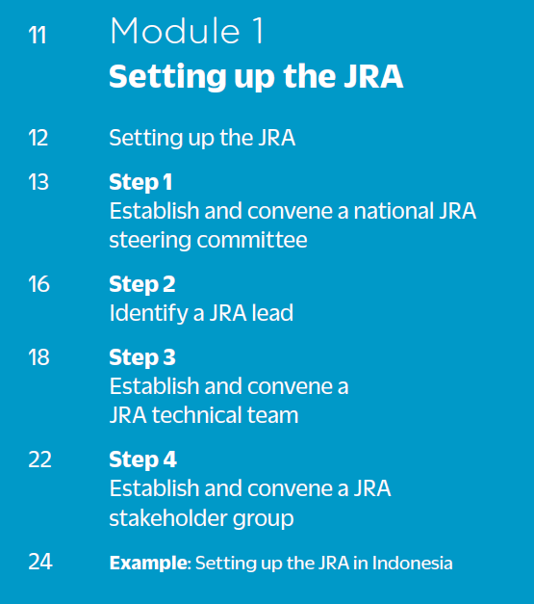

Table of contents

Slide 3
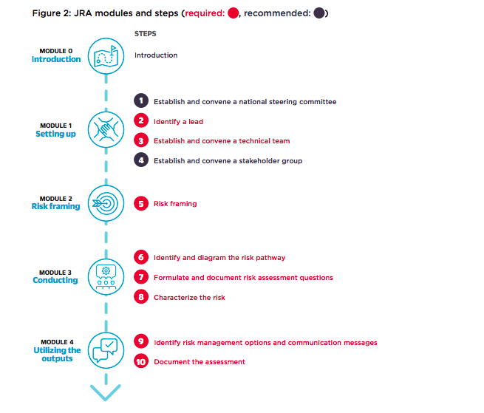


JRA modules & steps
You are here

Slide 4
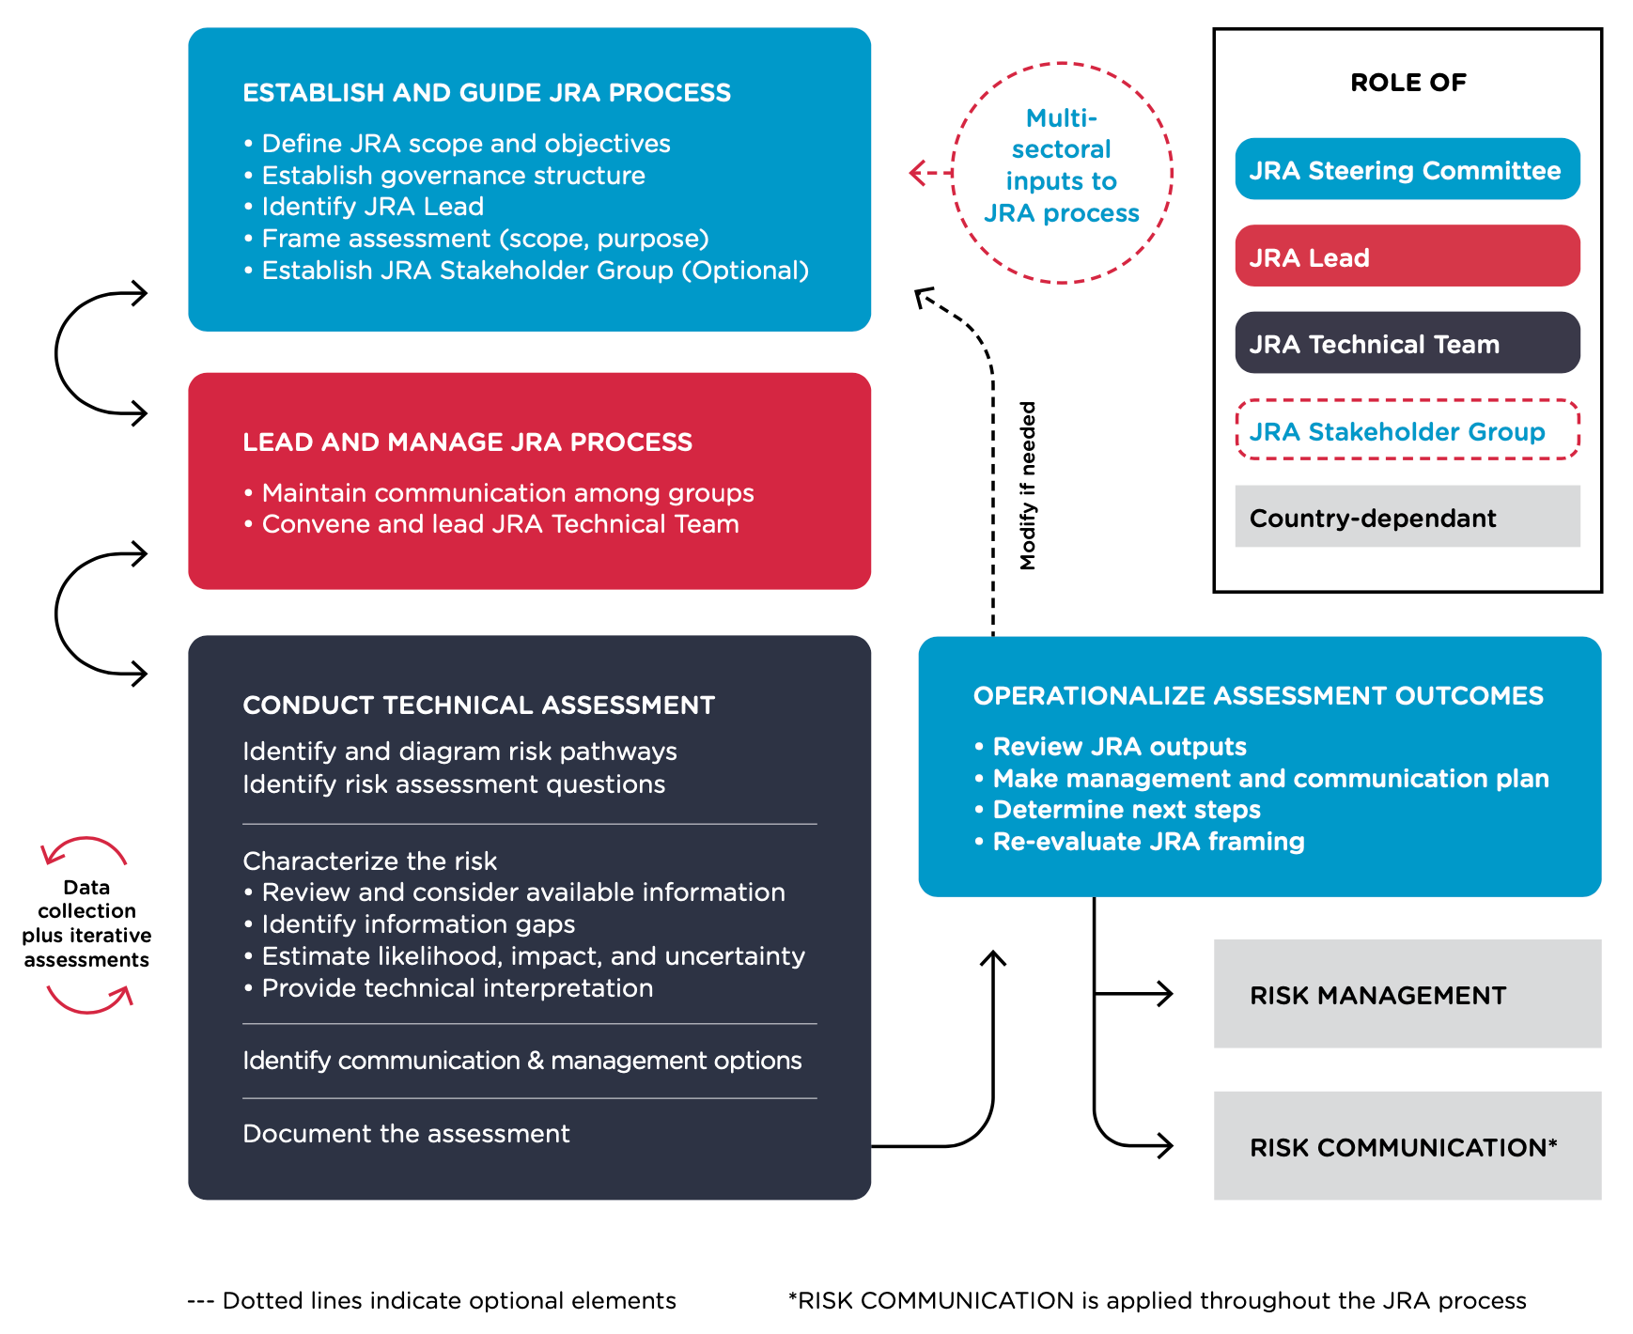
Roles & responsibilities
Module 1

Slide 5
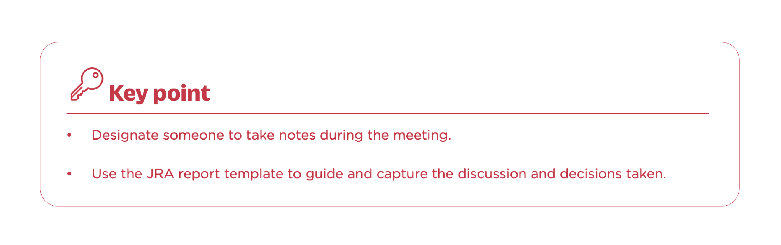
Important notes
Key points and tips are highlighted in boxes throughout the JRA OT
Definitions and language were developed for the purpose of the JRA only
Agreed upon by experts from different backgrounds (Rome 2017)
The language is a compromise between being clear and simple
JRA only assesses risks at the animal-human-environment interface
  For sector-specific questions/problems, do sector-specific assessments
Always use the JRA OT document

Slide 6
Roles and responsibilities in JRA process
Figure 4: Tasks and flow, p. 9

Slide 7
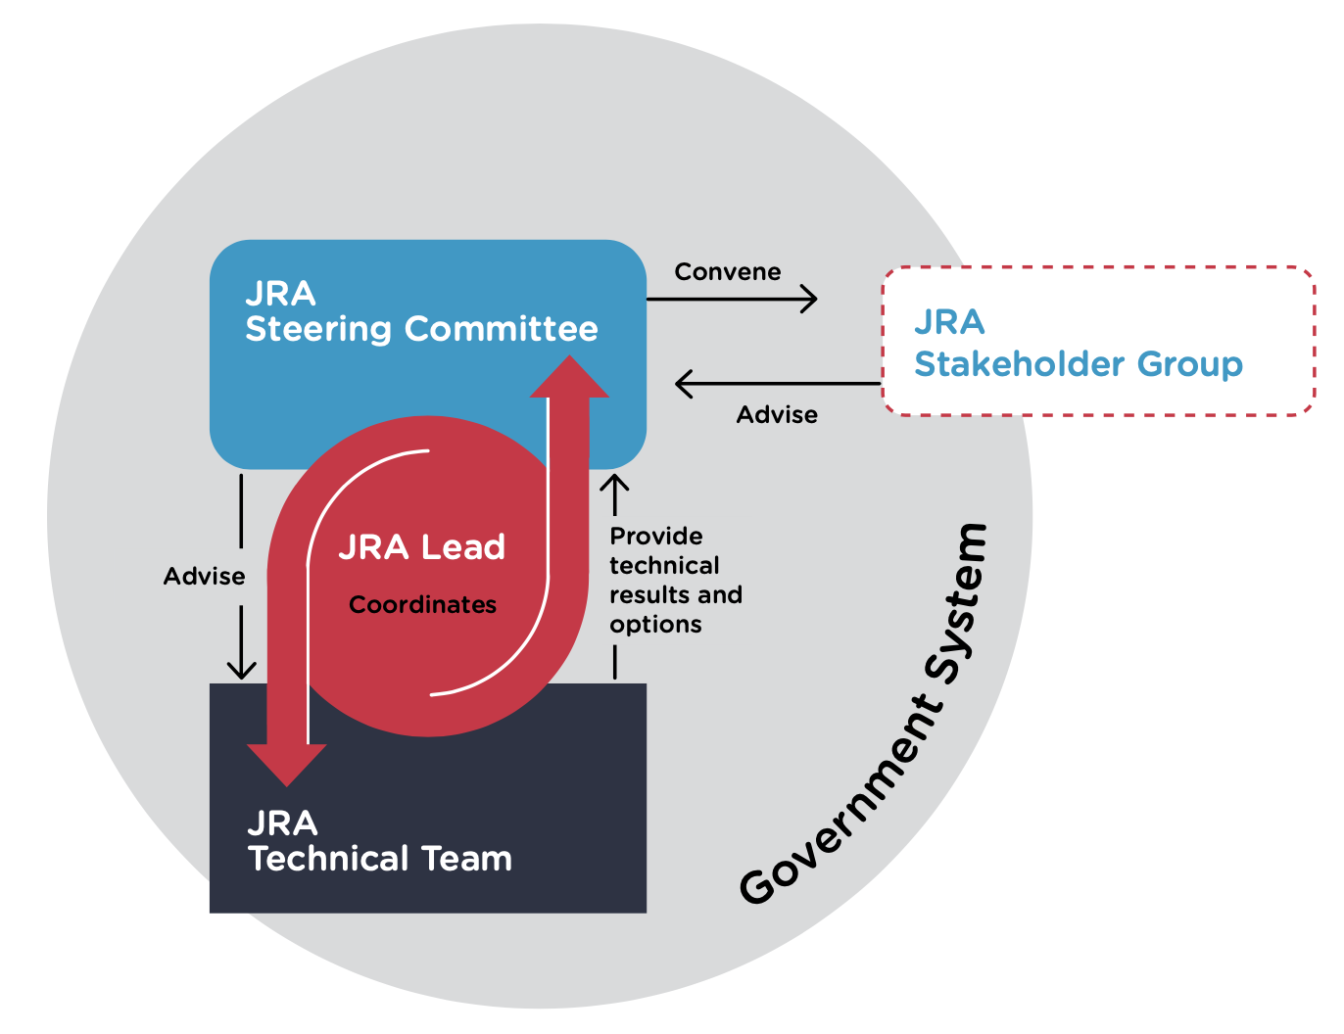
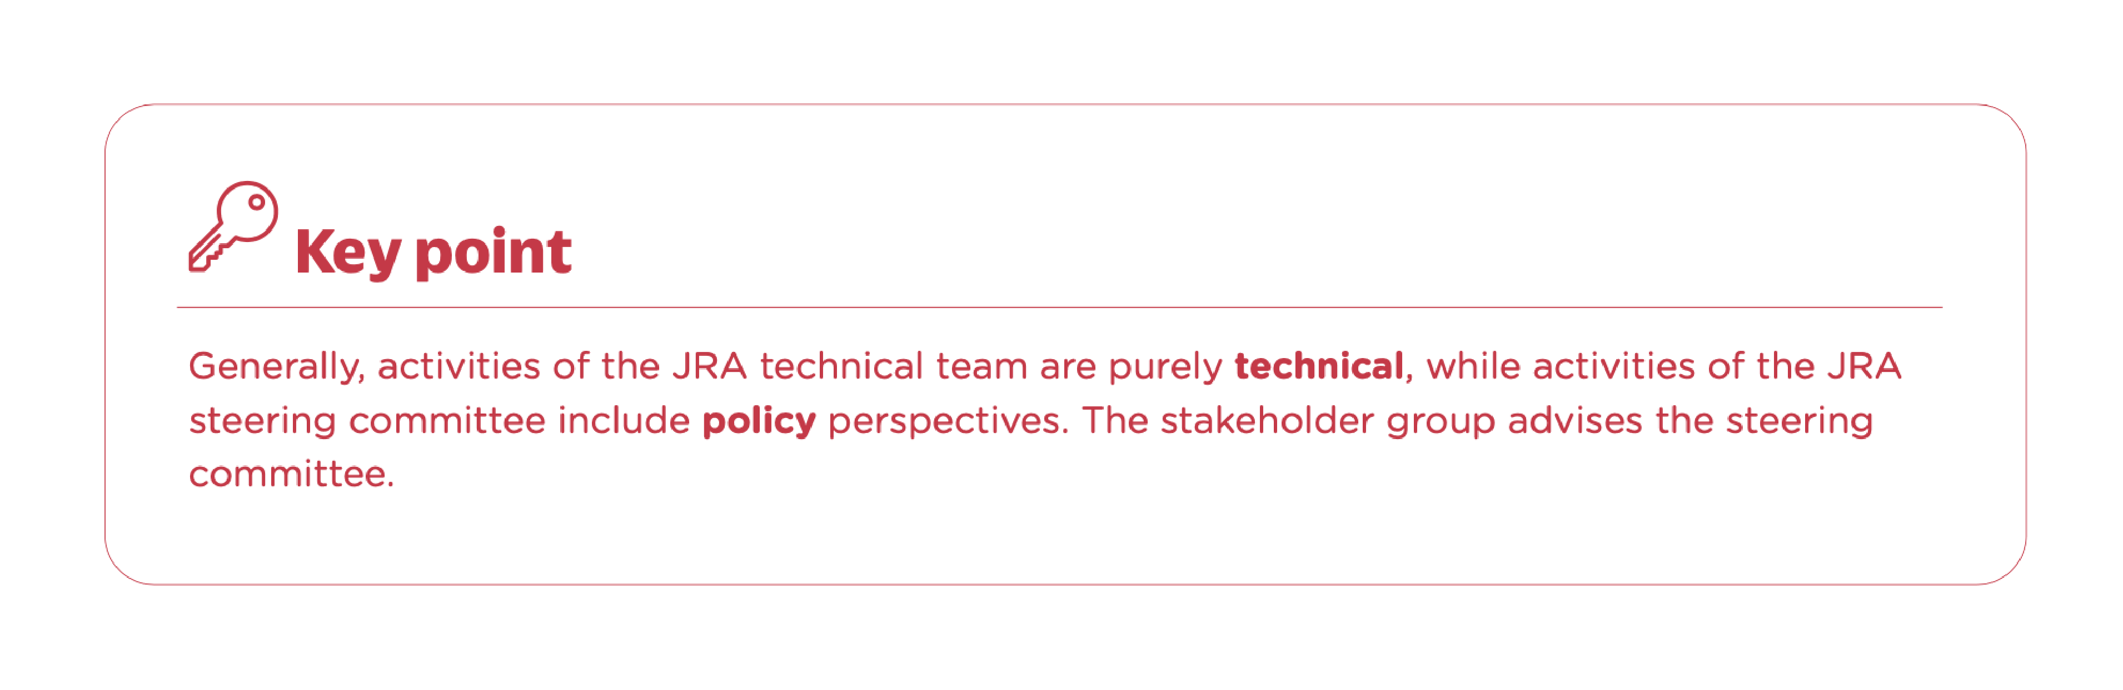
Setting up the JRA
Figure 5: JRA organisational structure, p. 13

Slide 8
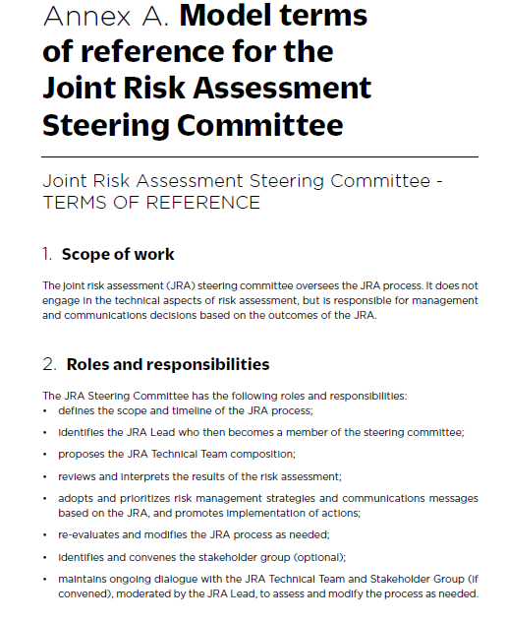
Step 1: JRA steering committee
p. 14-15; see also Annex A for model ToRs, p. 54-56
Working with existing structures, mechanisms, and objectives:
Define the scope and timeline of the JRA process
Review and interpret the results of the risk assessment
Responsible for management and communications decisions
Does not engage in technical aspects
Ensures technical team is not influenced by policy considerations
This step is always recommended, but may be skipped in urgent situations

Slide 9
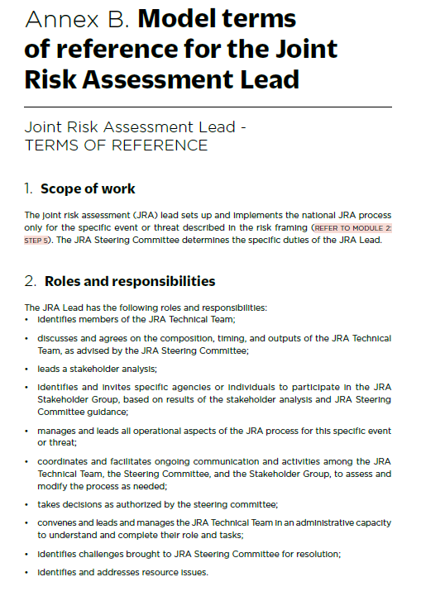
Step 2: JRA lead
p. 16-17; see also Annex B for model ToRs, p. 57-58
Designated by JRA steering committee
Responsible to and participates in steering committee
Authority/autonomy and scope of activities determined by JRA steering committee
In charge of set up and implementation of JRA process
Manages and leads all operational aspects of JRA process for this specific event or threat
Identifies challenges and resource issues
This step is always done, i.e. in non-urgent AND urgent situations

Slide 10
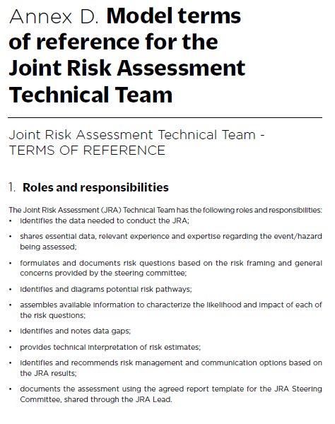
Step 3: JRA technical team
p. 18-21; see also Annex D for model ToRs, p. 60-61
Small group of technical staff
Usually includes human and animal health and wildlife experts
Conduct the risk assessment
Provide a report back to steering committee
This step is always done, i.e. in non-urgent AND urgent situations

Slide 11
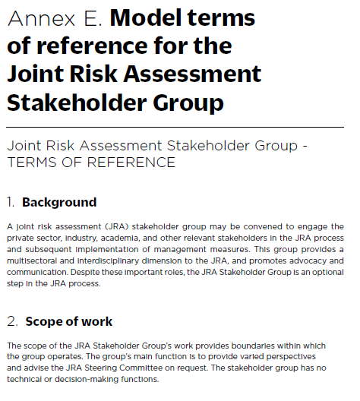
Step 4: JRA stakeholder group
p. 22-23; see also Annex E for model ToRs, p. 62-63
Provide multi-sectoral, interdisciplinary dimension (e.g. academic, industry, non-profit, etc.)
Promote advocacy and communication
Provide varied perspectives and advice to steering committee
Normally no technical or decision-making function
Plays a critical role in operationalising the results of the JRA
This step is always recommended, but may be skipped in urgent situations

Slide 12
Questions?

Slide 13

Thank you!
More information on the TZG project
OIE webpage: www.oie.int/en/for-the-media/onehealth/controlling-health-risks/national-collaboration/
WHO webpage: www.who.int/initiatives/tripartite-zoonosis-guide
FAO webpage: www.fao.org/animal-health/en/

