Slide 1
Coronavirus disease (COVID-19)
IPC SIMULATION EXERCISE

Slide 2
Agenda
09:15 Introduction to the exercise
09:25 Scenario
09:45 Scenario update
10:15 Hospital administration meeting
10:45 Coffee break (15 min)
11:00 Wrap up Hospital administration meeting
11:15. Scenario update
12:00 Hot wash/Review of needs in countries
13:00 Lunch
Notes:
ADJUST THE TIMING BASED ON YOUR OWN AGENDA BUT MAKE SURE YOU KEEP ENOUGH TIME FOR PART 2. THIS IS THE MOST ESSENTIAL PART OF THE SIMEX!!!

Slide 3
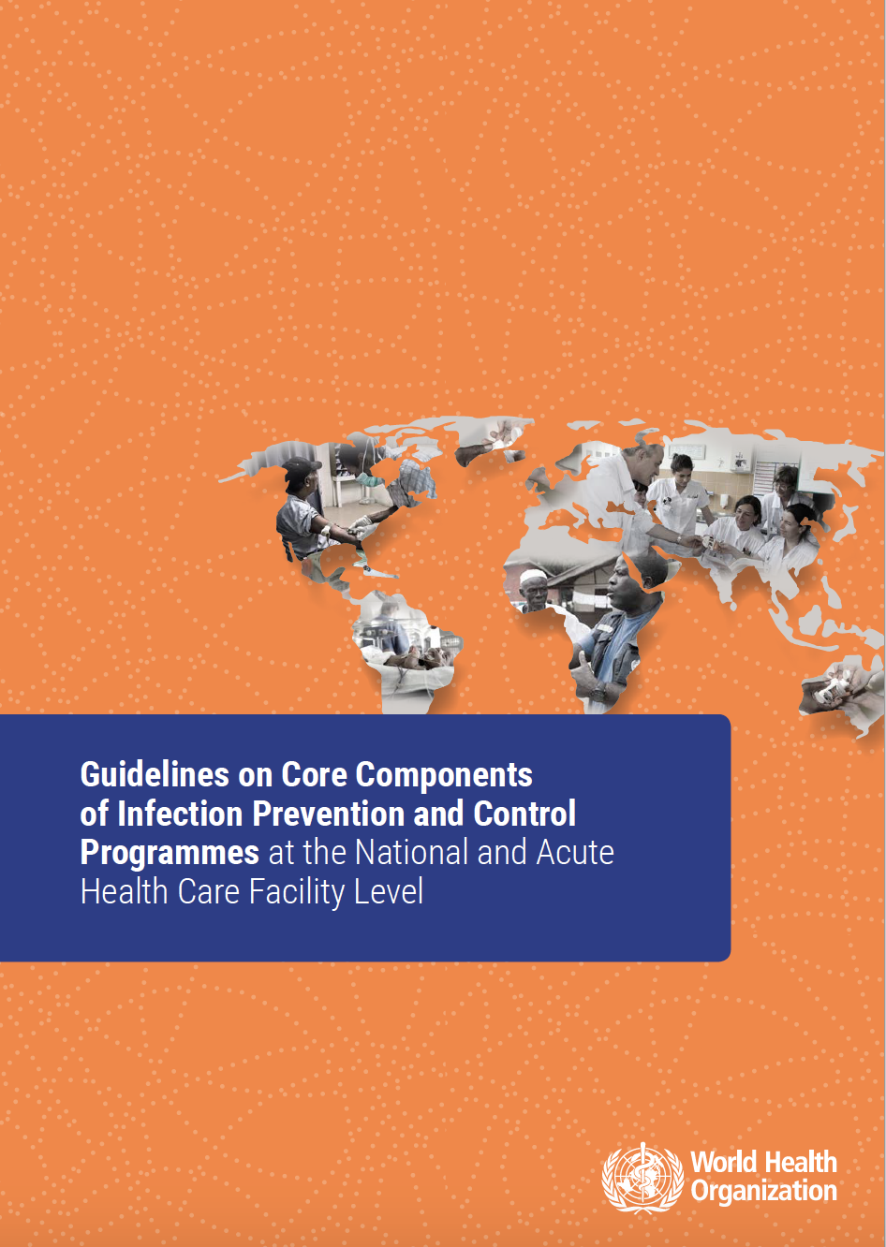
Design & Purpose
Exercise Design
Based on the Core Components of Infection Prevention and Control Programmes at the National and Acute Care Facility Level, specifically core component
7: Workload, staffing and bed occupancy at the facility level, and
8: Built environment, materials and equipment for infection
prevention and control at the facility level
Purpose
Through facilitated group discussion, the exercise aims to examine implementation of components 7 and 8 in an ongoing MDRO event with an influx of COVID-19 patients.
Notes:
The “WHO monitoring response implementation checklist for 2019-nCoV” should have been printed and distributed to all participants.
Tell participants, it is in their reference documents.

Slide 4
General objectives of the TTX
General Objectives
Share information on practices on IPC for endemic colonization in a tertiary facility and how those precautions could evolve based on the progress of the event, then further integrating response capabilities, plans and procedures to triage and implement source control measures for case of COVID-19 in your facility.
Identify challenges in bed occupancy and staff management between different departments.
Conduct gap analysis through reflection on how the scenario could play out in your countries.
Identify areas for action in your facilities based on the issues explored in the scenario.

Slide 5
Rules of the TTX
Not an individual test
Respect the views of others
Consider the scenario as it would impact your assigned unit.
Use your existing plans, guidelines and regulations to inform your responses
Focus on solutions and forward planning.

Slide 6
Table-Top Exercise: How to Play
Scenario
Questions & Discussion (1)
Scenario update
Questions & Discussion (2)
Questions & Discussion (4)
Scenario update
Hot-Wash
Review of needs in countries

Slide 7
Questions
ANY
QUESTION
BEFORE
WE START

Slide 8
Coronavirus disease (COVID-19)
IPC SIMULATION EXERCISE

Slide 9
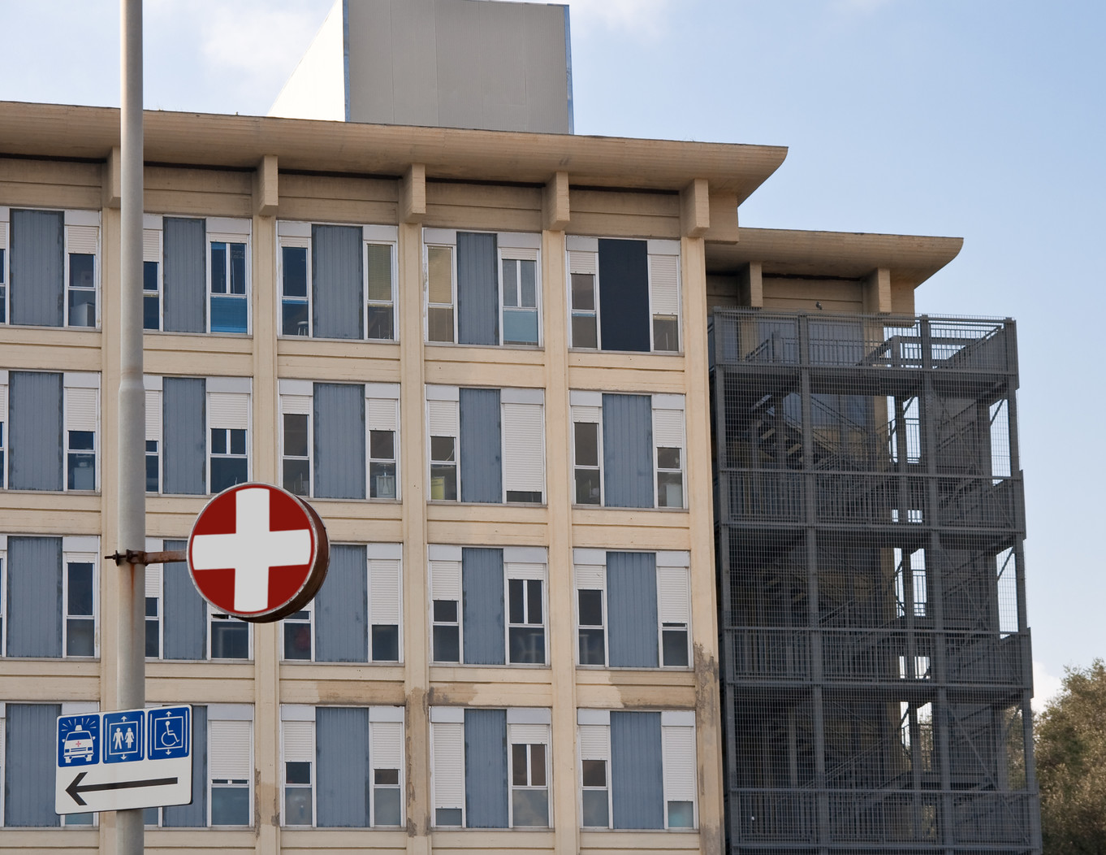
Scenario
SIMULATION ONLY
Heroes Hospital is a 300 bed tertiary facility in the capital. The hospital operates on average at 90-95%capacity. (floor plan in handouts)
The hospital was the site of an ongoing pseudomonas aeruginosa outbreak in the NICU, ICU, Surgical and Clinical wards from November 2018-November 2019. During this period 247 patients developed infections including pneumonia and sepsis and 19 died, including 2 children from the NICU.
There have only been 2 new infections detected since November 2019, both pneumonia in adults in ICU, however both pediatric and adult surgical, ICU and clinical wards report colonization in 40-60% of patients.
Notes:
NICU – neonatal intensive care unit
ICU- intensive care unit

Slide 10
Session 1
Questions for discussion
What would IPC recommendations (including staffing) be for patients now that the MDRO is effectively endemic?
What surveillance would be ongoing for pseudomonas aeruginosa?
Would the current situation pose any challenges in patient bed occupancy and staffing?
What kind of training or other activities would keep staff alert to the need for IPC measures in the presence of high colonization but few infections?
20 mins
Notes:
MDRO- multi-drug resistant organism

Slide 11
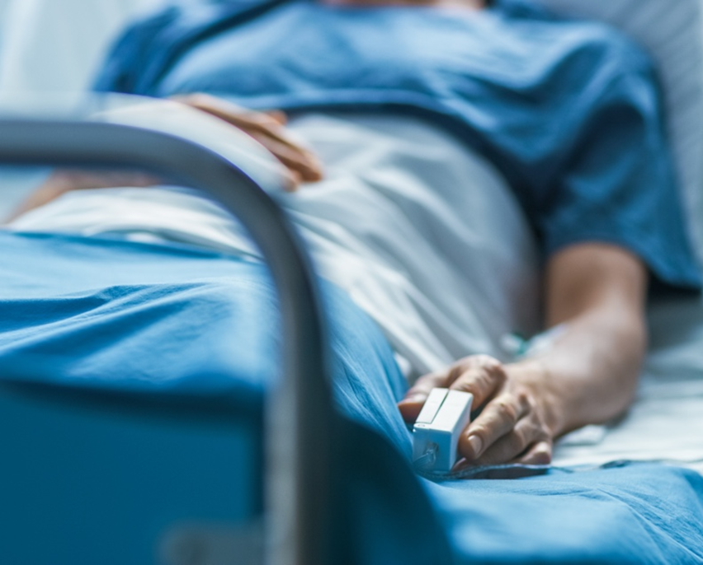
Scenario update
SIMULATION ONLY
A 62-year-old man on the surgical ward (colonized) develops cough and fever (patient 1).
His daughter who brought him to the hospital for admission reports to the Emergency department with a high fever and difficulty breathing (patient 2). She reports that colleagues from the Malaysia, Singapore and South Korean offices of the company where she works had been visiting and they went to dinner several times. She received a call this morning from her boss that several of these colleagues are now positive for COVID-19.
Based on guidance from public health authorities, both patient 1 and 2 should be put in isolation and tested for the novel virus.
Notes:
2019-nCov the novel coronavirus currently causing illness in mutiple countries

Slide 12
Session 2
Questions for discussion
How will you confirm is either patient is infected with the novel Coronavirus? Where will the samples have to be sent to test for COVID-19?
What IPC measures should now be implemented for patients 1 and 2?
Where will Patient 1 be moved?
To what unit will patient 2 be admitted?
What other measures might be implemented regarding both patients?
30 mins

Slide 13
Session 2- Hospital administration meeting
Hospital administration calls a meeting to discuss the 2 cases and plan and determine priority actions including
Necessary guidelines and advice
Equipment needs
Training
Staffing
Cleaning requirements
Bed occupancy and staffing management in parallel with isolation needs from pesudomonas colonization
An IPCAF was recently completed for the hospital and is included in handouts
60 mins

Slide 14
Scenario update
SIMULATION ONLY
Five days later both patients are confirmed positive for COVID-19.
Patient 1 develops pneumonia and requires transfer to ICU.
Patient 1 had 22 identified contacts, all in the hospital or family who had visited. His wife, three nurses from the surgical ward, two radiology technicians, and a urologist have also tested positive for COVID-19. All have mild illness except for one radiology technician (patient 3), who also has asthma and has a high fever and labored breathing (contact list in handouts) and needs to be admitted for care.
Patient 2 had 48 contacts that were different from patient 1. Of these, three are currently positive, all with mild illness.

Slide 15
Session 3
Questions for discussion
Where will patient 1 be moved for intensive care ?
What can other wards do to prepare?
What IPC precautions and staffing assignments will be recommended for the hospitalized coronavirus cases?
What impact will these measures have on bed occupancy, staffing and PPE usage?
Do any measures change if a patient is colonized with an MDRO?
45 mins

Slide 16
ENDEX

Slide 17
Hot-Wash/Review of needs in countries
Based on strengths and gaps in the exercise, what are your priority actions in your own countries?
What will be the biggest challenges?
How can these challenges be reduced?

Slide 18
THANK YOU!
WHO RESOURCES
COVID-19
More
information
on
coronavirus

