Slide 1
Weight of evidence approach in the evaluation of efficacy dossier (Module 5)
Charles Wondji and Marco Pombi Assessors for PQT/VCP

Slide 2
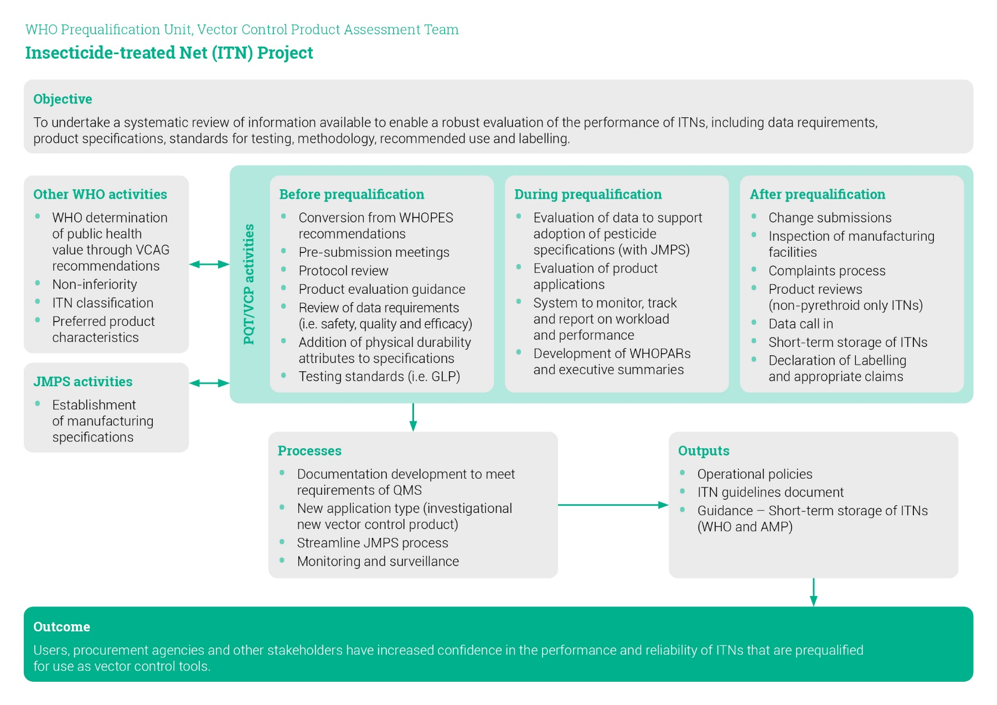
Decision to prequalify a VCP is based on
The substantiation of its performance through dossier evaluation

Slide 3
Evidence to support a reasonable expectation of product efficacy
The bioassays / trials chosen should be appropriate (sufficiently informative) to describe the product effect (e.g. killing, knock-down, repellency) on target species
Positive/negative controls
Study robustness
Consistency of rearing methods / trial setups
Potential entomological impact of the product in conditions / settings applicable to its intended use (outcome measures)

Slide 4
Evidence-based evaluation of product efficacy
Weight of evidence
Multiple lines of evidence are taken into account to support the conclusion about product efficacy
Stonger and more relevant evidences have greater wait in evaluating the overall dossier
(but all available data are taken into account as well)

Slide 5
Minimize the need for interpretation of information
Consistent approaches and criteria to data requirements, data generation, methodologies
Appropriate statistical analyses (according to bioassay-trial)
Variability in results should be properly discussed
Give access to raw data

Slide 6
Uncertainty and variability in decision-making process
Uncertainty: Some studies may present incomplete data (e.g. lacking some points/replicates), thus affecting the interpretation of the overall study
Variability: different results may be obtained among replicates or studies
5 washes
10 washes
15 washes
20 washes
Repl.1
Repl.2
Repl.3

Slide 7
Importance of species/strain selection and characterization
What work for mosquitoes does not necessarily for sand flies
Action of a product on Malaria vectors does not automatically imply action on arbovirus vectors (e.g. Culex, Aedes)
Geographic variability in species/population resistance (physiological, behavioural) should taken into account
Need to characterise the various species/strains before claiming efficacy

Slide 8
Thank you for your attention

