Slide 1
Assessing the regeneration time of insecticide treated nets
By
Dr. Corine Ngufor
18-20th October 2022, Geneva
WHO/PQT ITN guideline consultation meeting

Slide 2
What is regeneration time?
Long-lasting insecticidal nets (LLINs) - retain their biological efficacy against vector mosquitoes over multiple washes when used by householders.
Insecticide is incorporated or coated onto the fibres of the net.
Washing depletes the insecticide from ITN surface - replenishes over time to restore biological activity
Regeneration time = time required for the reestablishment of observable intended effects (bioefficacy) of the active ingredients in a net (or fabric) after depletion by washing.

Slide 3
Why is it necessary to measure regeneration time of an ITN?
A candidate ITN must demonstrate wash resistance - capacity to retain its intended entomological effect against vector mosquitoes in laboratory bioassays and semi-field studies after a defined number of standardised washes.
Washing interval for wash resistance studies must align with the active ingredient regeneration characteristics of the ITN i.e Regeneration time
The regeneration time = interval that must be applied between successive washes in wash resistance studies.
RT can be determined in laboratory bioassays prior to washing of nets for wash resistance studies using established bioassay methods measuring entomological endpoints

Slide 4
Key points to consider when designing a regeneration time study
Sample preparation
Test organism (species/strain)
Bioassay method selection
Endpoints and positive controls
Study report considerations
Data analysis and interpretation
ITN design/construction

Slide 5
ITN construction/design - examples
No. of active ingredients e.g single AI, dual-AI design, triple AI design.
mode of action of each AI e.g mortality, sterilant etc
Spatial distribution of AI on ITN panels e.g homogenous vs. mosaic

Slide 6
Sample preparation for regeneration time studies
A minimum of 3 production batches of candidate ITN – should be same batches used for other data generation
RT bioassays should be performed on net pieces sampled from each fabric used in the construction of the candidate ITN under evaluation.
Cutting of net pieces for RT studies will depend on the design/construction of the candidate net and the distribution of the active ingredients of the different panels of the net.
Sampling of ITN pieces must consider the importance of characterization of potential inter- and intra-batch variability.

Slide 7
Cutting ITNs for Regeneration time studies
Cut 14 pieces/net measuring 25x25cm from 4 randomly selected whole nets
ITN pieces for RT studies can be a random selection from each fabric of the net
Sampling frame for a homogenous ITN

Slide 8
Sample preparation - continued
Cutting – size will depend on type of bioassay to perform e.g for typical WHO cone bioassays and tunnel tests – 25cmx25cm
Washing – shaker bath method, using soap and water, wash 3X to deplete a.i. from ITN surface
Storage – 30C between washes and between test
1-l beakers containing 0.5 l deionized water with 2 g/l of soap (pH 10–11) added
Introduced samples (25cmx25cm) individually
Placed into a water-bath at 30 °C and shaken for 10 min at 155 movements per minute.
Rinsed twice for 10 min in clean, deionized water – follow same procedure
Dry at room temperature and store at 30 °C in the dark between washes
Shaker bath

Slide 9
Strain selection for regeneration time studies
Selected strain should be relevant to the intended use of the ITN – should be vector of the disease(s) it is intended to impact
Selected strain should be susceptible to the AI under investigation.
The selected strains should be well-characterized in terms of the susceptibility to the AI(s) and the specific mechanisms of resistance, if applicable
The use of multiple species/strains in a regeneration study, can provide valuable information about:
E.g For ITN fabric with a mixture of AIs, the strains selected for each active ingredient should allow assessment of its regeneration time without any confounding effects from the companion active ingredient e.g dual AI ITNs containing pyrethroids.

Slide 10
Selection of Endpoints and controls for Regeneration time studies
Endpoints must be representative of the intended effect of the product and should align with the mode of action of the active ingredients involved e.g mortality, oviposition inhibition for IGR.
The selected endpoint should guide the method and controls to use for the study.
  Negative Control: untreated netting made of polyethylene or polyester.
  Positive control
  to validate the experimental procedures.
  should be selected based on the intent and design of the study, including the selection of method(s), endpoint(s), and species/strains, in order to support the assessment of the validity of the study.

Slide 11
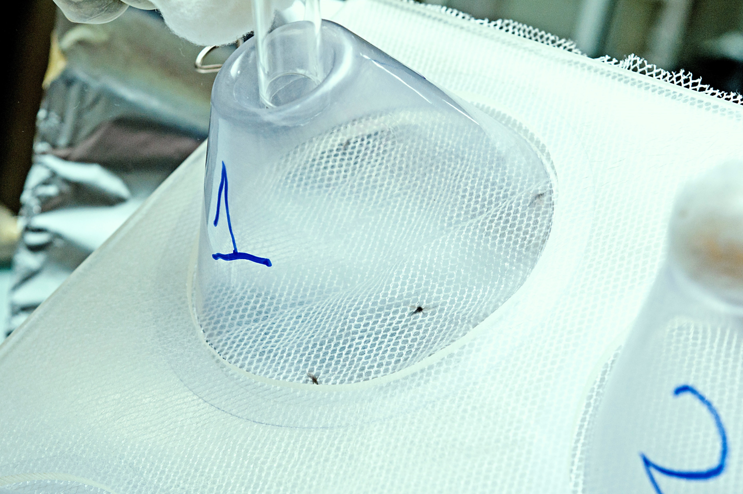
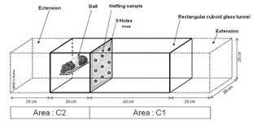
Experimental procedure
Unwashed net – bioassay
Wash 3 times on a single day - Day 0
Bioassay on 1, 2, 3, 5 and 7 days after washing
Record outcomes each day e.g Knockdown, mortality, fertility etc
RT=number of days required for outcome to reach a plateau
Cone test
Tunnel tests
- Method selected should be appropriate for the mode of action of the Ais e.g tunnels for chlorfenapyr
Temperature of 27 ±2° C and 75% ± 10% relative humidity

Slide 12
Interpretation of results
Bioassay results should be plotted on a graph (y axis - % response; x axis – days) in order to analyze the observed response over time.
Separate graphs should be prepared for each endpoint, each strain and each ITN fabric tested
Regeneration time should be assessed for the final endpoint of each AI as the number of days required to reach a plateau in response(s).
NB: Logistic regression can be used used to identify the response plateau.
For ITNs with multiple Ais where regeneration time differs between the constituent active ingredients, the longer regeneration time should be applied to the net during washing.

Slide 13
Changes in chemical content in relation to RT
ITN samples should also be assessed for chemical content:
Before washing – to ascertain quality of samples and determine significant changes in the product have occurred during the transport, receipt and handling of fabric samples
After 3x washing to quantify the loss of AI during sample preparation
After completion of the tests to quantify surface concentration and remaining AI reservoir
- Samples should be individually wrapped in aluminum foil and held at 4°C until chemical analysis

Slide 14
Final regeneration time study report
Study should be performed to Good Laboratory Practice
– in 2 laboratories?
Report should be comprehensive; describe methods, test items, test system, sampling, replication, endpoints, results, full data, graphs, changes in chemical content, discussion and conclusions.

