Slide 1

Methods for evaluating Insecticide Treated nets (ITNs)
Sarah J Moore
Consultation Session on revised WHO Guideline
Prequalification of Insecticide Treated Nets (ITNs) Guideline and Implementation Guidance
Geneva President Wilson Hotel 18th October 2022

Slide 2
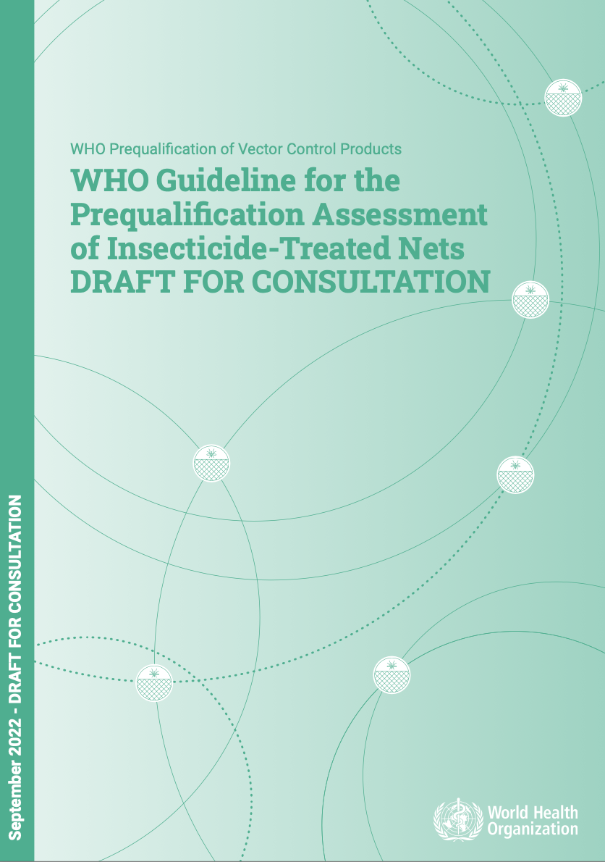
Methods similar to previous guidance, but manufacturer lead and flexible
Previous guidelines were robust for testing
  pyrethroid ITNs
  pyrethroid susceptible mosquitoes
New methods needed for
  new chemistries
  resistant mosquitoes
GLP will ensure traceability of data
Good experimental design and reproducible methods (bioassays) also required

Slide 3
Selection of methods will depend on label claim and study aim
Manufacturers define how to best test their product
Guidelines outline key considerations for testing
Methods are selected based on product “label claim”, product characteristics or intended effects

Slide 4
TEST SYSTEM (mosquitoes)
1) Species
2) Resistance
3) Circadian rhythm
4) Fitness
5) Anthropophagy
6) Age
7) Physiological status
8) Starvation
HOST
1) Body size
2) Attractiveness
3) Motivation / skill / training
4) use of soap / perfume / alcohol /tobacco
ENVIRONMENT
1) Temperature
2) Humidity
3) Airflow
4) Ambient light
PRODUCT
1) Active ingredient
2) Formulation
3) Preparation e.g. washes, use conditions
4) Storage conditions
BIOASSAY
1) Surface area : volume
2) Duration of exposure
3) Time of day
4) Insect density
5) Independence of observations
MEASURED EFFECT
Bioassay results depend on multiple factors
beyond product characteristics

Slide 5
Methods in guidelines focus on how to make bioassays reproducible
Consider appropriateness of selected method for the product
Ensure consistent use of the method within studies
Ensure consistent use of the method between facilities
Use the most appropriate test system (mosquito)
Flag any deviations from standardized procedures

Slide 6
Methods outline ways to make bioassays reproducible
Purpose of the method
Factors affecting test validity
How the method can be used within studies
Details on how to set up and conduct methods
Sources of variability and bias to be monitored & documented
Considerations for presentation of results

Slide 7
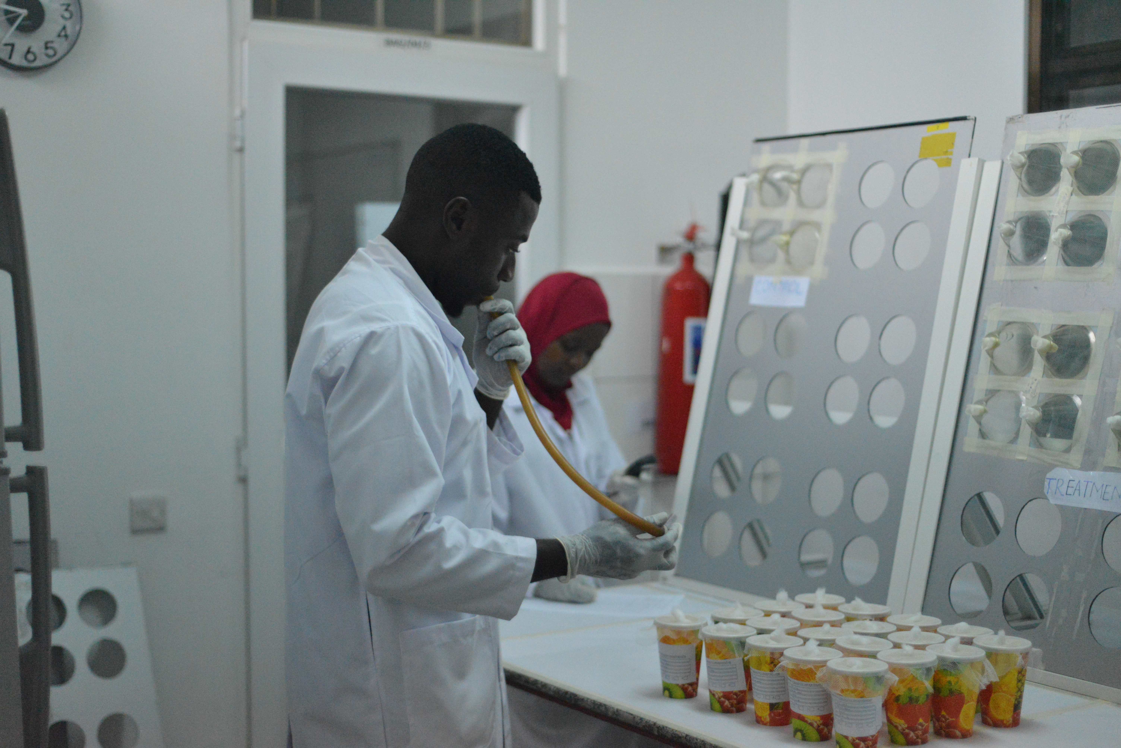
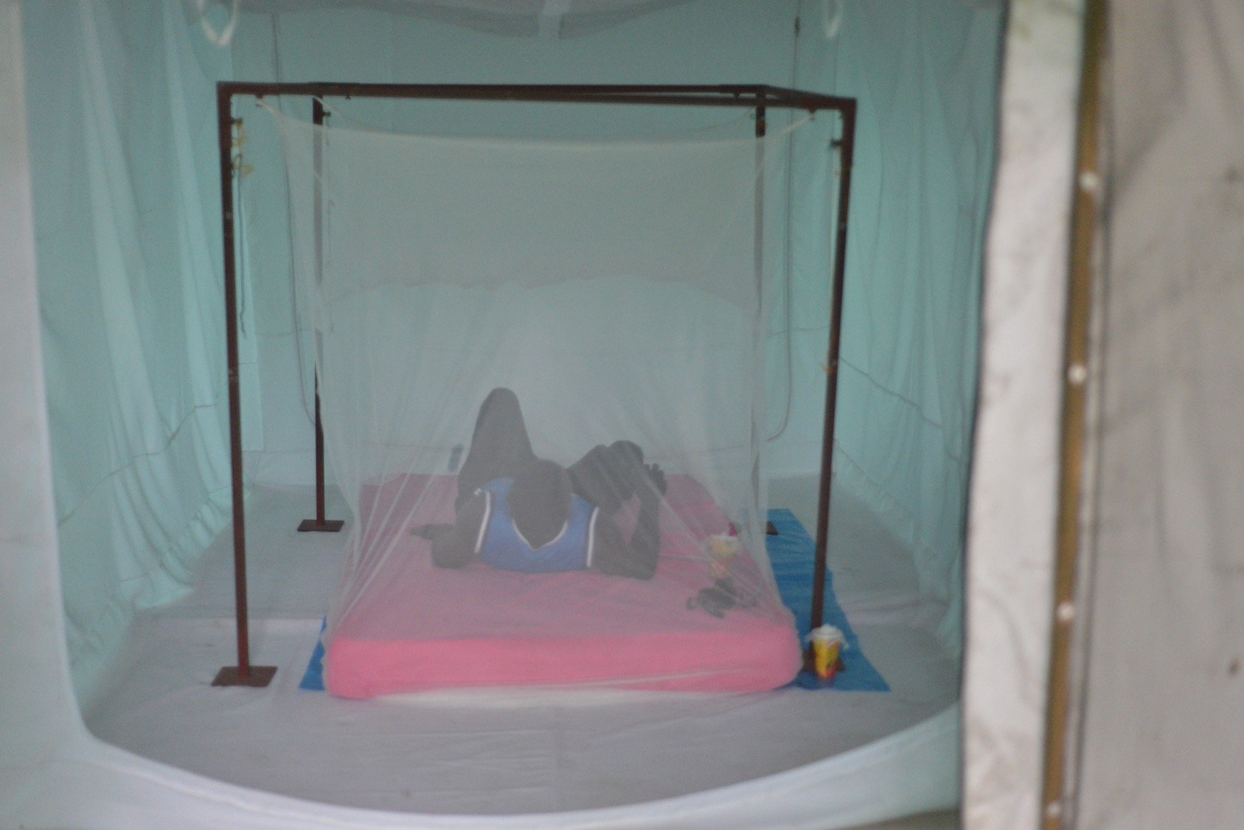
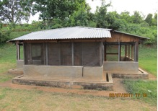
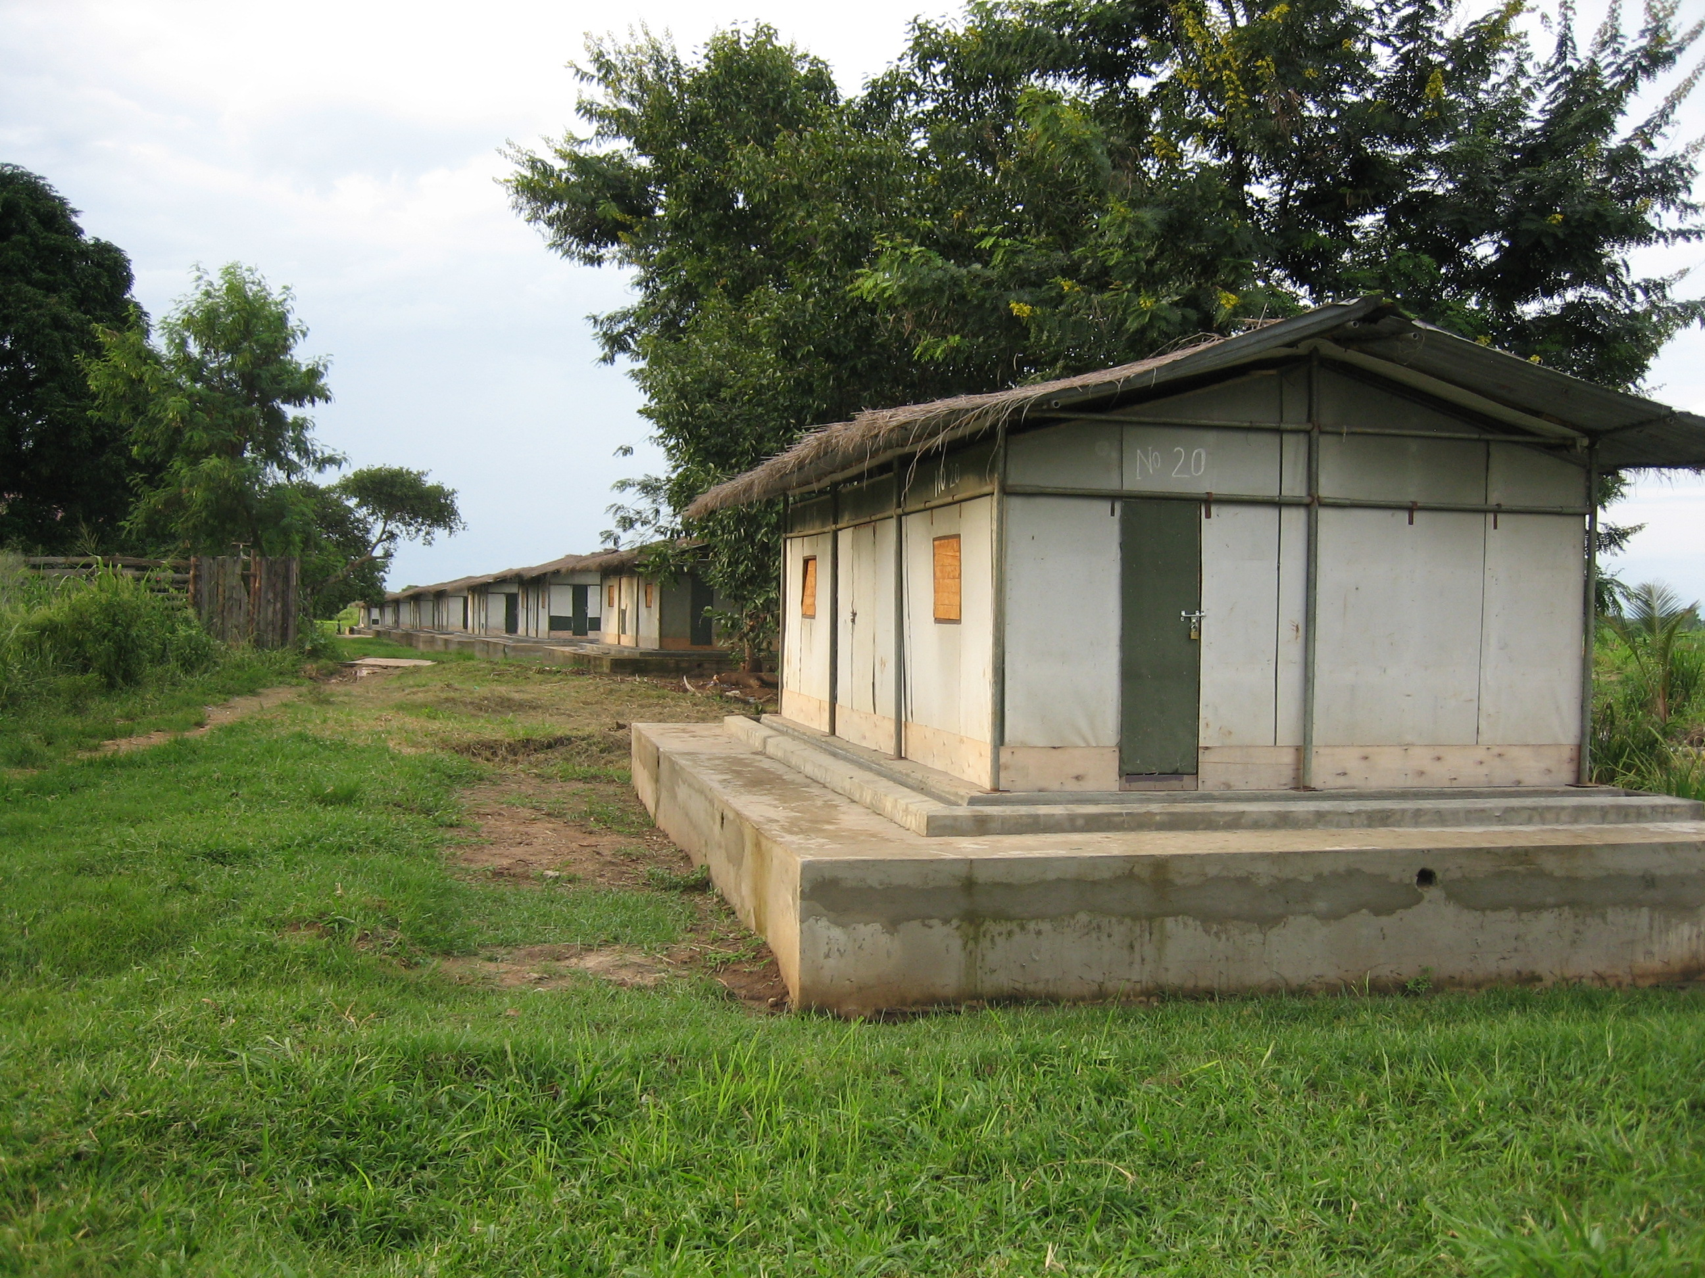
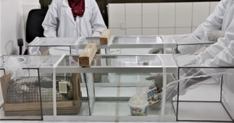
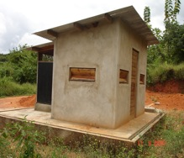
Bioassay methods included
CONE
HUT
TUNNEL
I-ACT
Laboratory (ITN pieces) ▷ Laboratory (whole ITNs) ▷ semi field (whole ITNs)

Slide 8



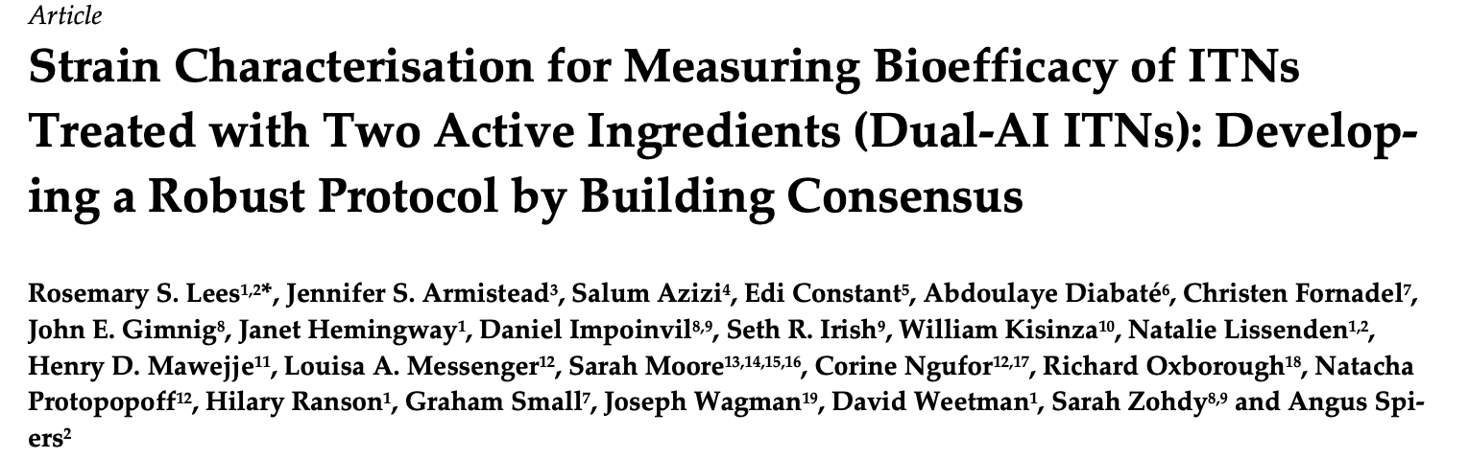
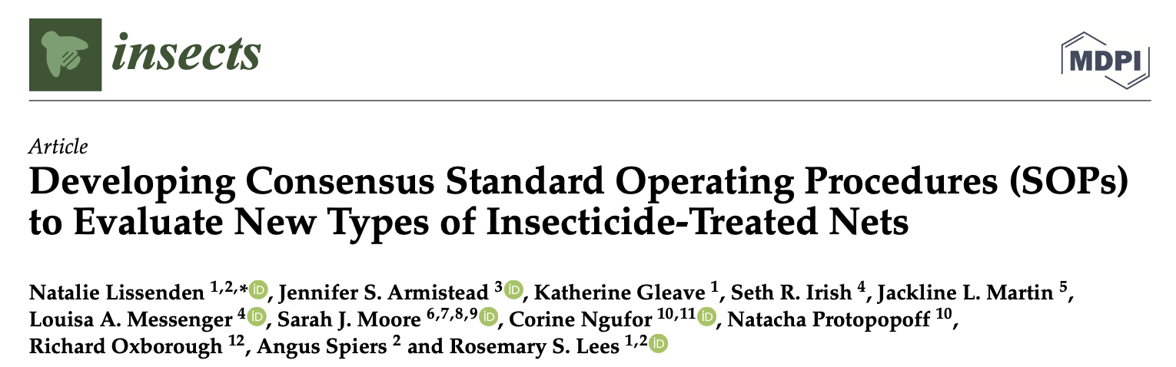
Guidance is based on existing consensus SOPs
Authors of consensus SOPs
Alex Wright
Rajpal Yadav
Graham Small
Luke Lucas
Dave Malone
Experts from
CREC, CSRS, IHI, IRD, IRSS, KCMUCo
LITE, LSTM, LSHTM
Main SOPs used
(from i2i / WHO / IVCC co-development)
Cone Bioassay
Tunnel Test
Experimental hut (5 SOPs)

Slide 9
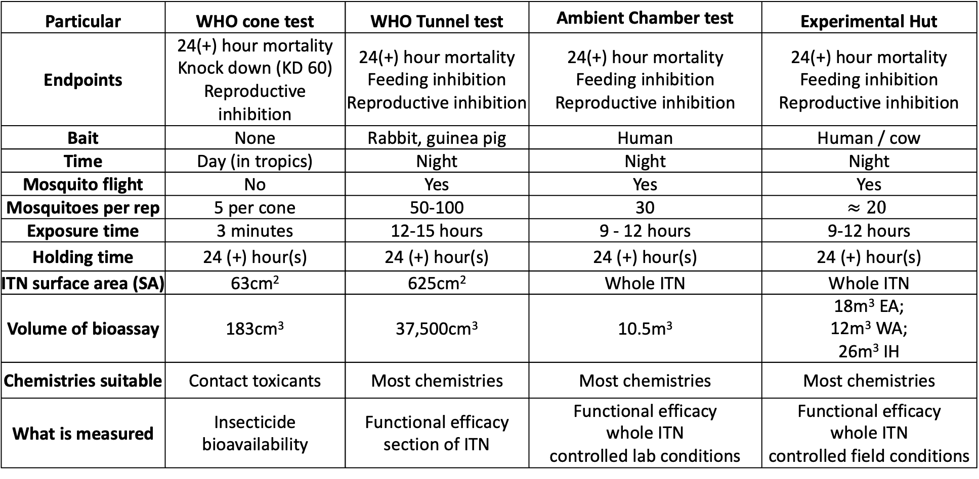
Summary of ITN bioassay methods
Particular | WHO cone test | WHO Tunnel test | Ambient Chamber test | Experimental Hut
Endpoints | 24(+) hour mortality Knock down (KD 60) Reproductive inhibition | 24(+) hour mortality Feeding inhibition Reproductive inhibition | 24(+) hour mortality Feeding inhibition Reproductive inhibition | 24(+) hour mortality Feeding inhibition Reproductive inhibition
Bait | None | Rabbit, guinea pig | Human | Human / cow
Time | Day (in tropics) | Night | Night | Night
Mosquito flight | No | Yes | Yes | Yes
Mosquitoes per rep | 5 per cone | 50-100 | 30 | $$≈20$$
Exposure time | 3 minutes | 12-15 hours | 9 - 12 hours | 9-12 hours
Holding time | 24 (+) hour(s) | 24 (+) hour(s) | 24 (+) hour(s) | 24 (+) hour(s)
ITN surface area (SA) | 63cm² | 625cm² | Whole ITN | Whole ITN
Volume of bioassay | 183cm³ | 37,500cm³ | 10.5m³ | 18m³ EA; 12m³ WA; 26m³ IH
Chemistries suitable | Contact toxicants | Most chemistries | Most chemistries | Most chemistries
What is measured | Insecticide bioavailability | Functional efficacy section of ITN | Functional efficacy whole ITN controlled lab conditions | Functional efficacy whole ITN controlled field conditions

Slide 10
Methods – cone test
Aim: investigate biological activity of test material’s surface under controlled laboratory conditions using optimized exposure
Test validity: -ve control mortality <10% @ M24 or <20% at >M24, environmental parameters
Outcomes: KD60, M24 + , fertility
Considerations: Test system, exposure time, time of conduct (day/night)
Benefits
Consistent, highly controlled
measures how ITN fabrics may change through their life stages
Suitable for: Contact toxicants (fast or slow mode of action), Insect growth regulators
Not suitable for
Chemistries that require mosquitoes to be metabolically active /
Measuring feeding inhibition

Slide 11
Methods – tunnel test
Aim: investigate biological activity of test material’s surface under controlled laboratory conditions using free flying and interaction with a host
Test validity:-ve control mortality <10% @ M24 or <20% at >M24, >50% blood feeding in control, environmental parameters
Outcomes: M24 + , blood feeding, fertility
Considerations: Test system, exposure time, time of conduct (day/night)
Benefits
consistent operation
measures how ITN fabrics may change through their life stages stages
Suitable for:
Most chemistries

Slide 12
Methods – experimental hut test
Aim: investigate the biological activity of a whole ITN under controlled user conditions using wild free flying mosquitoes and interaction with a host
Test validity criteria:
-ve control mortality <10% @ M24 or <20% at >M24
adequate replication dependent on local mosquito abundance
Measures: M24 + , blood feeding, fertility
Considerations: Local mosquito population resistance and behaviour, mosquito density
Benefits
“real world evaluation”
Links with epidemiological outcomes
Suitable for:
All chemistries

Slide 13
Methods – I-ACT test
Aim: investigate the biological activity of a whole ITN under controlled user conditions using laboratory free flying mosquitoes and interaction with a host
Test validity criteria: -ve control mortality <10% @ M24 or <20% at >M24
Measures: M24 + , blood feeding, fertility
Considerations: Test system, exposure time, time of conduct (day/night)
Benefits
Controlled “real world evaluation”
Suitable for:
All chemistries

Slide 14
Critical factors to consider when selecting the method
Entomological mode of action (MoA)
Justification for the selection of the test method
Consistent use of the method within studies and between sites
How the method will be used as part of the study to demonstrate product efficacy
New methods can be developed as new products are developed

