Slide 1
Developing the WHO guideline: Prequalification of Insecticide Treated Nets (ITNs) Meeting the needs of key stakeholders
Marion Law – Team Lead
Dominic Schuler – Case Manager WHO Prequalification/Vector Control Products (PQT/VCP) 18 October 2022

Slide 2
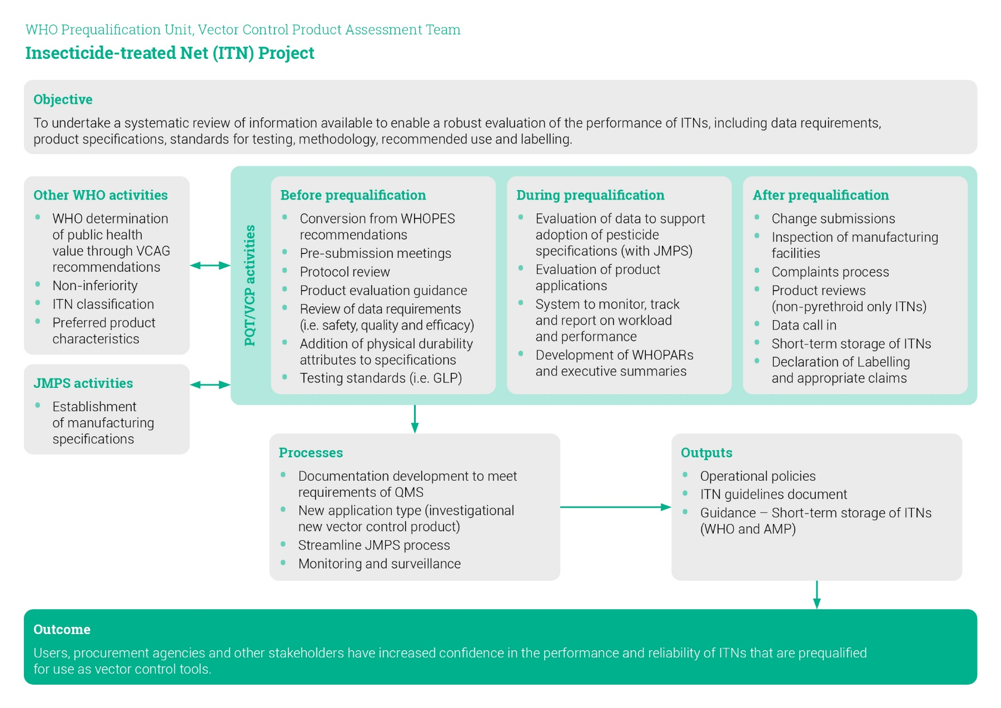
Insecticide Treated Nets – continue to be a priority

Slide 3
Purpose of this Consultation Session
Inform stakeholders of the process followed and approach taken to develop the Guideline
Share challenges we encountered
Seek input to the approach, proposed format and content of the Guideline and Implementation Guidance
Consolidate feedback and/or provide rationale for not including specific feedback
Develop next draft leading to finalisation

Slide 4
Guideline Development Principles
Reflective of the mandate of the WHO PQ/VCP and appropriate to the use of the product (commensurate to use and risk)
Reflective of existing products and that can evolve to meet needs of new interventions (flexibility)
Use established practices and systems where still relevant (efficiency)
Useful and user friendly and targeted to key stakeholders ( relevancy)
Collaborate and involve stakeholders and partners (transparency)

Slide 5
WHOPES ITN guidelines Served a different purpose
Targeted broader stakeholder audience
Focused on product development, testing and methods to generate data
Emphasized entomological testing which addressed aspects of quality and efficacy
Developed based on the WHOPES staged/phased approach (i.e. laboratory, experimental hut studies, large scale field studies)

Slide 6
WHO Guideline for Prequalification of ITNs Reflective of the role and mandate of the Prequalification process
Purpose and target audience
Explanation of PQT role, mandate and processes
Evidence-based operational policies supporting science and processes
Detailed science requirements to demonstrate quality, safety and efficacy, and methods for consideration
Format and presentation of data (dossier)
Assessment approaches
Documentation

Slide 7
New ITN guideline has specific goals
To address all aspects which support the prequalification of an ITN
To fill current gaps in information required to assess ITNs
To bring clarity to areas of confusion and misunderstanding
To apply consistent approaches and criteria to data requirements, data generation, methodologies, processes and policies
To provide more detail to minimize the need to make assumptions and to assist with the interpretation of supporting information
To strengthen product baseline information
To allow for evolution of science and methods within a robust framework

Slide 8
Considerations for new guideline development approach
Electronic format
Guideline (what is required) versus implementation guidance (how to fulfill the requirement)
Varying stakeholder needs
Data collection over the past 5 years
Experts who indicated their interest to contribute to the development of the guideline
Existing guideline content that is relevant, evidence based and peer reviewed
Notes:
Electronic format (layout, links, graphics, animation, photographs/diagrams, etc.)
Distinguishing the concept of guidance (what is required) and implementation guidance (how to fulfill the requirement)
Existing guideline content which is relevant, evidence based and peer reviewed (previous guidelines, existing norms and standards, publicly available information/literature)
Experts who indicated their interest to contribute to the development of the guideline
Valuable information obtained from 5 years of assessing PQT applications, product complaints, ITN Product Review, issues raised within the sector, information from numerous consultations, meetings and convenings
Varying stakeholder needs (Socialization through small FGDs with key stakeholders before major consultation)

Slide 9
New ITN guideline - transformational elements
Complete and comprehensive dossier provided to PQT/VCP for evaluation
No phased approach to decision making
Manufacturer is responsible for the generation of supporting data and compiling the completed dossier
Role of contract testing facility as a partner and for advice
Requirement for data to be generated in GLP accredited facilities
Role of contract testing facility as a partner and for advice
Supporting data requirements linked to appropriate product component
Results from bioassays provide information to support the quality of the ITN
Introduction of requirements to support physical durability
Requirements and guidance on the linking of the same data to support aspects of quality and efficacy, e.g., test sample preparation

Slide 10
Seeking feedback
Usefulness of the guideline design
Overall flow of the information and ease of use
Level of detail
Clarity
Gaps in the content
Areas of disagreement

Slide 11
Thank you

