Slide 1
Overcoming the challenges in local production to improve timely access of diagnostics
Wenjing Chen
General Manager
International Account & Project Department
SHENZHEN MINDRAY BIO-MEDICAL ELECTRONICS CO., LTD.

Slide 2
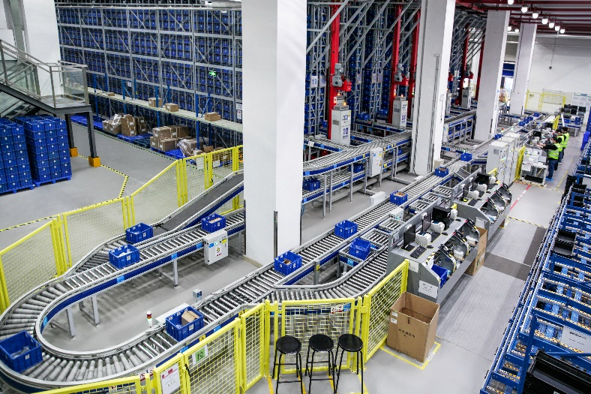
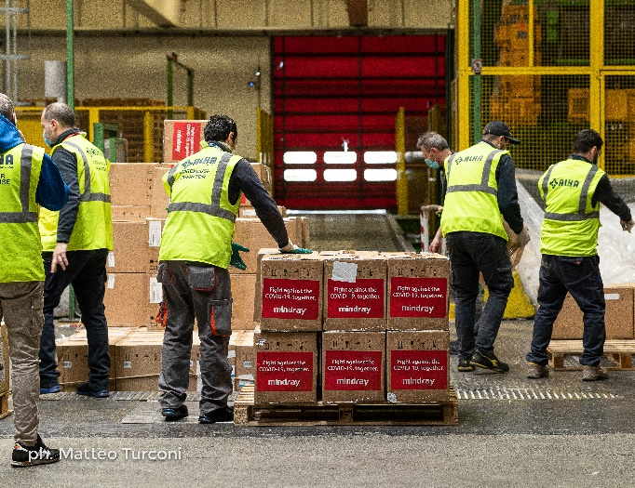
Improve access to diagnostics: a daunting challenge Trends towards Deglobalization
The pandemic adds momentum to the deglobalization trend with an increasing number of countries advocating for the production of goods and services within their own borders.
The importance of diversifying production is now acknowledged both nationally and internationally.

Slide 3
Improve access to diagnostics: a daunting challenge Trends towards Deglobalization
Transfer of Technology
Skilled Workers and Training
Support from Local Government
Sufficient Market
Demand
Ensuring the transfer of technology and maintaining quality standards is inherently very challenging.
Maintenance of
product quality and stability
Policy support :
Finance Investment
Law and Regulation
sufficient output is needed to maintain the operation of local production
Notes:
Deglobalization is also sometimes referred to a near-shoring, which is opting for sourcing in a country in the same region, or reshoring, bringing domestic product manufacturing back to your home country.
Although there are costs associated with deglobalization, the move to restructure your supply chain and find alternate suppliers can help build resilience to the next big disruption.

Slide 4
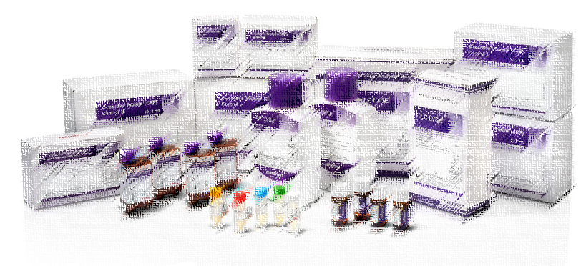
Improve access to diagnostics: a daunting challenge keep thinking globally and acting locally
Major Challenges
Shelf Life of Reagent
Raw Material
Unbalanced Regional Development
Adaptability to
Regulatory Changes
Logistics
Demand Sensing and Forecasting
Strategic Inventory Management
Investment in Quality Control
Regulatory Support and Compliance
Notes:
Providing widespread access is challenging for low-income and middle-income countries (LMICs). They have a disproportionately large share of the global burden of disease but a disproportionately low share of global healthcare resources.
The IVD supply chain is highly complex, involving a variety of raw materials, consumables, and equipment. The absence of any single link can lead to the stagnation of the entire production process.
Adaptability to Regulatory Changes
: The IVD market faces major challenges such as an uncertain regulatory environment, raw material shortages, and strict regulations on medical devices and testing. Particularly in the European Union, the regulatory approval timeline for IVD products is uncertain, and if regulatory authorities reject approval, investment in research and development may be wasted.

Slide 5
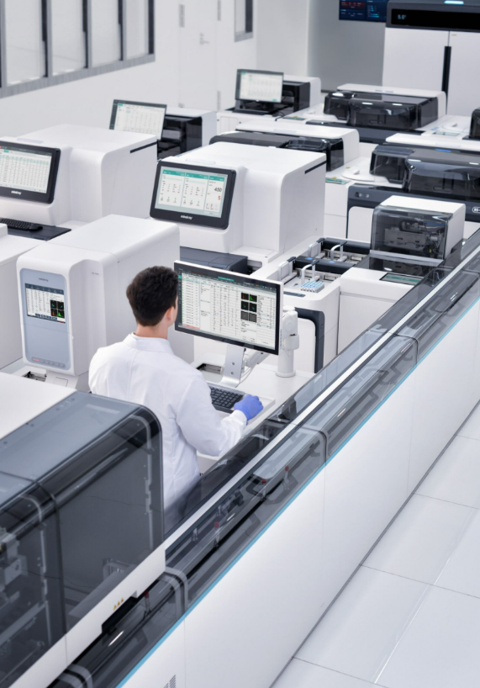
In-Vitro Diagnostics A trusted partner of labs of various sizes and test objectives
Mindray International Market
Instrument and reagent sales share
4.93 Billion USD
Total Revenue in
2023
410 Million USD
IVD Int. Market
2023
Reliable results
1.75 Billion USD
IVD Revenue in
2023
213 Million USD for reagent sales in 2023
23%
77%
2019

Slide 6
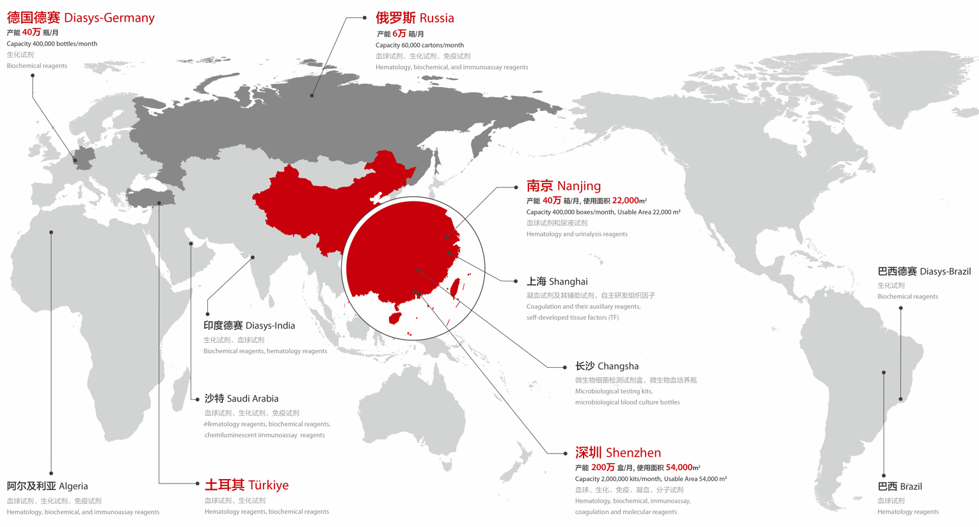
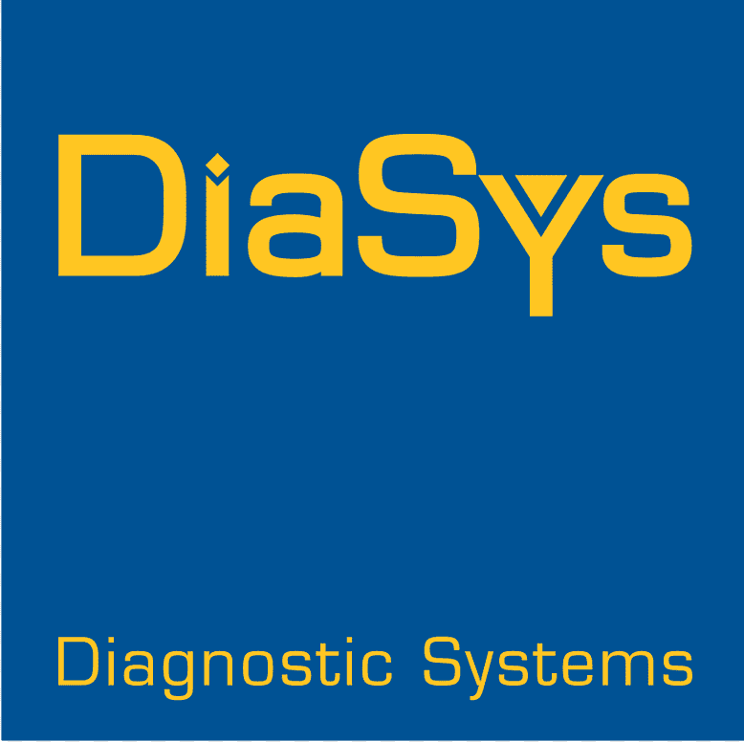
Localized Production
Improve overseas reagent supply chain platform
Chemiluminescent raw materials
Improve overseas supply chain platform
Notes:
Upon completion of the transaction, DiaSys will be integrated into Mindray's system. With a unified team, both parties will work closely together to enhance products, facilitate joint development, expand platforms, and execute the DiaSys integration plan orderly and smoothly. This strategic alignment aims to substantially strengthen Mindray's global competitive edge in the In-vitro diagnostics business.
About DiaSys
Established in 1991 and headquartered in Holzheim, Germany, DiaSys has over three decades of experience in the fields of In-vitro diagnostics reagents, calibrators, and controls. As the global pioneer in liquid-stable, ready-to-use biochemical reagents, DiaSys has established a solid reputation among its international customers. The company has built an extensive global supply chain system, with production facilities across Europe, APAC, and Latin America. DiaSys also possesses robust R&D and production capabilities in calibrators and controls, ensuring the delivery of top-quality products to its customers.
Going forward, Mindray will leverage DiaSys’ global supply platforms and international team of professionals to expedite overseas supply chain construction, in order to achieve the further expansion into medium to large volume customer segments worldwide, and offer more timely and comprehensive professional service to clients.
At the same time, DiaSys’ extensive experience in clinical chemistry is also expected to bring synergies to Mindray's IVD business. DiaSys’s ability to develop and produce IVD controls and calibrators will complement Mindray’s IVD product offering and enhance its system performance.

Slide 7
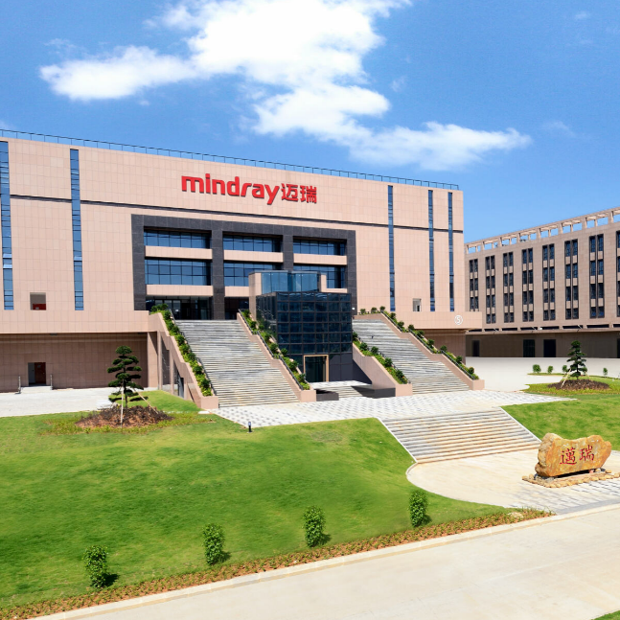
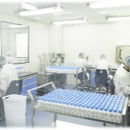
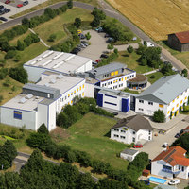
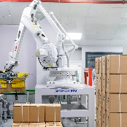
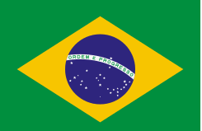
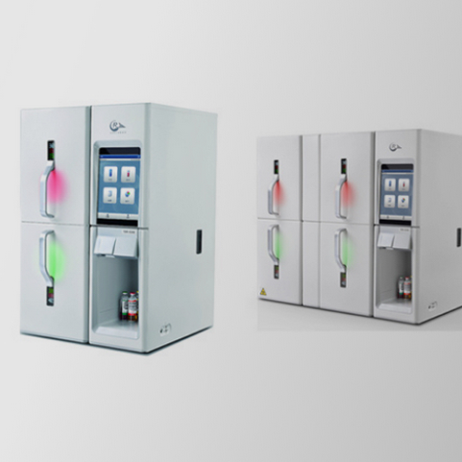
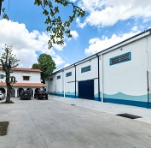
Localized Production
Improve overseas reagent supply chain platform
Self-build production
Mergers and Acquisitions
OEM Partners
Shenzhen
Guangming Base
HyTest
Finland Base
Algeria
Production Base
Major Production base
Focus on production of IVD raw material
Nanjing
Production Base
DiaSys
Germany Base
Turkey
Production Base
Main Product lines - domestic
hematology ragent
Main Product lines – biochemical reagents, covering 90 categories
Shanghai
Production Base
DiaSys
India Base
Brazil
Production Base
Focus on production of coagulation
reagents
Focus on production of IVD raw material
Changsha
Production Base
DiaSys
Kovalent Brazil Base
Saudi Arabia
Production Base
upcoming
Main product lines – biochemical reagents, covering over 70 categories
Focus on production of microbiology
testing kits, microbiology blood
culture bottles

Slide 8
VISION
Better healthcare for all
MISSION
Advance medical technologies to make healthcare more accessible
CORE VALUES
Align with our customers Value and enrich our people Be precise and practical Always forge ahead

