Slide 1
WHO’s role in strengthening the sustainability and quality of local production and technology transfer
David Woo
Technical Officer
Local Production and Assistance Unit
Innovation and Emerging Technologies
Access to Medicines and Health Products
World Health Organization

Slide 2
LPA Unit’s Mandate
Coordination and implementation of resolution WHA74.6: strengthening local production and technology transfer
• World Local Production Forum
• WHO Biomanufacturing Workforce Training Initiative
• Interagency statement on promoting local production
• Strategic partnerships with UN agencies, partners, etc. through interagency meetings/consultations and joint activities with UN agencies, partners, etc.
• Global database on capacities, market data, etc.
• Secretariat of TAG-LPTT
Global coordination and Partnerships
Country/regional support in local production & tech transfer
• Ecosystem assessments for sustainable, quality & green manufacturing
• Strategy/roadmap setting & implementation
• Facilitation of technology transfer & absorption
• Comprehensive capacity building & technical assistance
• Global resources related to local production & technology transfer
PQ/EUL-related specialized technical assistance
• Technical assistance and capacity building to manufacturers of medicines, vaccines, IVDs, etc. to speed up attainment of WHO PQ & EUL and ERP/ERPD

Slide 3
World Local Production Forum fosters global coordination & galvanizes collective action to strengthen local production
WLPF brings Member States and the global community (industry, academia, civil societies, UN agencies, etc.) across sectors to co-create solutions and synergize efforts
Ministers and 500+ delegates from 100+ countries attended virtually the 1st WLPF in June 2021
Greater private sector engagements were among the 3 recommendations of the 1st WLPF
The 2nd WLPF convened 20 Ministers and 1200+ delegates from 120 countries to The Hague in November 2023
The 2nd WLPF recommended 4 actions to address key gaps in the global ecosystem: create & strengthen national, regional & global ecosystems; develop a global database; establish a network to synchronize training; develop supportive policies for a conducive financial environment
The 3rd WLPF will be hosted by United Arab Emirates from 7-9 April 2025

Slide 4
WHO Biomanufacturing Workforce Training Initiative addresses the global need for training
Efforts in geo-diversifying local production are ramping up and innovative biotherapeutics are on the horizon
Sufficient skilled workforce are needed to meet the future demand
For Africa to produce & supply over 60% of the total vaccines needed by 2040, more than 10,000 need to be trained
Many LMICs continue to face significant challenges due to a shortage of skilled workforce
WHO established the WHO Biomanufacturing Workforce Training Initiative with 3 pillars
LPA
GTH-B
RTC
Global Training Hub for Biomanufacturing
Capacity building activities
Regional training centers
WHO Biomanufacturing Workforce Training Initiative

Slide 5
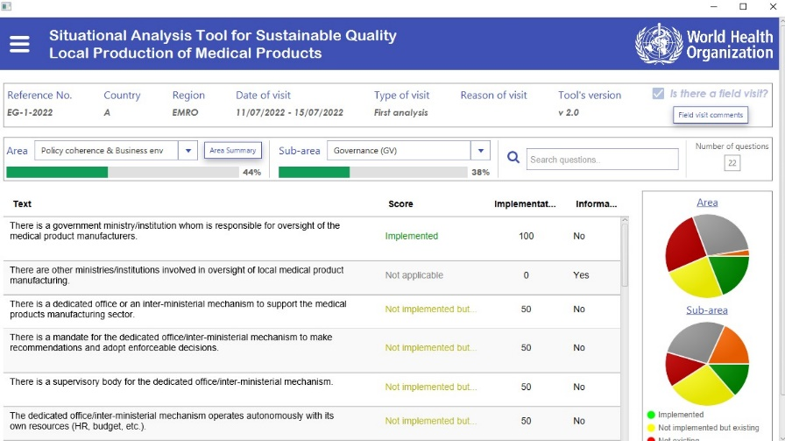
Ecosystem assessments are critical for sustainability of local production and technology transfer
Identify gaps in the ecosystem that hinder quality and sustainability
Provide evidence to prioritize actions to strengthen quality, sustainable, green local production
Screenshot of the digital tool for the ecosystem assessment
Inform the development of a holistic national strategy with Health in the driver’s seat

Slide 6
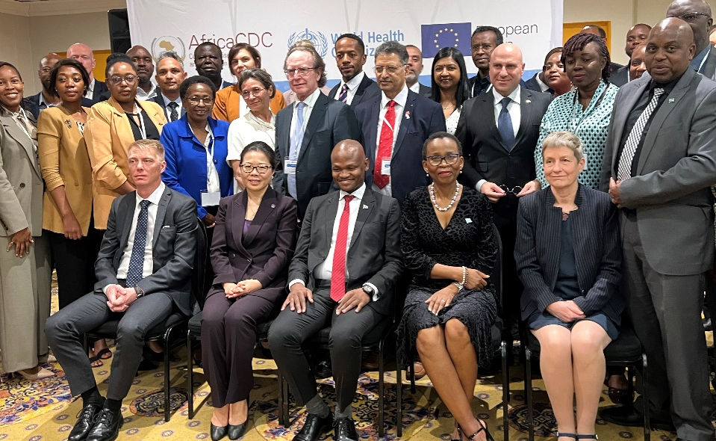
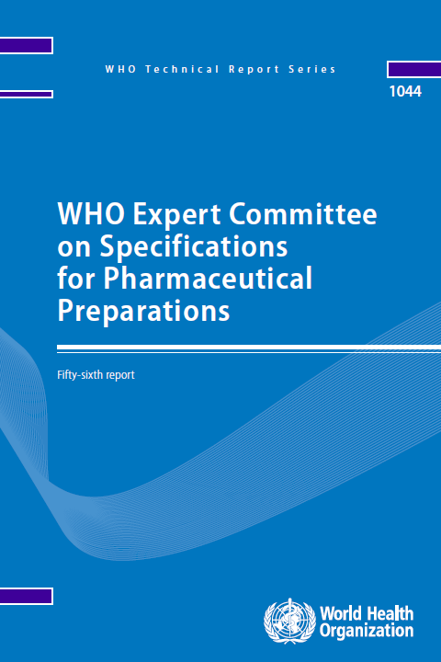
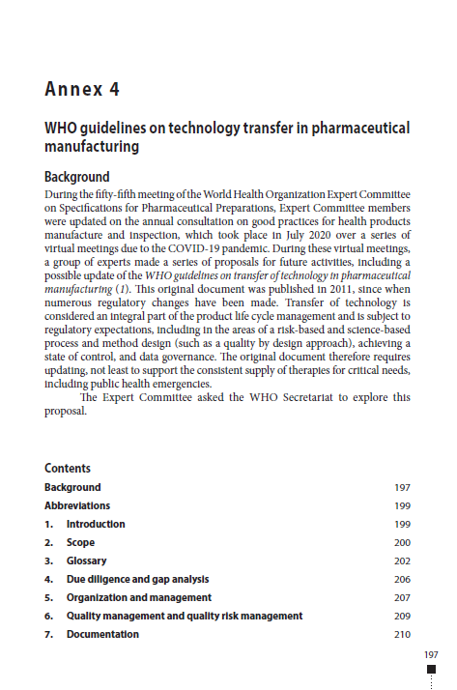
Facilitating technology transfer and absorption
WHO Guidelines on Technology Transfer in Pharmaceutical Manufacturing
WHO Technical Report Series No. 1044 (2022)
Technology transfer meeting in Gabarone convened African manufacturers & regulators, regional bodies, DFIs, academia, UN agencies & partners to co-create solutions to bottlenecks in transferring technologies into Africa
Technology transfer meeting in Gaborone opened by Honourable Dr Edwin Dikoloti, Minister of Health of Bostwana (seated, center)

Slide 7
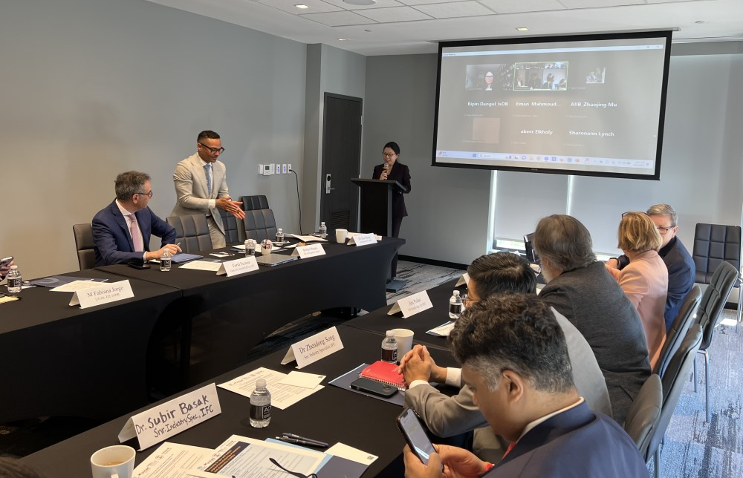
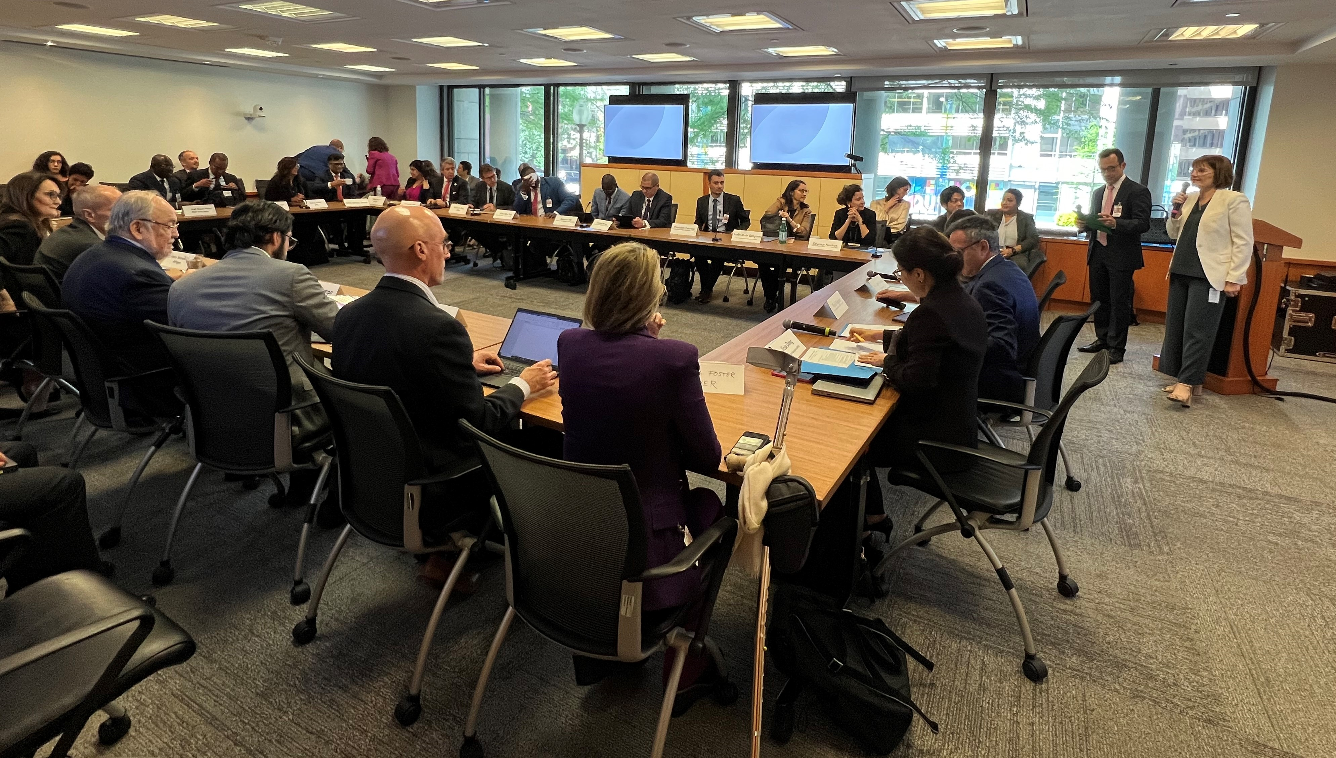
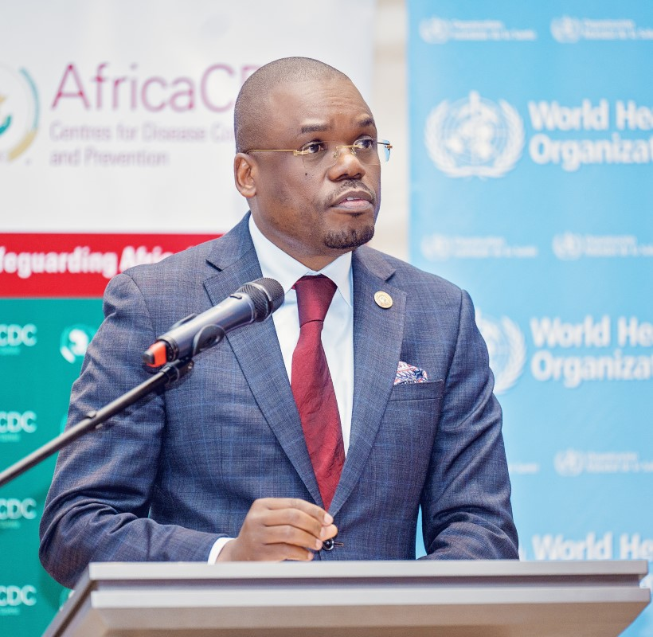
Private sector engagements in local production to foster technology transfers and partnerships
Private sector engagement forum in Nairobi provided a timely platform to foster partnerships and collective actions for sustainable local production in Africa among the 170+ African & international manufacturers, DFIs and other partners
Roundtables co-organized with IFC, Unitaid & partners during World Bank Group Spring Meetings 2024
Collaborations with IFC, Unitaid & partners for engagements with private sector on innovative financing mechanisms for strengthening local production
Private sector engagement forum in Nairobi opened by H.E. Susan Nakhumicha Wafula, Cabinet Secretary for the
Ministry of Health of Kenya (left) and Dr Jean Kaseya, Director General, Africa CDC (right)

Slide 8
Countries gaining skills to ensure sustainable local production and technology transfer of quality health products
Comprehensive range of training programmes are addressing the demand for skills training to build conducive ecosystems, achieve sustainability and ensure quality
~33-40% (avg) from African region
Since 2020, thousands of professionals were successfully trained to achieve quality and sustainable local production and technology transfer (e.g.):
Annual Virtual cGMP Training Marathon
Annual Week of Quality
Ecosystem strengthening workshops
Regional workshops for vaccine production
Other didactic and hands-on training
The chart is for pictorial purposes only

Slide 9
PQ/EUL-related specialized technical assistance (STA) speeds up attainment of WHO PQ/EUL
Manufacturers gain access to international, donor-funded procurement tenders and other procurement markets
STA is tailored, but it can include (e.g.):
Mock inspections, GMP gap assessments
Dossier gap assessments
Quality issues (e.g. specifications, quality control)
Since 2020, 26 manufacturers of medicines, vaccines & IVDs are currently receiving STA for 32 products
IVD: in-vitro diagnostics MED: medicine VAX: vaccine

Slide 10
Thank you
For more information and updates:
https://www.who.int/teams/regulation-prequalification/lpa
localproduction@who.int
LPA_Worldwide

