Slide 1
Enabling participation, inclusiveness, respect, safety Zero tolerance policy
Notes:
WHO is committed to enabling events where everyone can participate in an inclusive, respectful and safe environment.
WHO events are guided by the highest ethical and professional standards, and all participants are expected to behave with integrity and respect.

Slide 2
Notes:
WHO is committed to enabling events where everyone can participate in an inclusive, respectful and safe environment.
WHO events are guided by the highest ethical and professional standards, and all participants are expected to behave with integrity and respect.

Slide 3
Ensuring Health Equity:
Partnerships For Accessible Quality Products
Marta Seoane Aguiló
Department of Communications, WHO, Geneva
seoanem@who.int
@martaseoaneWHO
Notes:
Welcome everyone to the annual joint meeting of the UN Agencies , manufacturers and suppliers of in vitro diagnostic products, vaccines & immunization devices, finished pharmaceutical products, active pharmaceutical ingredients, contraceptive devices and vector control products
A pleasure to be your facilitator today
My name is Marta Seoane Aguilo, Team Lead of the External Relations Communications Team, part of the dept of comms in Geneva, headquarters of the WHO
Delighted to be here and help you move through the first day of this meeting, taking place in plenary.
Many in the room (many not new – ask?) Hope you all had safe travels.
But also, with colleagues and partners who are joining us remotely.

Slide 5
Other things you can do to help
Remember:
silent mode
Around
the building
Thanks for
being on time
Notes:
Always wear your Conference badge – Badge must be visible at all times
Check on the app where to go for food and drinks for an orderly and more nourishing process. Do not forget to return your badge on final day of meeting! Plenary meetings take place here – all day Monday.
Those familiar with the meeting, tomorrow and the next few days, there are different parallel meetings, for the various tracks. Check the app to find the location of where you need to be.
Reminder that tomorrow evening, after the meetings, there is a reception here in this building – we hope everyone can attend. Opportunity to further network.

Slide 6
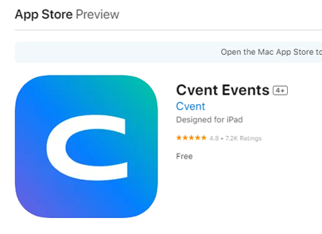
Don’t forget to get the word out! Digital : Event App & Social media channels
@UNICEF
@UNFPA
@WHO , World Health Organization
#accesstomedicines
Thanks for engaging!
Notes:
Wi-Fi network: “UN City Guest” (no password needed)
Check regularly the Joint Meeting page at https://extranet.who.int/pqweb (under tab «Events») and the Joint Meeting app – connect with participants, exchange ideas, ask questions, reach out to the colleagues in the organization who are also our experts and our helpdesk
Contact us, participate
Mario Musonda

Slide 7
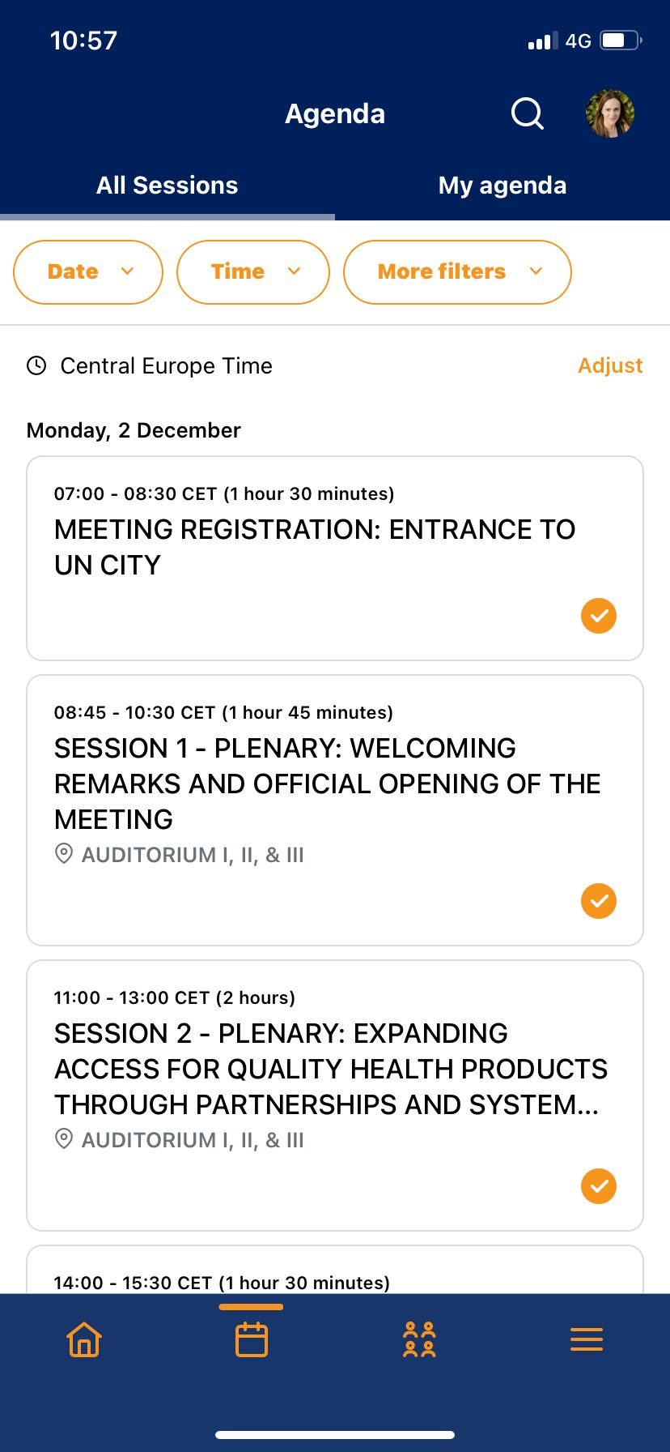
Key app functions
Notes:
Schedule – General Agenda and Sessions registered for:
on the smartphone: available on the bottom -> calendar icon; Top of App in orange «Schedule»
On the web version of the App: Top of page under «Agenda» and «My Agenda» to sessions registered for
Networking – Participants List; Discussions & Game(s)
On the smartphone: bottom icon with 4 people (List of participants – direct messaging)
Game center under last bottom icon (3 lines) – further information also availabel under this icon
On web version: Tope of page under «Networking»
Profile – Registered profile – Game stats
On the smartphone: click on your picture upper right corner
On web version: click on your picture upper right corner
“View profile”

Slide 8
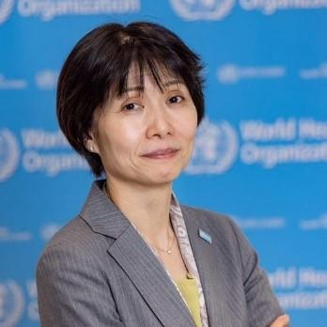
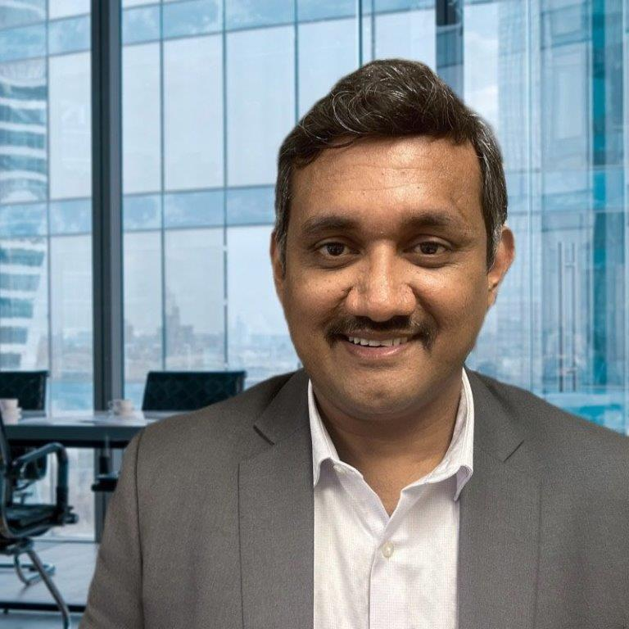
Welcome from host agencies
Srinivas Rajan
Officer In Charge/Quality Management Advisor
Supply Chain Management Unit UNFPA
Kennedy Ongwae
Deputy Director Supply Programme Supply Division
UNICEF
Yukiko Nakatani
Assistant Director-General
Access to Medicines and Health Products
WHO

Slide 9
Some questions for you
Please open your app
Notes:
Questions
Tell us what region you’re joining us from
What do you expect out of this meeting?
WHO Listed Authorities – 36 from 34 Member States.

Slide 10
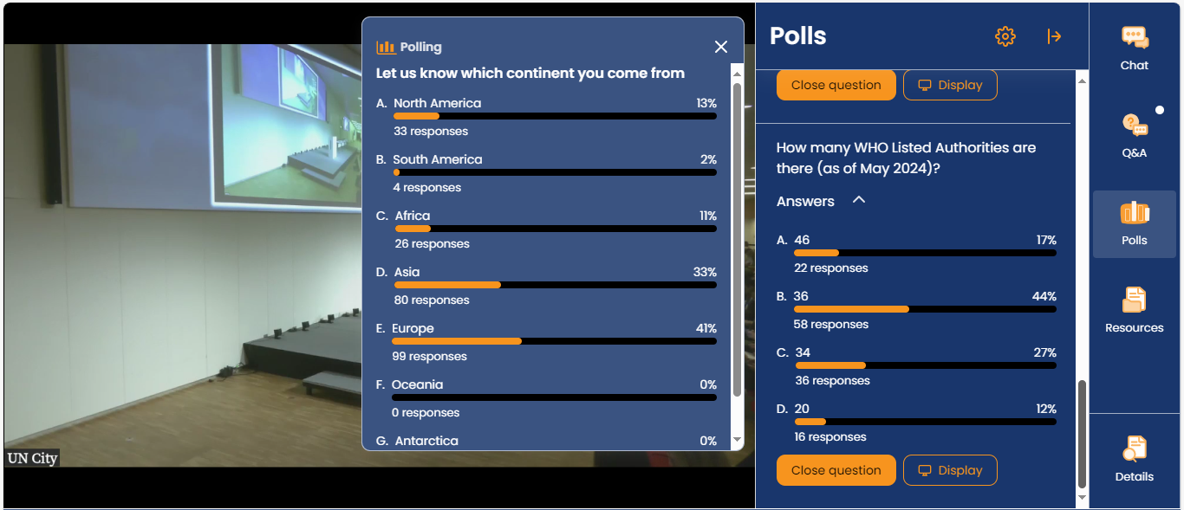

Slide 11
More than half first-time participants

Slide 12
…we’ve done our best
Guidance speakers/facilitators
Q&A and engagement compulsory
More discussions (and less ppts!)
Reception format → dialogue
More NRAs invited
Improved app
Thanks for your responses!
Still winter! … BUT…. hot food
Notes:
Avoid repetitive presentations / time management!
97% found the topics relevant and 92 found it was well organized. With 8 out of 10 being satisfied.
Still, 66% asked for a meeting during spring or summer,

Slide 13
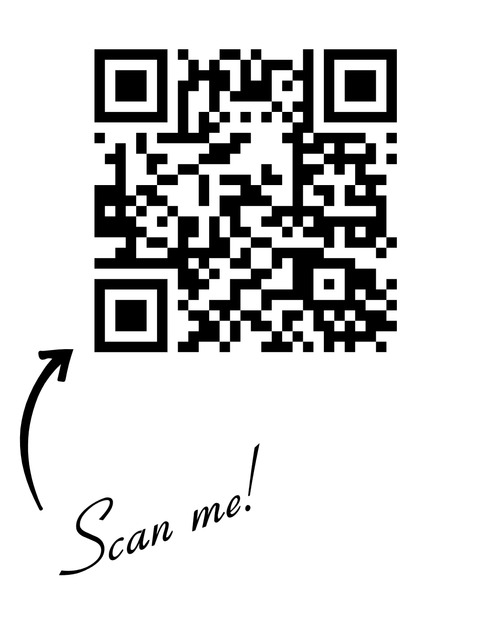
Our starting point – takeaways from the meeting: equitable access through innovation and collaboration
PQ focus on expanded scope and updated guidance
Alignment of WHO normative and prequalification for timely access to innovations.
Innovations across tracks
Progress with WLAs
WLPF - global/regional mapping collaboration financial environment
New projects - manufacturing support - tech transfer & local capacitates
Innovation in Partnerships for local African Vaccines manufacturing
New modalities for collaboration and new initiatives?
Notes:
We had a few takeaways from last year – a few requests coming from your work ont eh parallel sessions and also some
World Local Production Forum

Slide 14
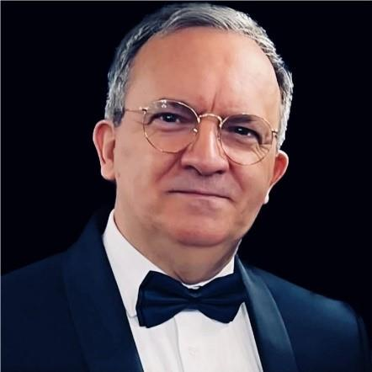
What to expect?
Objectives, Agenda, Themes and Expected Outcomes
Rogerio Gaspar
Director
Regulation and Prequalification
World Health Organization

Slide 15
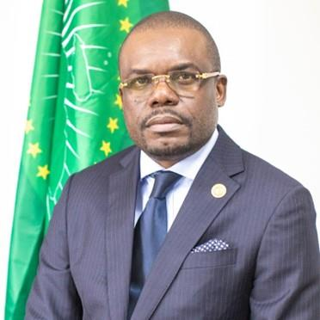
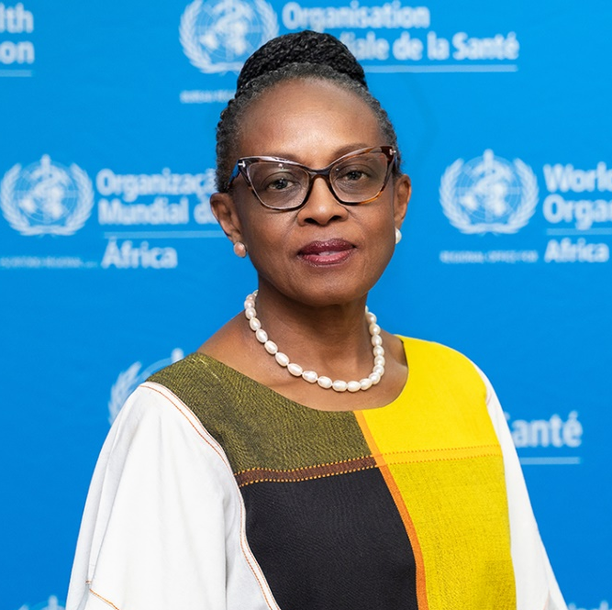
Keynote
H.E Dr Jean Kaseya
Director-General of the Africa Centres for Disease Control and Prevention (Africa-CDC)
Dr Matshidiso Moeti
WHO Regional Director for Africa

