Slide 1
SARS-CoV-2 AgRDT Self-test
Ute Ströher, PhD

Slide 2
WHO EUL & SC2 AgRDTs intended for self-testing
Requirements for the validation of SC2 AgRDTs intended for self-testing are in development as an Annex to PQDx-347 (Instructions and requirements for Emergency Use Listing (EUL) Submission: In vitro diagnostics detecting SARS-CoV-2 nucleic acid or antigen)
Applications to be accepted soon
For updates: https://extranet.who.int/pqweb/vitro-diagnostics/coronavirus-disease-covid-19-pandemic-%E2%80%94-emergency-use-listing-procedure-eul-open
https://extranet.who.int/pqweb/in-vitro-diagnostics

Slide 3
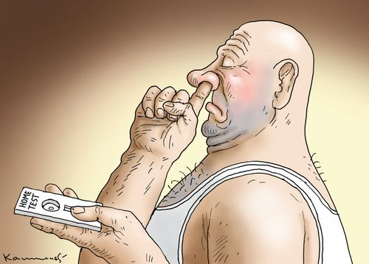
WHO EUL & SC2 AgRDTs intended for self-testing
General considerations
Specimen types
Prevalence – PPV/NPV
VOCs
Validation requirements developed for SC2 AgRDTs intended for POC/professional use are also applicable for SC2 AgRDTs ST
cartoonstock.com

Slide 4
Validation of SC2 AgRDTs
PQDx_347 v6: Instructions and requirements for Emergency Use Listing (EUL) Submission:
In vitro diagnostics detecting SARS-CoV-2 nucleic acid or antigen
 | POC/professional use | Self-test
Analytical performance | ✓ | ✓
(stability, LOD, cross-reactivity etc)
Clinical performance | ✓ | ✓
(prospective, stratified by days post symptom onset, including a range of Ct values)
Qualification of Usability |  | ✓
(Labelling comprehension, results interpretation & observer untrained user studies)

Slide 5
Usability studies
Study | Specimens | # lay users | Comments
Labelling Comprehension Study | Questionnaire-based | ≥100 | comprehend key messages from packaging and labeling & follow up actions participants must be representative of intended users
Result Interpretation Study | Interpretation of contrived test devices non-reactive range of invalid results reactive weak reactive | ≥100 | simulated devices should be static and stable colour intensity of test or control lines should not change over time
Observed Untrained User Study | prospective symptomatic | 2 different sites ≥90 per site ≥30 positive per site (≥180 in total) | Comparator results: Test result read by a professional observer NP/OP NAT result
Software Usability Studies | Questionnaire-based | ≥100 | Software installation Maintenance activities Error messages
DRAFT

Slide 6
Abridged assessment – SC2 AgRDT ST
 | WHO EUL’d products (POC) | FDA/HC/TGA authorized products
QMS assessment | TBD | ✓
PMS report | ✓ | ✓
‘Mini-dossier’:
Product information/design | ✓ | ✓
Risk assessment | ✓ | ✓
Product stability for ST config. | ✓ | ✓
Analytical sensitivity | Specimen type claimed for ST | Specimen type claimed for ST
Clinical study | Specimen type claimed for ST | Specimen type claimed for ST
Usability study | PQDx_347 | PQDx_347 or FDA/HC/TGA
Labelling review | ✓ | ✓
Post-listing activities (PMS, CR) | ✓ | ✓
Independent lab evaluation | possible | possible
DRAFT
* Stringent regulatory authority – to be confirmed

Slide 7
Thank you!

