Slide 1
11
Training users

Slide 2
Disclaimer
WHO Health Security Learning Platform – Training Materials
These WHO Training Materials are © World Health Organization (WHO) 2022. All rights reserved.
Your use of these materials is subject to the “WHO Health Security Learning Platform, Training Materials – Terms of Use”, which you accepted when downloading them and which are available on the Health Security Learning Platform at: https://extranet.who.int/hslp.
Should you adapt, modify, translate, or in any other way revise the contents of these materials, you shall not imply that WHO is in any way affiliated with such modifications and shall not use the WHO name or emblem in such modified materials.
Furthermore, please inform WHO of any modifications of these materials that you use publicly, for record-keeping purposes and continued development, by emailing ihrhrt@who.int.

Slide 3
Learning objectives
At the end of this workshop, you will be able to:
apply basic principles of adult learning to training
use the training methods discussed in this workshop to facilitate a SARS-CoV-2 Antigen RDT User Training workshop.

Slide 4
Key points for facilitating a training
What I hear, I forget…
What I hear and see, I remember a little…
What I hear, see and discuss, I begin to understand…
What I hear, see, discuss and do, I acquire knowledge and skill…
What I teach to another, I master…

Slide 5
Key points to remember when training others
You already know a lot about training and health.
You have much to share with others.

Slide 6
Training basics
Know your audience.
Use adult learning principles.
Be prepared.
Manage the training.
Communicate effectively.
Engage the participants.

Slide 7
Why know your audience?
Knowing your audience helps you to…
Design and adapt your training
Choose the right participants for the training
Omit unnecessary content

Slide 8
Getting to know course participants
Use a “get-to-know-you” exercise.
Ask participants to share their expectations of the course.
Talk with them before the training starts, during breaks, etc.

Slide 9
Training adults

Slide 10
Adult learners versus children¹
Adults are autonomous and self-directed. They need to be free to direct themselves.
Adults have accumulated extensive life experiences and knowledge. They need to connect learning to this knowledge/experience base.
Adults are goal-oriented. They usually know what goal they want to attain and appreciate if the training programme helps them achieve that goal.
Adults are relevancy-oriented. They must see that learning is applicable to their work or other responsibilities.
Adults are practical. They focus on the aspects of the training that are most useful to them in their work and may not be interested in knowledge for its own sake.
¹ Modified from: Stephen Lieb, Principles of adult learning, 1991.

Slide 11
Training tips
Participants learn best when:
They are under low to moderate stress; if stress is too high, it becomes a barrier to learning.
They find the information provided and required tasks meaningful.
You listen to their needs and are flexible in your planning.
You change your approach if your methods are not working.
You recognize that adults bring a great deal of experience and knowledge to any learning situation; use it to improve their learning

Slide 12
Be prepared!
Practice before you train.
Know the material and how it is structured.
Use organizational skills to keep the training on task in the allotted time.
Demonstrate effective communication skills. Teach by example!
Use the skills you are trying to teach.

Slide 13
Preparing to train

Slide 14
Preparing the training rooms
Check the rooms before the training day (if possible).
Make sure the materials, supplies and equipment are available.
Arrange the training rooms to allow for the best learning situation.
Consider social distancing requirements when preparing the training venue, and consider organizing training in smaller groups.
Arrive early on the training day.

Slide 15
User training structure
Welcome and introduction (Module 01)
Preparing for testing (Modules 02−07)
Testing (Module 08)
Practical demonstration
User practice
Monitoring performance (Modules 09−10)
Self-testing (Module S1, optional)
Competency assessments
Thank you and close
Timing
The SARS-CoV-2 Antigen Rapid Diagnostic Test User Training Workshop should take approximately 5 hours (including practical) for a group of 5−10 participants per trainer

Slide 16
What you will need (1)
To conduct the user training, you will require the following:¹
Attendance register
User training slide presentations
Stationary for participants (e.g., one set of pens, paper per participant)
Printouts: SARS-CoV-2 Antigen RDT Competency Assessment (one per participant)
Printouts: SARS-CoV-2 Antigen RDT Result Recording Sheet (one per participant)
Printouts: SARS-CoV-2 Antigen RDT Reading Sheet (one per participant)
¹ See the SARS-CoV-2 Antigen RDT Testing Workshop − Trainers Guide and the Checklist of Training Materials

Slide 17
What you will need (2)
To conduct the user training, you will require the following:¹
Personal protective equipment (PPE), including gloves, gowns, eye protection or face-shields, and respirators (N95 or FFP2) (various sizes)
Pens for marking or labelling
Bleach, ethanol and paper towels to clean the workstation
Sufficient materials (test kits) for each participant to perform three practice tests
Sufficient materials (test kits) for each participant to perform two competency (proficiency) tests
¹ See the SARS-CoV-2 Antigen RDT Testing Workshop − Trainers Guide and the Checklist of Training Materials

Slide 18
What you will need (3)
To conduct the user training, you will require the following:¹
Soap for hand-washing
Leak-proof biohazard bags for containing or moving biohazard waste
Waste bins for biohazard bags
Two spray bottles (one for bleach, the other for ethanol)
Measuring devices for making bleach and alcohol solutions
Timers
Proficiency test materials (positive and negative controls)
SARS-CoV-2 Antigen RDT Logbooks
Thermometers
¹ See the SARS-CoV-2 Antigen RDT Testing Workshop − Trainers Guide and the Checklist of Training Materials

Slide 19
User training content
Refer to the SARS-CoV-2 Antigen Rapid Diagnostic Test Training Workshop –Trainers Guide on how to conduct the SARS-CoV-2 Antigen RDT Testing User Workshop.
Clearly articulate the goals and objectives of the training.
Before delivering the content, share the ground rules with the participants about how the training will be managed (e.g., mobile phones must be switched off, participants must give each other a chance to participate, etc.).
Clearly deliver the content, considering the participants’ existing knowledge of the subject.
For brevity, the presentations have been kept short. During the presentations, note additional topics in the “parking lot” and return to these at the end of the presentation.

Slide 20
Conducting a competency assessment (1)
The objective of the competency assessment (or proficiency test) is to determine whether participants have understood the content of the training, can perform the nasopharyngeal sample collection and SARS-CoV-2 Antigen RDT(s), and can interpret the test result:
Observe the participant collecting a nasopharyngeal sample and conducting a SARS-CoV-2 Antigen RDT. Use the Competency Form to record whether the procedures are performed correctly.
Ask the participant the theoretical questions and record whether they have answered correctly.
Provide the participant with the SARS-CoV-2 Antigen RDT Reading Sheet and record their interpretation of the test results and understanding of how to manage patients in their setting.
Score the competency assessment.

Slide 21
Conducting a competency assessment (2)
If participants pass the competency assessment, they can conduct testing.
If participants do not pass the competency assessment, they must be re-trained and the competency assessment must be repeated.
Monitor the performance of testers in the field:
Once participants pass a competency assessment and start testing patient samples routinely, a system should be put in place to monitor their performance.
This is covered in Module 09: Using SARS-CoV-2 data and Module 10: Assuring quality results.

Slide 22
Have a back-up plan
Be prepared for any (and all) problems by having a back-up plan.
Have extra supplies and materials.
Use multiple formats (handouts, slides).
Be flexible.
Make positive situations out of negative ones (e.g., if a participant doesn’t pass the competency assessment, turn it into a teaching experience).

Slide 23
Managing the training

Slide 24
Use your voice
Set the tone of the training.
Convey the training content.
Show enthusiasm.
Encourage participation.
Provide positive reinforcement.
Project your voice so everyone can hear you.
Vary your pitch.
Use a comfortable and varied pace.
Speak at the audience’s technical level.
Use a friendly tone.
Use a microphone if necessary.

Slide 25
Observe and listen
Observe participants | Use listening skills
Are participants engaged? Do participants understand? What is the energy level? What are the group dynamics? Who is not participating? | Listen to what participants are saying. Do they understand? Are there concerns? What are the needs of the participants?

Slide 26
Engage the participants
Use examples that relate to participants’ jobs/situations.
Ask questions during your presentations.
Encourage participants to contribute and share their knowledge and experiences.
Allow for differences of opinion.
Keep participants alert and engaged.

Slide 27
Ask questions to determine participants’ knowledge and understanding
Ask participants to:
explain complex issues
describe how they would apply the information to their jobs
repeat key content during the reviews.

Slide 28
Three types of questions
Closed questions | Open questions | Probing questions
Generate short answers (yes or no) Do not encourage discussion Limit what participants say | Invite descriptive answers to encourage discussion Encourage participation and sharing of knowledge | Generate additional discussion Encourage participants to go into further detail

Slide 29
Dealing with training difficulties

Slide 30
Ways to manage difficult participants
Maintain control.
Use verbal cues.
Use body language.
Refer to the previously established “ground rules” for the training.
Use the “parking lot” to note questions to return to at the end of training.
Give the person a specific task.
Talk to the person outside the classroom.
Never lose your “cool” or be rude.

Slide 31
When participants do not respond
Maintain a deliberate silence
Repeat or rephrase the question
Use body language/eye contact
Encourage answers
Give an example
Answer the question yourself

Slide 32
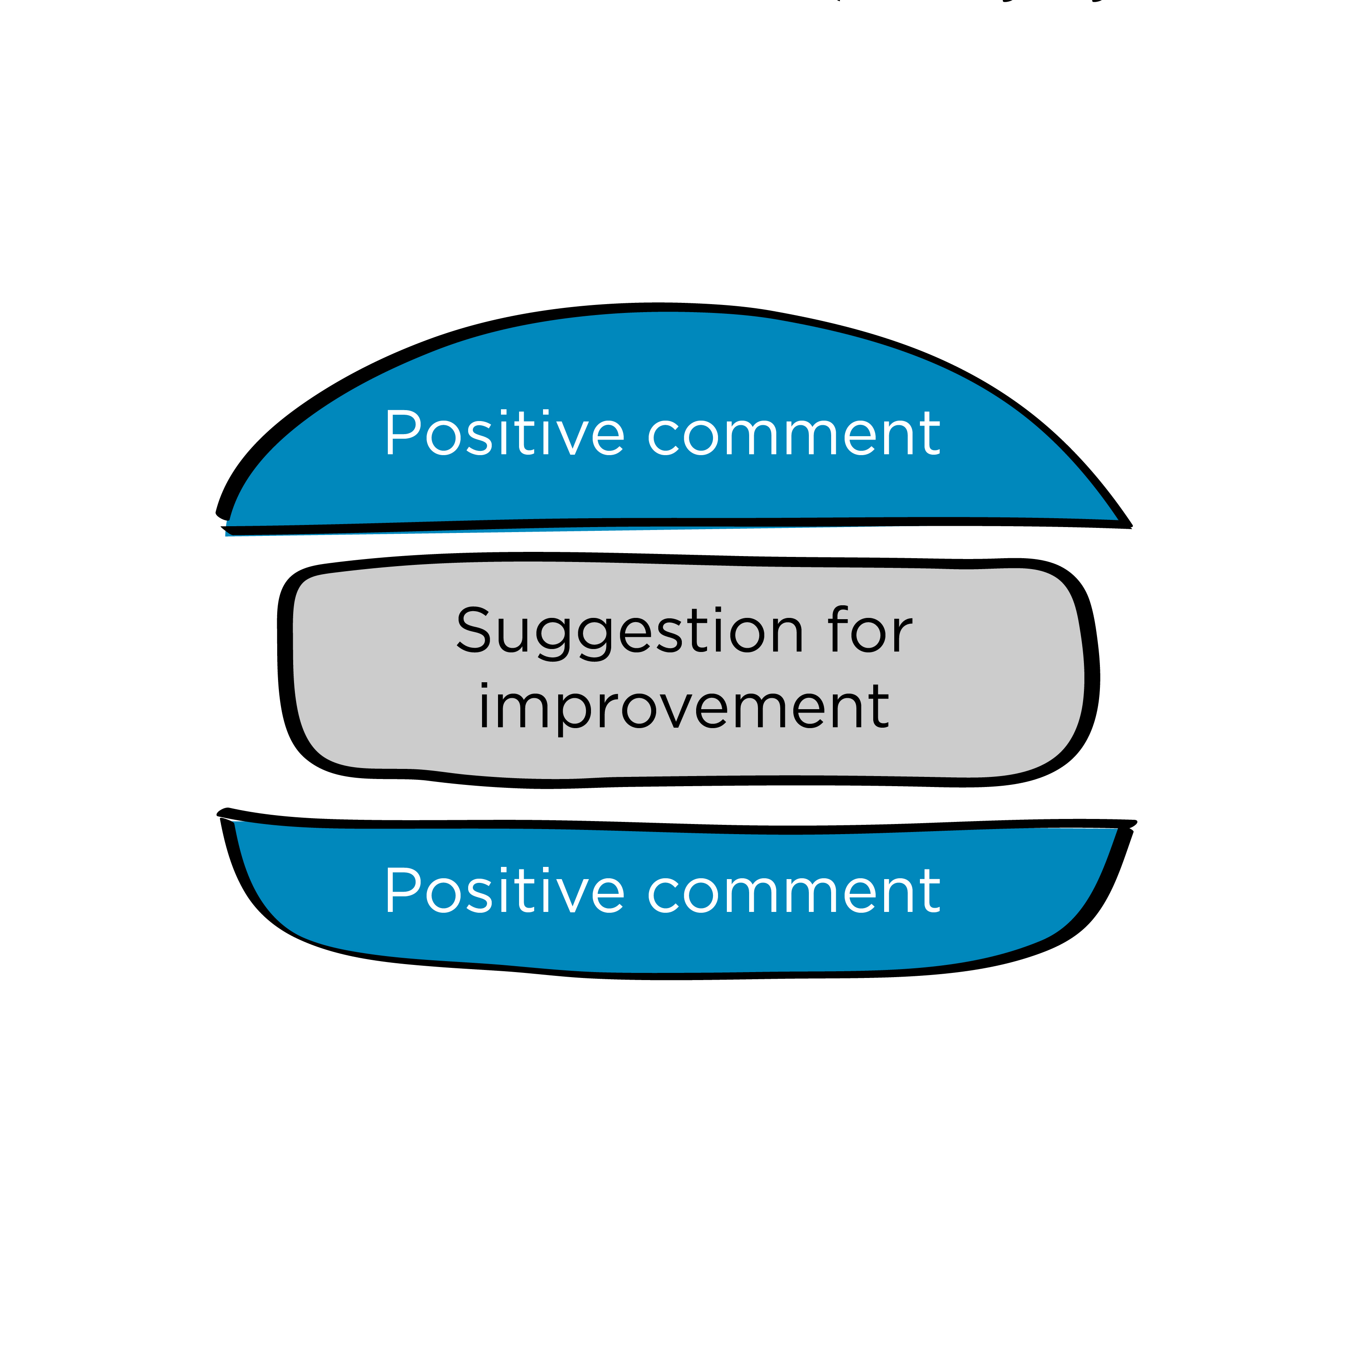
Giving feedback
A feedback sandwich consists of criticism “sandwiched” between two positive comments, as follows:
a specific positive comment
critique and/or suggestion for improvement
overall positive comment

Slide 33
Questions?

