Slide 1


S1
Use of SARS-CoV-2 Ag-RDTs for COVID-19 self-testing

Slide 2
Disclaimer
WHO Health Security Learning Platform – Training Materials
These WHO Training Materials are © World Health Organization (WHO) 2022. All rights reserved.
Your use of these materials is subject to the “WHO Health Security Learning Platform, Training Materials – Terms of Use”, which you accepted when downloading them and which are available on the Health Security Learning Platform at: https://extranet.who.int/hslp.
Should you adapt, modify, translate, or in any other way revise the contents of these materials, you shall not imply that WHO is in any way affiliated with such modifications and shall not use the WHO name or emblem in such modified materials.
Furthermore, please inform WHO of any modifications of these materials that you use publicly, for record-keeping purposes and continued development, by emailing ihrhrt@who.int.

Slide 3
Learning objectives
At the end of this module, you should be able to:
understand the role of self-testing in addition to professional SARS-CoV-2 testing
list the recommendations for SARS-CoV-2 Ag-RDT self-testing implementation;
identify priority population for self-testing
understand and be able to communicate when and how community members should self-test
understand and be able to communicate actions community members should take based on test results

Slide 4




Self-testing using SARS-CoV-2 Ag-RDT: General recommendations
Specific role and use of self-testing needs to be adapted to suit national priorities, epidemiology, resource availability and the local context and health system.
Should be offered as part of SARS-CoV-2 testing services, in addition to professionally administered testing services.
  Expands access to testing, enabling additional individual and social benefits.
Should always be voluntary and never mandatory or coercive; costs should not be borne by students or workers.
Age-appropriate, accurate and accessible information should be provided.
Use of SARS-CoV-2 antigen-detection rapid diagnostic tests for COVID-19 self-testing. Interim guidance- 9 March 2022. Geneva. World Health Organization. https://www.who.int/publications/i/item/WHO-2019-nCoV-Ag-RDTs-Self_testing-2022.1
Notes:
Policymakers and implementers need to consider reasons for testing and evolving epidemiology when COVID-19 self-testing is offered along with other testing approaches. Clear and up-to-date messaging will need to be provided to health workers, individuals and communities so that self-testers can understand the meaning of their test results and what actions to take post-test

Slide 5
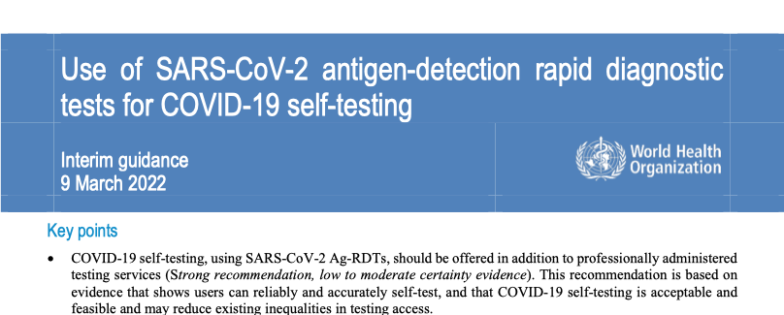
Global guidance
WHO released the first interim guidance on the use of SARS-CoV-2 Antigen RDTs for self-testing on 9th March 2022*
* Use of SARS-CoV-2 antigen-detection rapid diagnostic tests for COVID-19 self-testing. Interim guidance- 9 March 2022. Geneva. World Health Organization. https://www.who.int/publications/i/item/WHO-2019-nCoV-Ag-RDTs-Self_testing-2022.1

Slide 6
SARS-CoV-2 self-testing implementation
COVID-19 self-testing, using SARS-CoV-2 Ag-RDTs, should be offered in addition to professionally administered testing services
Key to engage with health workers and communities
Select affordable SARS-CoV-2 Ag-RDTs approved for self-testing meeting minimum performance requirements (≥80% sensitivity and ≥97% specificity).
  Use of Emergency Use Listing (EUL)-approved COVID-19 self-tests.
  Caution: not all SARS-CoV-2 Ag-RDTs are approved for self-testing
Notes:
Considerations for successful implementation
Last bulletpoint expansion- careful consideration of whether and how to adopt self-testing in different contexts, including the populations being prioritized; the disease prevalence in that population; and the impact on accessibility of testing, health care services and result reporting

Slide 7
SARS-CoV-2 self-testing implementation
Storage and operation of COVID-19 self-testing kits according to IFU: temperature range, sample type, reaction volumes, running time, etc.
Adapt existing quality assurance procedures to include COVID-19 self-testing kits, including lot testing and other post-market surveillance activities.
National programmes should routinely review the role of COVID-19 self-testing-as the pandemic continues and the virus evolves, policy adjustments related to SARS-CoV-2 testing approaches and services, including COVID-19 self-testing, will be needed.
Notes:
Considerations for successful implementation
Last bulletpoint expansion- careful consideration of whether and how to adopt self-testing in different contexts, including the populations being prioritized; the disease prevalence in that population; and the impact on accessibility of testing, health care services and result reporting

Slide 8
Priority population for self-testing
Essential workers.
Close contacts of confirmed or probable SARS-CoV-2 cases.
Individuals most at risk of hospitalization or severe COVID-19 disease.
Individuals with greater challenges in accessing existing testing services.
Widespread/routine testing of asymptomatic individuals with unknown or no known exposure is NOT recommended at this time.
Individuals may choose to self-test to gain increased confidence that they do not have a SARS-CoV-2 infection (e.g. for participation in group activities, social events etc).

Slide 9
SARS-CoV-2 self-testing
Diagnostic: in settings with ongoing community transmission and when used by symptomatic individuals or those who have been recently exposed to SARS-CoV-2
  ongoing community transmission
  testing in individuals with symptoms ≤ 7 days
  testing in individuals with recent exposures (such as close contacts and health and care workers) who are asymptomatic
  testing to detect and respond to suspected outbreaks.
Screening: irrespective of the level of community transmission:
  testing in asymptomatic individuals with unknown or no known exposure who want increased confidence that they do not have a SARS-CoV-2 infection
  For screening purposes, a negative self-test result could enable participation in an activity, such as group activities or indoor gatherings, and confirmatory testing for positive results can be considered.
Notes:
In a similar manner to ‘regular’/professional SARS-CoV-2 Ag- rdt
Expands access to testing, enabling additional individual and social benefits.

Slide 10
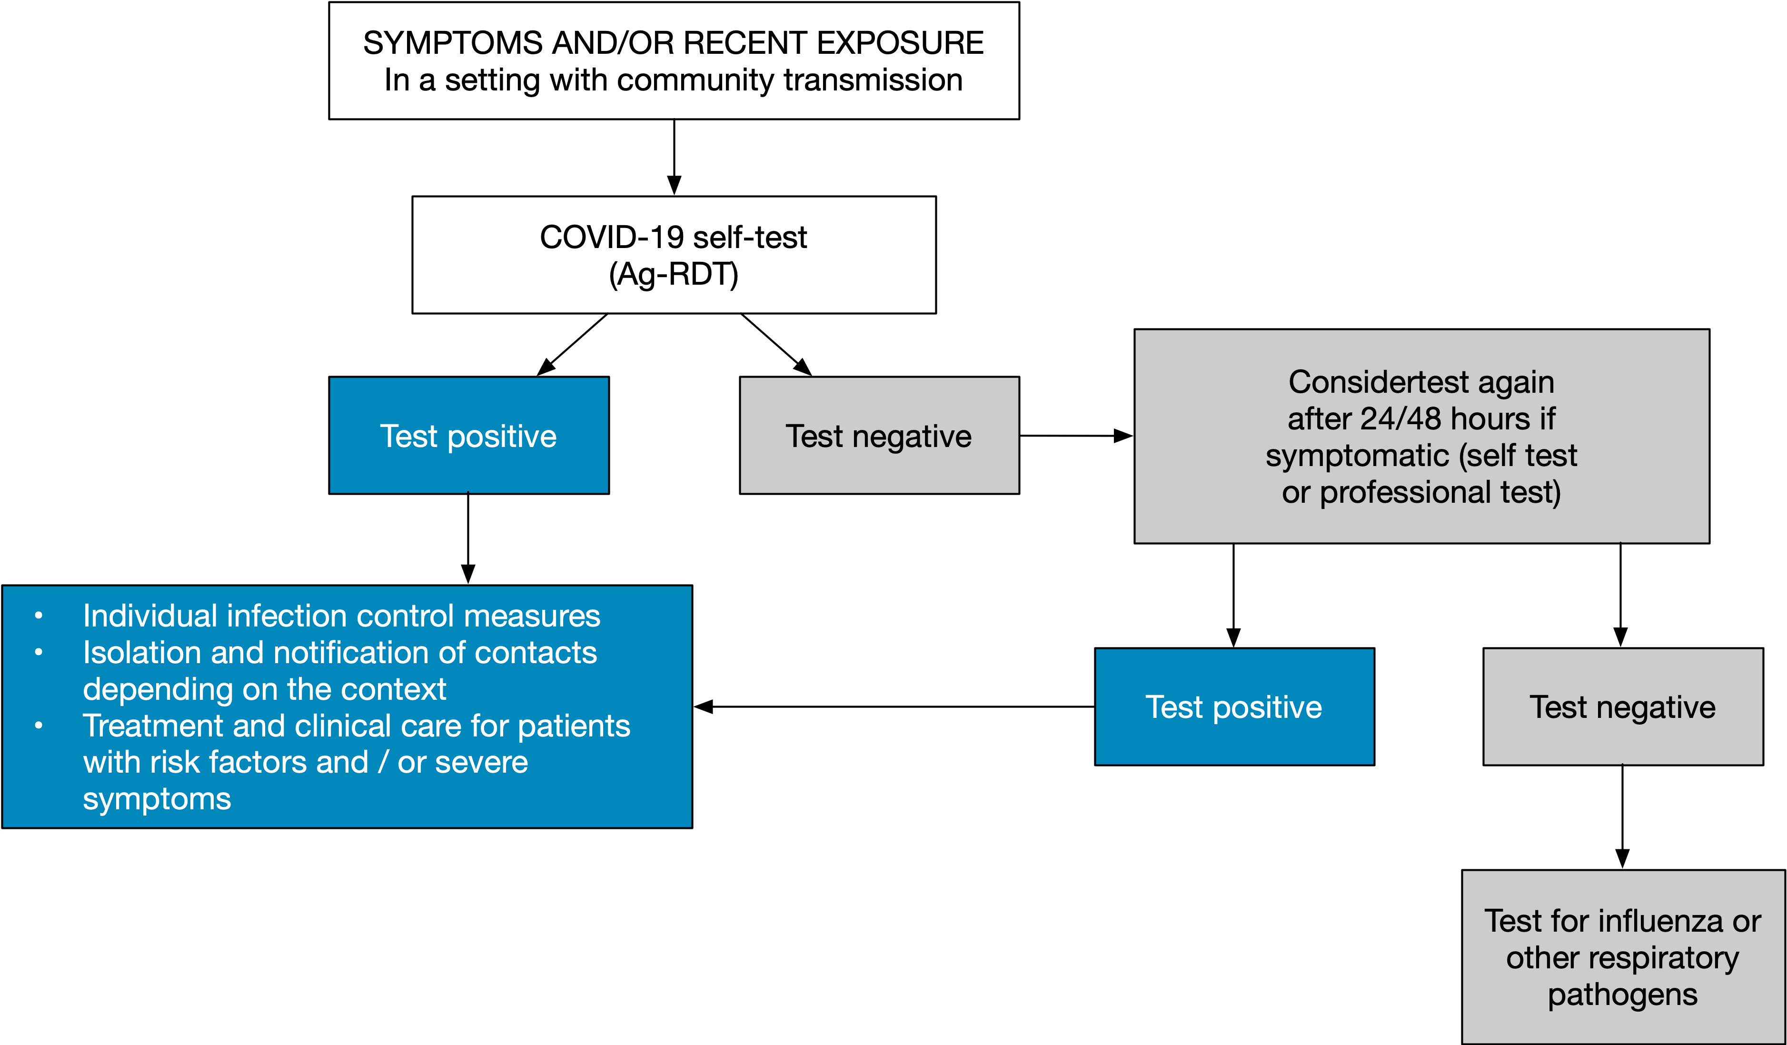
Self-testing can support diagnosis
Ag-RDTs, used by trained operators (professionals) or for COVID-19 self-testing, can be considered for diagnosing an SARS-CoV-2 infection, without a requirement for further confirmatory testing
Notes:
Diagnostic: in settings with ongoing community transmission and when used by symptomatic individuals or those who have been recently exposed to SARS-CoV-2
ongoing community transmission
testing in individuals with symptoms ≤ 7 days
testing in individuals with recent exposures (such as close contacts and health and care workers) who are asymptomatic
testing to detect and respond to suspected outbreaks.

Slide 11
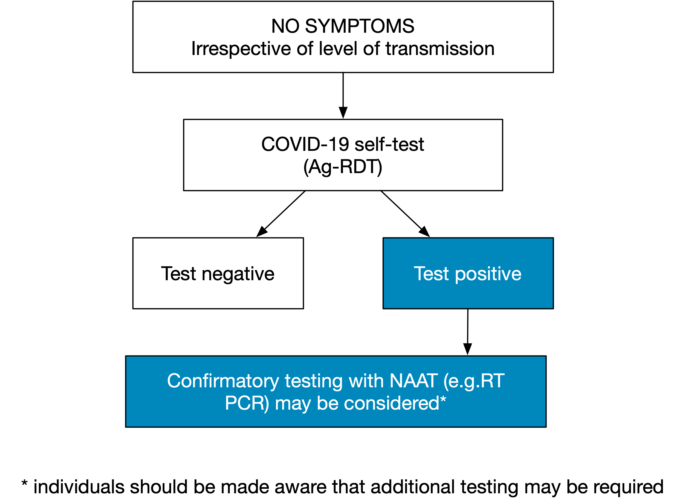
Self-testing can support screening
COVID-19 self-testing can be considered for screening purposes in asymptomatic individuals with no known exposure to the virus
Testing in asymptomatic individuals could increase their confidence that they are not infected with SARS-CoV-2
A negative self-test result could enable participation in an activity, such as group activities or indoor gatherings
Confirmatory testing for positive results may be considered
Notes:
Screening: irrespective of the level of community transmission:
testing in asymptomatic individuals with unknown or no known exposure who want increased confidence that they do not have a SARS-CoV-2 infection
For screening purposes, a negative self-test result could enable participation in an activity, such as group activities or indoor gatherings, and confirmatory testing for positive results can be considered.

Slide 12


In summary, why should self-testing be offered?
Feasible.
Acceptable.
Timely diagnosis and prompt risk-based decisions and post-test actions.
Expands access to testing, enabling additional individual and social benefits.
Costs and resource requirements are uncertain and variable.
Negative test results may give a false sense of security– crucial to include messages on result interpretation and possibility of re-testing.
From SARS-CoV-2 antigen-detection rapid diagnostic tests for COVID-19 self-testing. Interim guidance- 9 March 2022. Geneva. World Health Organization. https://www.who.int/publications/i/item/WHO-2019-nCoV-Ag-RDTs-Self_testing-2022.1
Notes:
Feasible- self-testers can reliably and accurately perform SARS-CoV-2 Ag-RDTs, as compared to trained testers
Acceptable and has the potential to achieve good uptake
Potential to enable timely diagnosis and prompt risk-based decisions and post-test actions
Potential to enable additional individual and social benefits
Costs and resource requirements are uncertain and variable
No specific harms identified or reported following COVID-19 self-testing, however beware of false sense of security with negative test results – crucial to include messages on result interpretation and possibility of re-testing can be used to help mitigate these challenges.

Slide 13

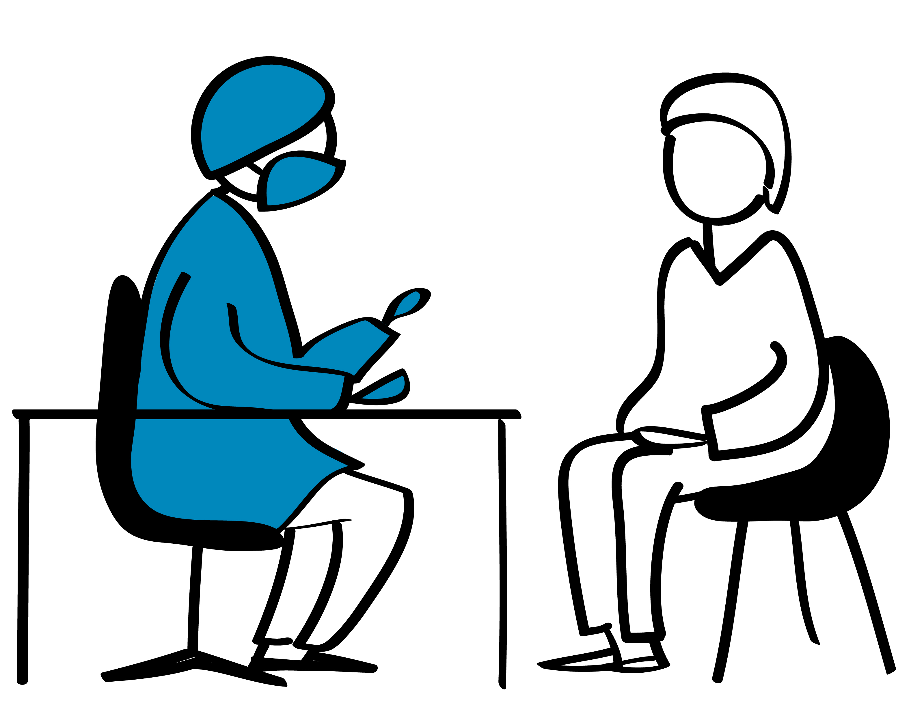
Key information for healthcare workers (1)
Adapt according to the guidelines in your country
Ensure that the SARS-CoV-2 Ag-RDTs provided are recommended for self-testing
Follow the manufacturer’s instructions on storage conditions
Check expiry dates of tests and ensure tests with the shortest expiry are used first
Do not provide tests that are past their expiry date

Slide 14
Key information for Healthcare workers (2)
Adapt according to the guidelines in your country
Instruct the community member on the correct sampling technique for the self-test provided. It is important for them to use the sampling method (e.g. nasal swab) that the test is recommended for.
Instruct the community member on the correct testing technique for the self-test provided. It is important for them to follow the test-specific Instructions for Use, as reagents and procedures including incubation times may vary between different tests.
Follow your country recommendations on interpretation & reporting of self-test results. These may include confirmation of test results, quarantine and re-testing using an approved SARS-CoV-2 PCR test.

Slide 15
Key information to be provided to users (1)*
When self-testing should be conducted.
Interpretation of positive or negative results.
Recommended follow-up actions after self-testing.
Information on result reporting, quarantine, contact tracing, when to seek confirmatory testing and retesting, availability of treatment services, updated information on infection prevention and control, masking and physical distancing, and public health and social measures.
Adapt according to the guidelines in your country
Individuals may choose to self-test to gain increased confidence that they do not have a SARS-CoV-2 infection (e.g. for participation in group activities, social events etc)
* Use of SARS-CoV-2 antigen-detection rapid diagnostic tests for COVID-19 self-testing. Interim guidance- 9 March 2022. Geneva. World Health Organization. https://www.who.int/publications/i/item/WHO-2019-nCoV-Ag-RDTs-Self_testing-2022.1
Notes:
Examples of importance of clear messaging and correct interpretation of results in next slide

Slide 16
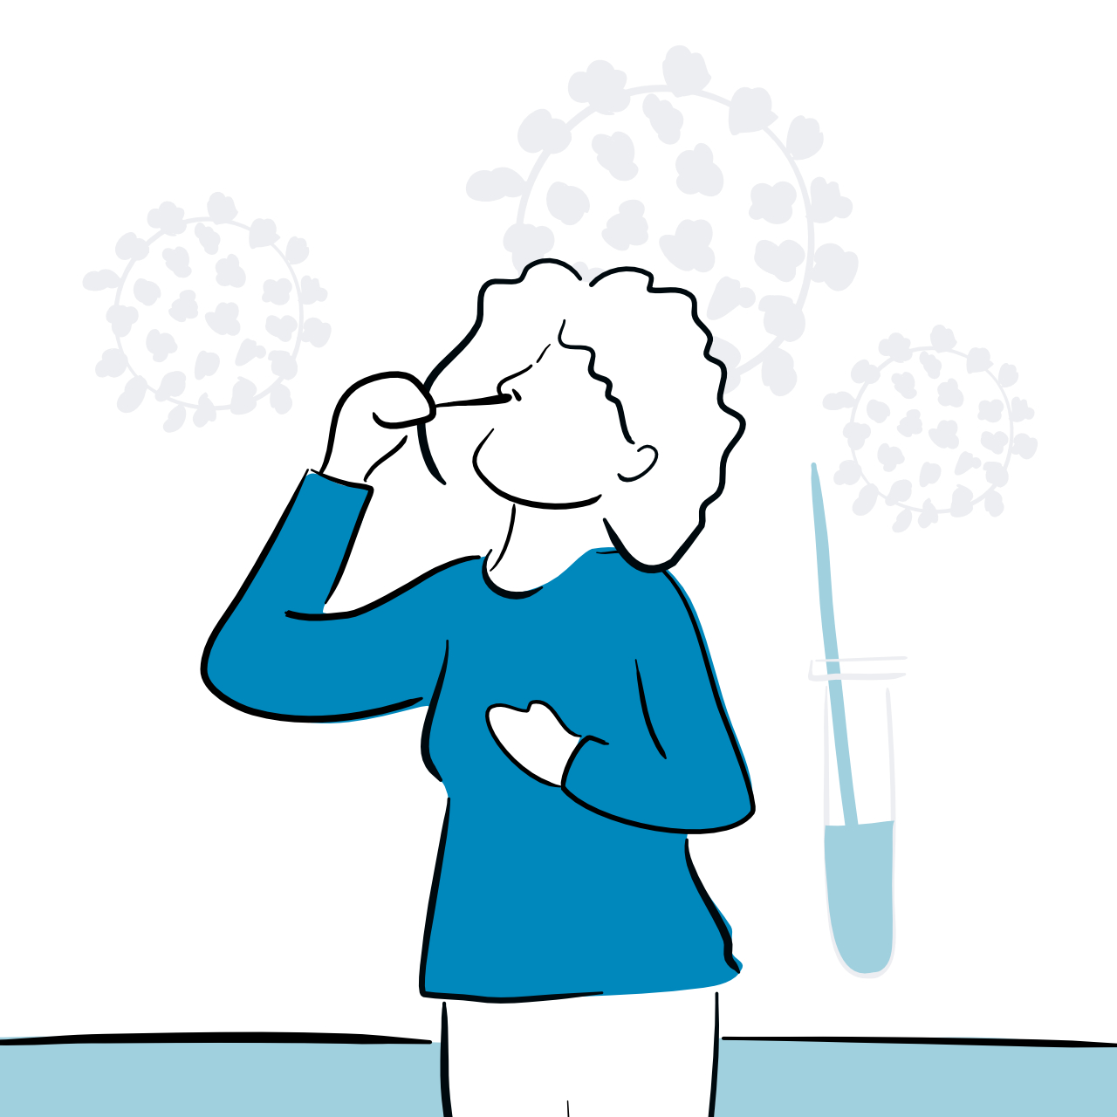
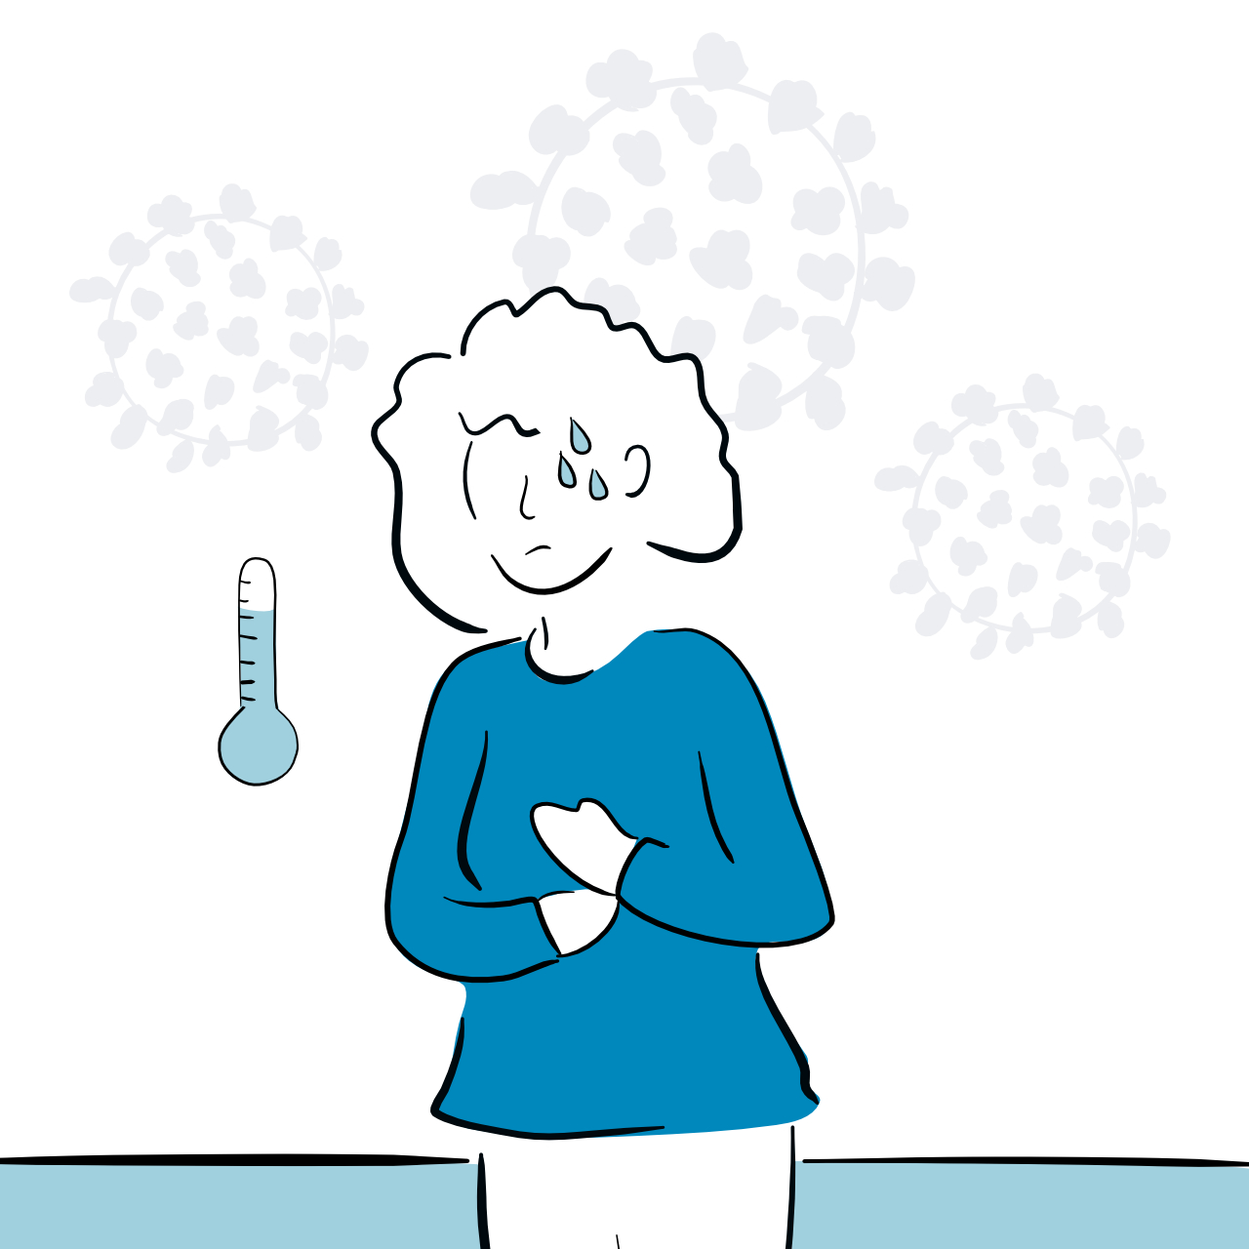
Key information to be provided to users (1)*
When and how to use SARS-CoV-2 self-tests
WHEN
HOW
Always follow the instructions on the pack of the test you are using (these change between brands)
Clean your hands well before and after using the test
Collect a sample from your nose and/or throat and run the test following the instructions
Interpret the results after waiting the recommended amount of time
Throw away the test as per the pack instructions
If you feel unwell with symptoms that could be COVID-19
If you think you were exposed to COVID-19 within the last seven days
If you want to check if you are negative just before deciding whether to participate in an indoor social activity
* Use of SARS-CoV-2 antigen-detection rapid diagnostic tests for COVID-19 self-testing. Interim guidance- 9 March 2022. Geneva. World Health Organization. https://www.who.int/publications/i/item/WHO-2019-nCoV-Ag-RDTs-Self_testing-2022.1

Slide 17


Key information to be provided to users (1)*
Test results and follow-up actions
POSITIVE
NEGATIVE
If you have symptoms seek advice from your health worker on whether you need treatment or care, especially if you are older, have an existing health condition, or have not been vaccinated against COVID-19.
Seek urgent medical care if you experience chest pain, difficulty breathing or dizziness.
Follow your national guidelines on what to do next to report your test results and whether you are required to isolate.
A negative test result gives you more confidence that you were not infected when you took the test.
Remember false negative results can occur, especially if you tested soon after exposure.
If you know you have been recently exposed, and/or you have symptoms that could be COVID-19, take another test 24 to 48 hours later.
* Use of SARS-CoV-2 antigen-detection rapid diagnostic tests for COVID-19 self-testing. Interim guidance- 9 March 2022. Geneva. World Health Organization. https://www.who.int/publications/i/item/WHO-2019-nCoV-Ag-RDTs-Self_testing-2022.1

Slide 18
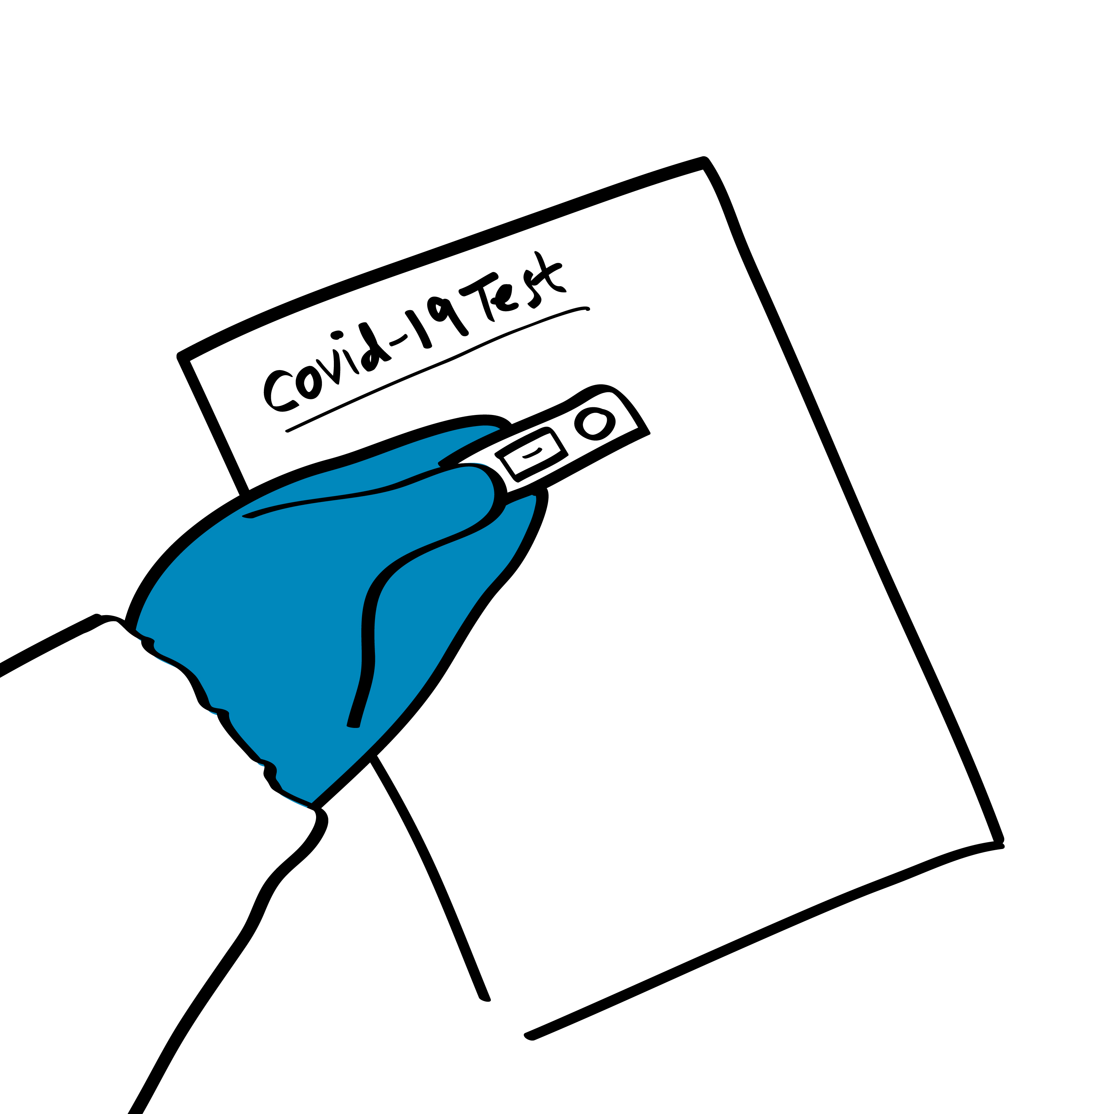
Importance of correct interpretation of test results
A positive self-test result likely indicates active SARS-CoV-2 infection, but false-positive results may be more likely when self-testers have no known exposure and are in settings with low-to no community transmission.
  A negative test result indicates a lower likelihood of current SARS-CoV2 infection, but false-negative results can occur and may be more likely in individuals who test very early after infection with SARS-CoV-2.
Adapt according to the guidelines in your country

Slide 19

Let’s practice
Adapt according to the guidelines in your country
Take a few minutes to practice scenarios where one participant plays a health worker and another participant a community member:
  Requesting self-tests and information on how to use the test (sampling, test run)
  Follow-up actions after a positive result
  Follow-up actions after a negative result

Slide 20
Post market surveillance*
All users should contribute to post-market surveillance by reporting any issues encountered to manufacturers immediately.
Who to provide user feedback to?
  Notify the manufacturer (their contact details are in the IFU) or their local authorized representative in your country.
  Notify WHO, if the product has WHO EUL rapidalert@who.int
When to provide user feedback?
  Immediately (or as soon as possible)
  Document rather than investigate
  You may not be the only user with this problem – you can avert harm to others
* For more information on post market surveillance: Guidance for post-market surveillance and market surveillance of medical devices, including in vitro diagnostics. June 2021.

Slide 21

Key points
SARS-CoV-2 Ag-RDTs self-testing should be offered as part of SARS-CoV-2 testing services.
Quality-assured self-testing SARS-CoV-2 Ag-RDTs meeting minimum performance requirements of ≥80% sensitivity and ≥97% specificity, and preferably Use of Emergency Use Listing (EUL)-approved.
Self-testing should always be voluntary and never mandatory or coercive, and costs should not be borne by students or workers.
As local epidemiology changes, information on self-testing and actions to take in case of a positive or a negative result that is context-specific, correct, clear, concise and age-appropriate should be made available.

Slide 22
Questions?

