Slide 1


07
Preparation for testing: Supplies

Slide 2
Disclaimer
WHO Health Security Learning Platform – Training Materials
These WHO Training Materials are © World Health Organization (WHO) 2022. All rights reserved.
Your use of these materials is subject to the “WHO Health Security Learning Platform, Training Materials – Terms of Use”, which you accepted when downloading them and which are available on the Health Security Learning Platform at: https://extranet.who.int/hslp.
Should you adapt, modify, translate, or in any other way revise the contents of these materials, you shall not imply that WHO is in any way affiliated with such modifications and shall not use the WHO name or emblem in such modified materials.
Furthermore, please inform WHO of any modifications of these materials that you use publicly, for record-keeping purposes and continued development, by emailing ihrhrt@who.int.

Slide 3
Learning objectives
At the end of this module, you should be able to:
  list and identify all the supplies required for SARS-CoV-2 Antigen RDT testing;
  list and identify all the components of SARS-CoV-2 Antigen RDT kits;
  explain the principles of stock management;
  explain when and how to order supplies;
  describe how to inspect the delivery of supplies before acceptance;
  explain the “first expired, first out” principles when managing SARS-CoV-2 Antigen RDT consumables;
  describe how to keep kits and supplies under proper storage conditions.

Slide 4
Components of SARS-CoV-2 Antigen RDT kits
Typical SARS-CoV-2 Antigen RDT kits consist of:
test device (individually wrapped in a foil pouch with desiccant)
extraction buffer tube
buffer
nozzle cap
paper stand for securing the extraction buffer tube
Instructions for Use (IFU).

Slide 5

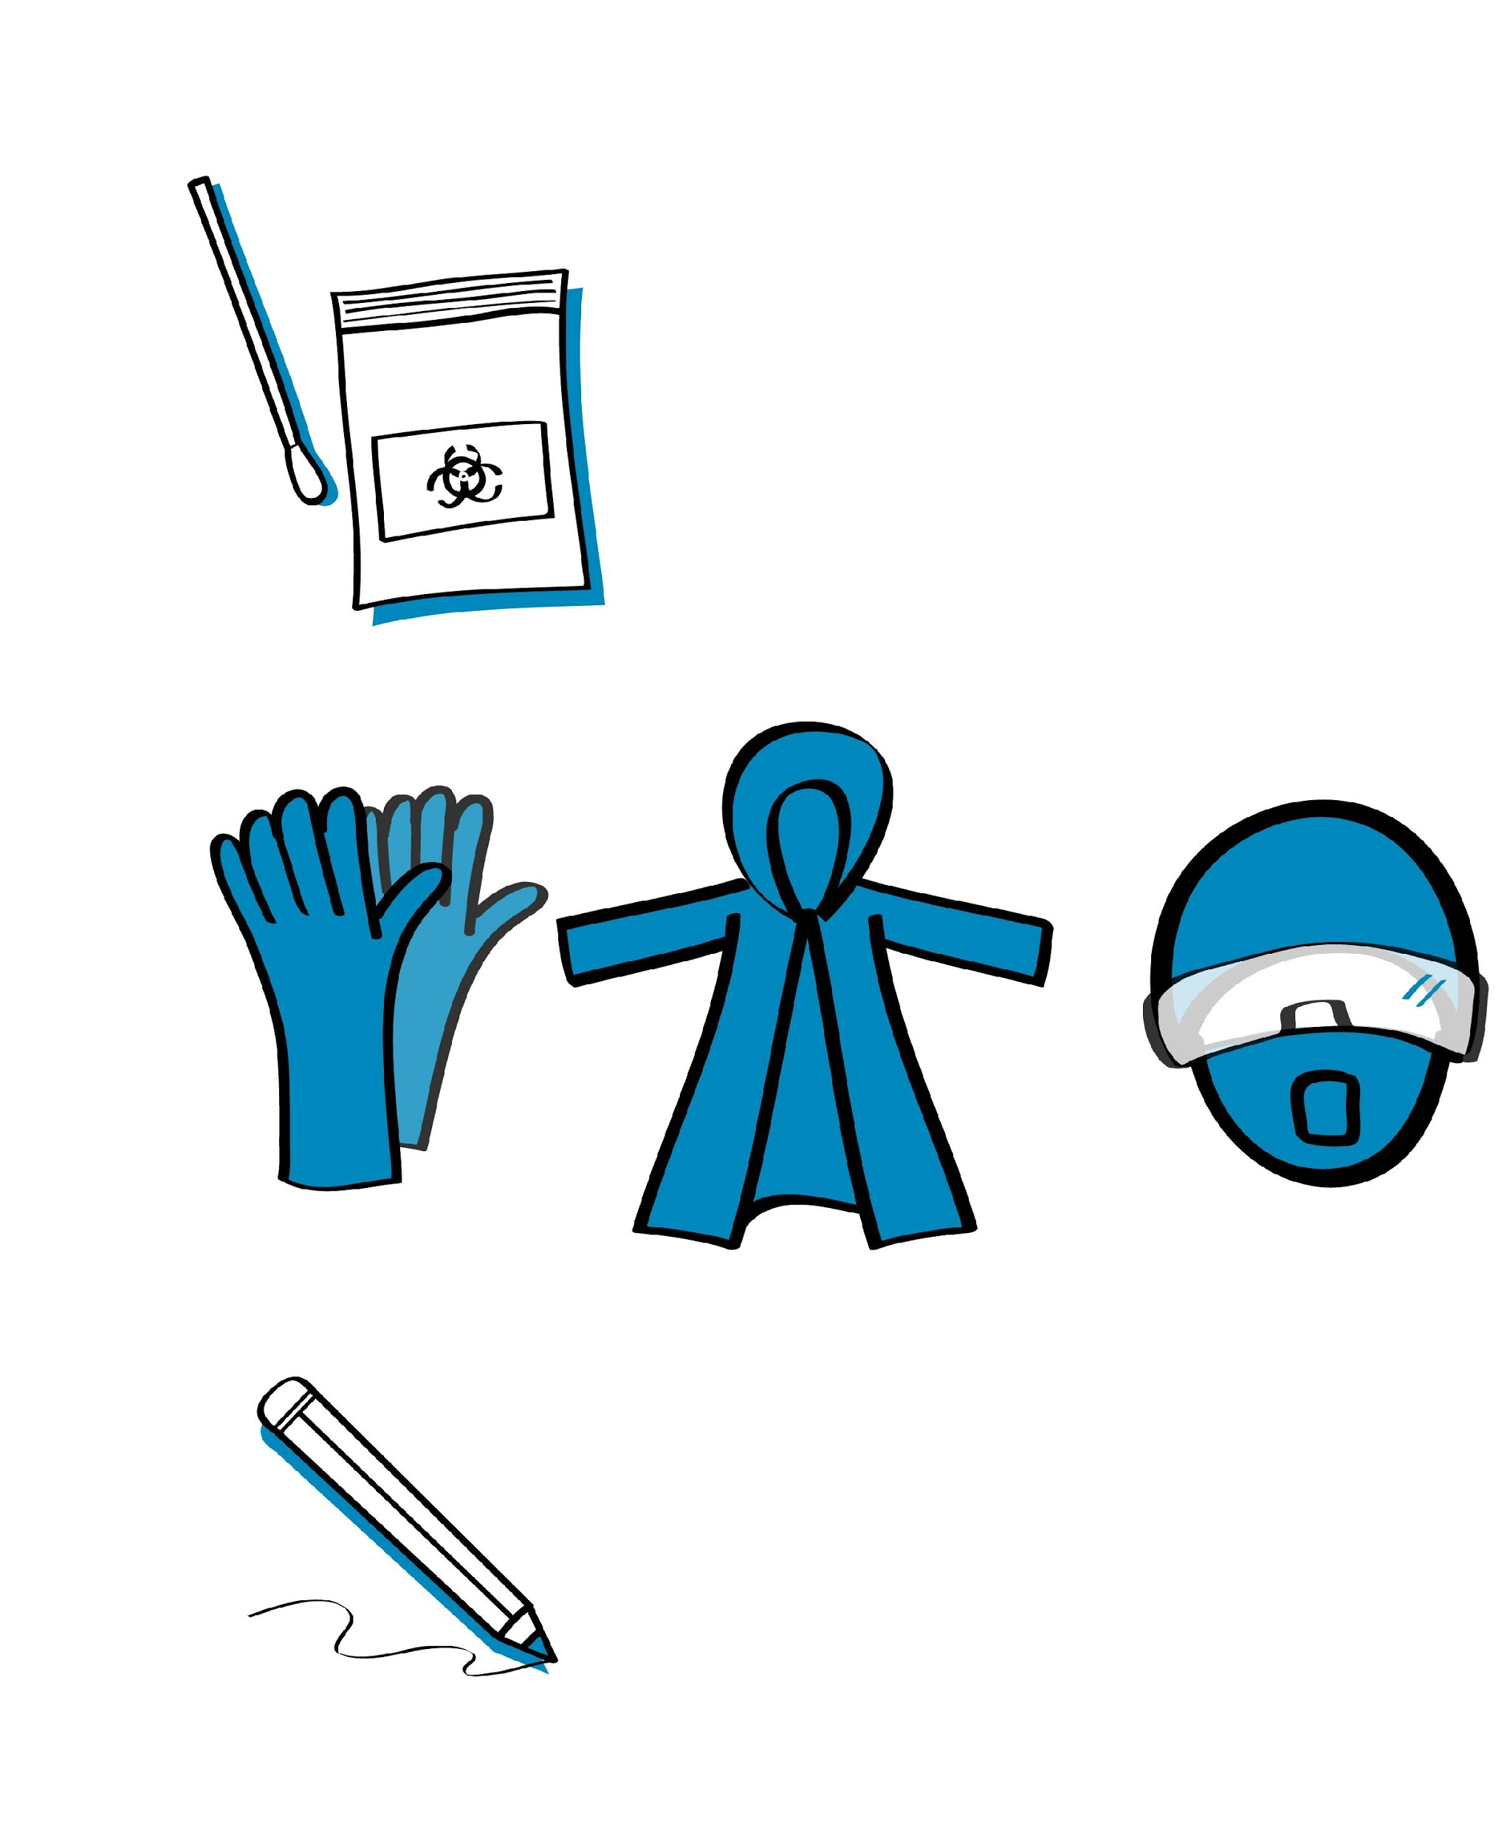
Sample collection supplies
Adapt according to the guidelines in your country
New (unopened) individually wrapped sterile nasopharyngeal swabs (use swabs provided in the SARS-CoV-2 Antigen RDT kit unless specified otherwise in Instructions For Use)
Primary receptacle (e.g., viral transport media or tube with buffer)
Personal protective equipment (PPE), including gloves, gown, eye protection (goggles or face-shield) and medical mask ¹
Pen for marking or labelling
Bleach, ethanol and paper towels to clean the workstation
Sample collection form
Soap for hand-washing or alcohol-based hand rub
Leak-proof biohazard bags and waste bins for containing or moving biohazard waste.
¹ Advice on the use of masks in the context of COVID-19 Interim guidance, 23 December 2020; Rational use of personal protective equipment for COVID-19 and considerations during severe shortages. Geneva: World Health Organization; 2020, Infection prevention and control during health care when coronavirus disease (‎COVID-19)‎ is suspected or confirmed. Interim guidance, 12 July 2021
Respirators are recommended for settings where aerosols generating procedures are performed. Based on values and preferences and if widely available, they could also be used when providing direct care to COVID-19 patients in other settings.

Slide 6
SARS-CoV-2 Antigen RDT testing supplies (1)
Adapt according to the guidelines in your country
SARS-CoV-2 Antigen RDT kit
Bleach, ethanol and paper towels to clean the workstation
Soap for hand-washing or alcohol-based hand rub
Leak-proof biohazard bags for containing or moving biohazard waste
Waste bins for biohazard bags
Spray bottles (for bleach and for ethanol)
Measuring device for making bleach and alcohol solutions

Slide 7
SARS-CoV-2 Antigen RDT testing supplies (2)
Adapt according to the guidelines in your country
Pen for marking or labelling
PPE, including non-sterile gloves, gown, eye protection or face-shield, and medical mask
Timer
Positive and negative controls (may be part of the SARS-CoV-2 Antigen RDT kit or may be sold separately)
SARS-CoV-2 Antigen RDT Logbook
Document outlining standard operating procedures (SOPs)
Thermometer

Slide 8
Examining test kits
Examine the different components found in each SARS-CoV-2 Antigen RDT kit:
Desiccant:
  This is not used when performing the test. It only serves to keep the packet contents dry before use and should be discarded when the test is opened.
  If the desiccant includes an indicator, this should be examined. If it suggests humidity exposure, then the test should be discarded and a new test selected.
Buffer solution:
  Required by some kits

Slide 9
Stock management

Slide 10
Stock management = uninterrupted testing
Ensures availability of materials and kits, when needed
Avoids the use of expired kits
Minimizes wastage

Slide 11
Stock management involves knowing:
the specifications for supplies and kits¹
what and how many supplies/consumables you have
how much of the received stock has been consumed
when to order
what and how much has been ordered
when stock was ordered
where to store stock
when and how much fresh stock was received, and by whom.
¹ Only use tests approved in your country. Ensure that country requirements for sample collection swabs, disinfectants and PPE are followed. Only obtain supplies from reputable suppliers.

Slide 12
Stock management involves:
performing a stock count
maintaining proper inventory records
determining when to re-order
determining how much to re-order
placing orders properly
inspecting supplies before accepting the delivery
ensuring proper storage of stock
documenting stock levels and movement of stock.

Slide 13
Performing a stock count
What is it? | Physically counting each item in the stock
When is it done? | Recommended at the beginning of each week
Who does it? | A designated person
All items must be accounted for. Everything that
comes in and goes out must be recorded.

Slide 14
Maintaining proper inventory records
Adapt according to the guidelines in your country
Stock card
Simple, heavyweight cards
Kept for each item in stock
Stock book or register
Contains a listing of all items in the store
Can be paper-based or electronic
Should be updated weekly after a physical count from information on the stock cards

Slide 15
When to order
Adapt according to the guidelines in your country
Analyse the needs of the testing site by making a list of all the required reagents and supplies:
  a detailed description of each item used for sample collection and testing
  the package count or number of units in which the item is supplied
  approximate usage per month
  the priority or importance level of the item in carrying out the work of the laboratory − e.g., Is it used every day or only once a month?
  the length of time required to receive a delivery − Will the order take a day, week or month to arrive?
  storage space and conditions − Will a bulk order use up too much storage space? Does the item require storage in a refrigerator?

Slide 16
How to order
Adapt according to the guidelines in your country
Establish a list of supplies to be ordered.
Complete a purchase order form and have it approved according to the procedure for the testing site.
Forward the purchase order to the procurement officer for processing and ordering.
Upon delivery, the order should be inspected for accuracy and damage.
The supplies should then be added to the current inventory and stored according to the manufacturers’ instructions.

Slide 17
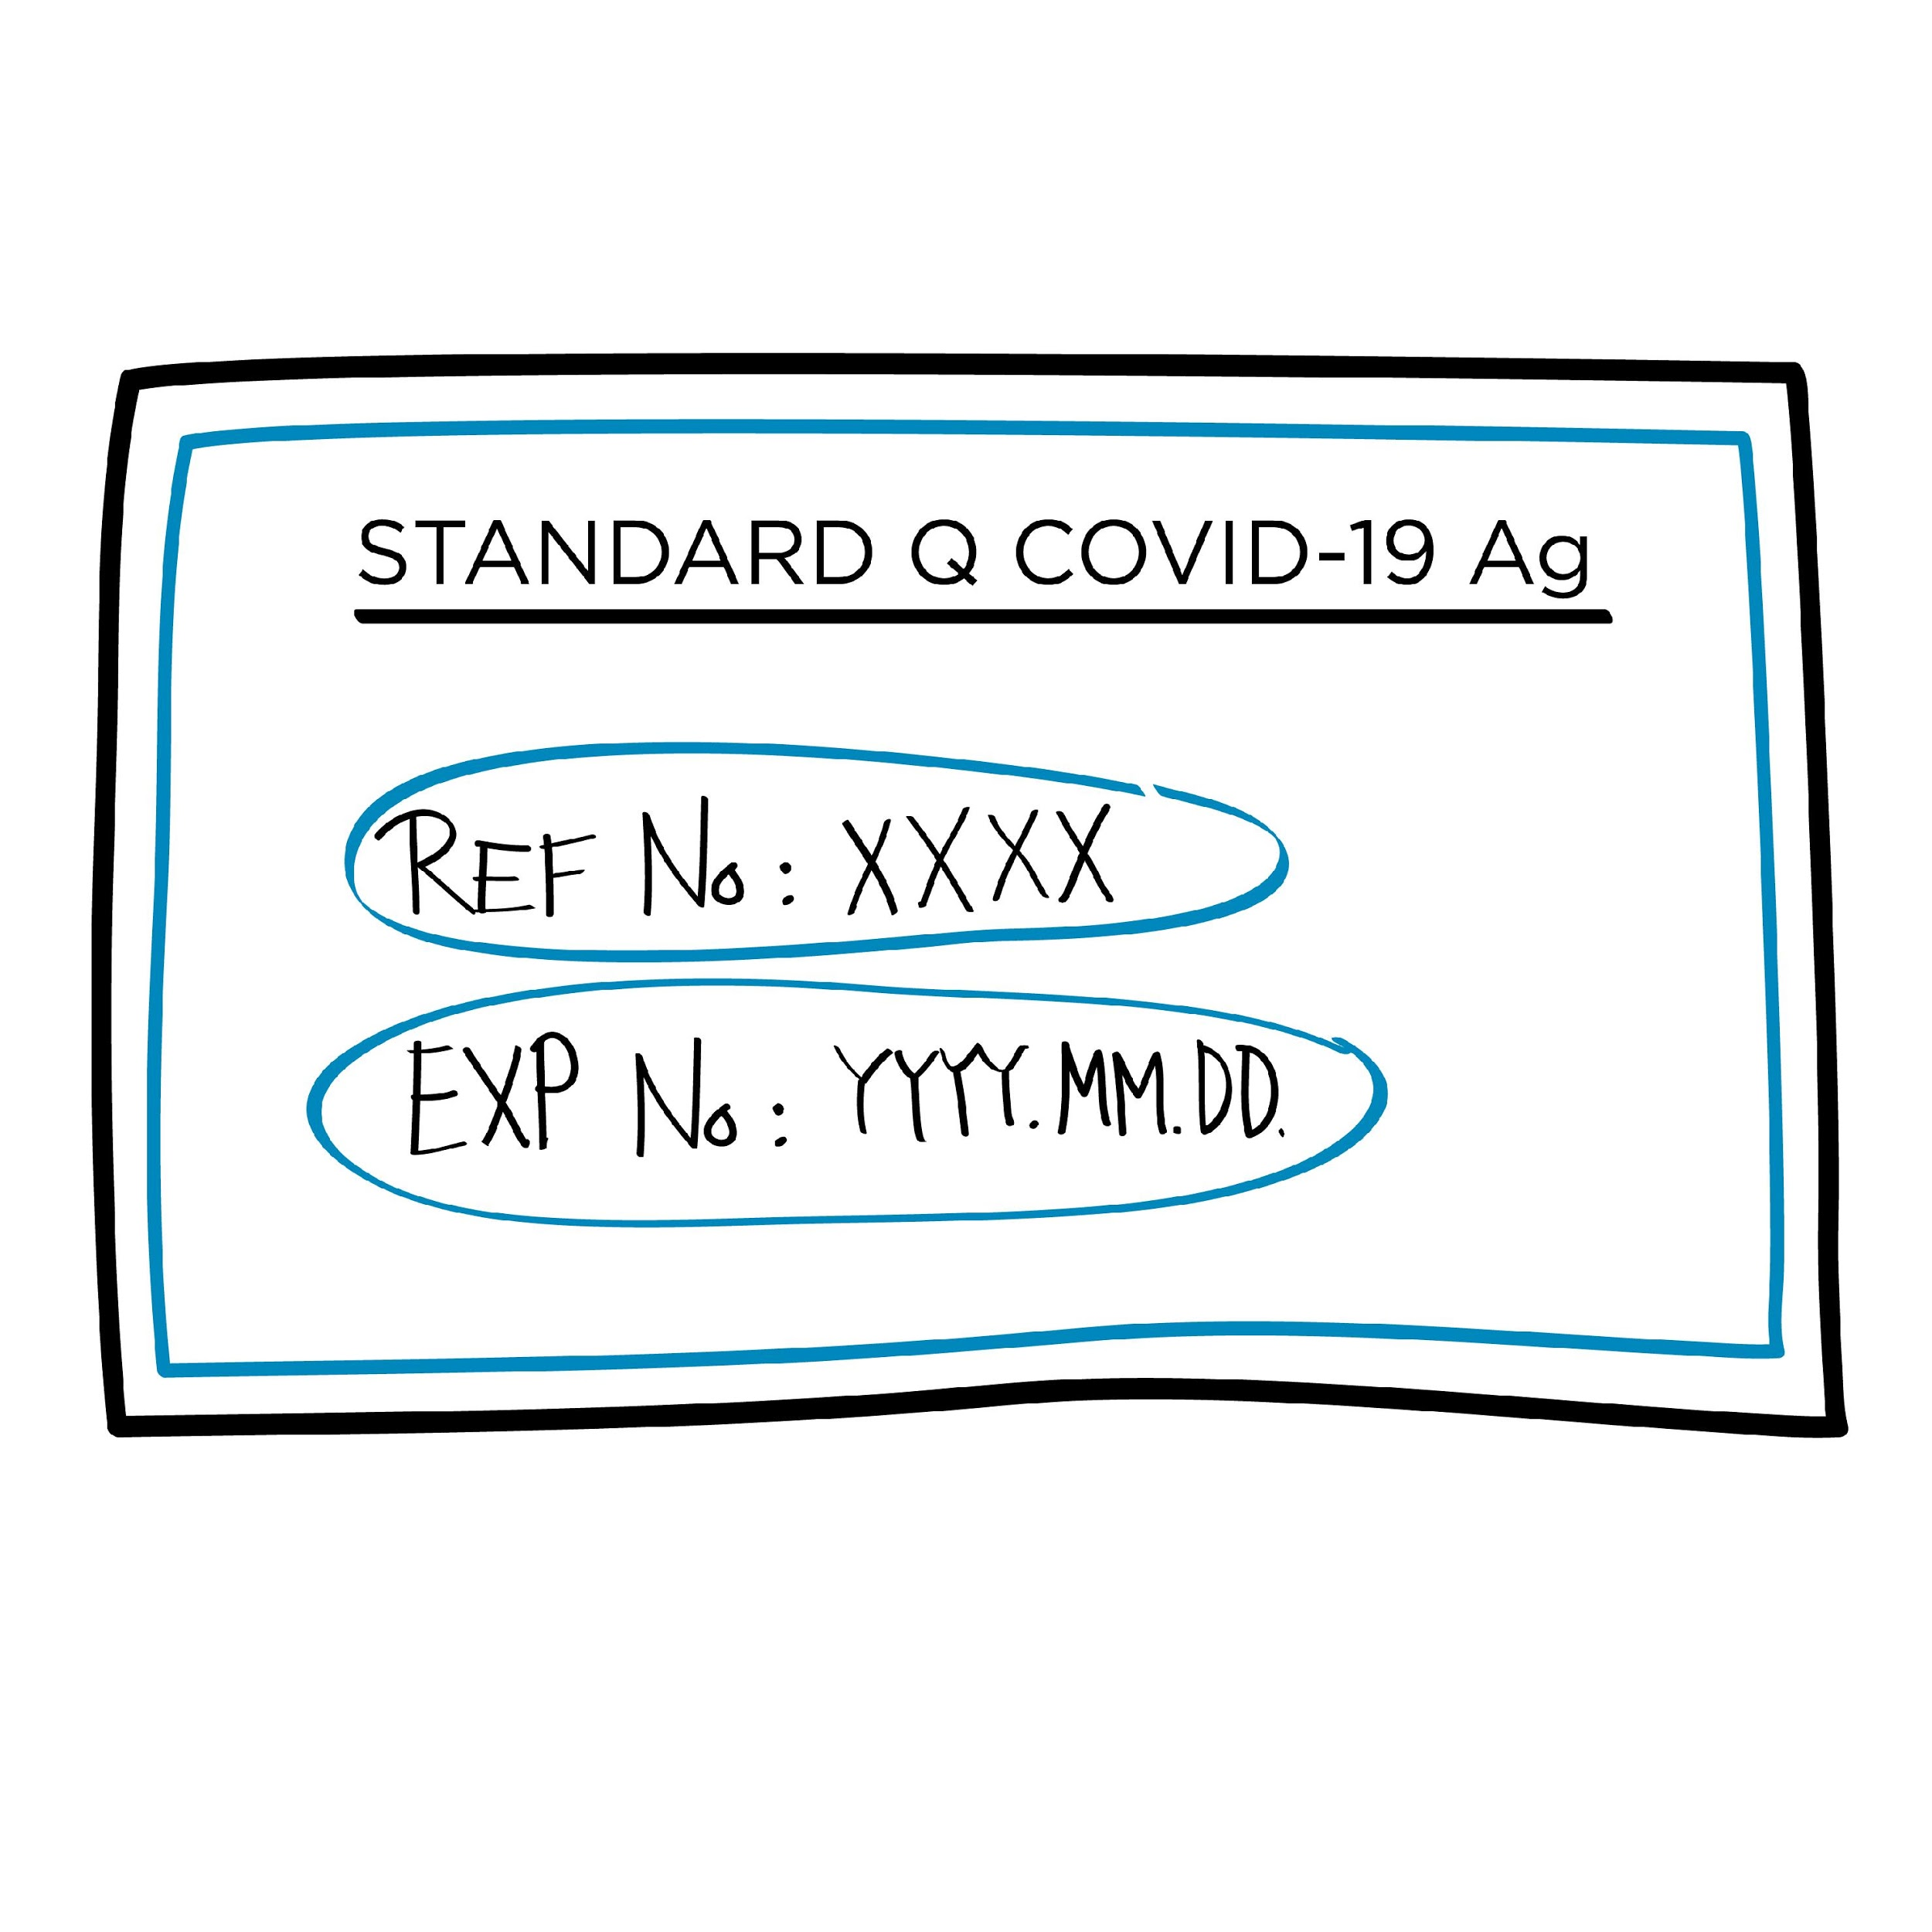
Inspect delivery of new orders¹
Adapt according to the guidelines in your country
Upon receipt:
Verify contents of the order received with the requisition.
Check the integrity of received supplies.
Date each item received.
Note the lot numbers and expiry dates.
Store the items with later expiry dates behind the items with earlier expiry dates.
Create or update records.
SARS-CoV-2 Antigen RDT
¹ The mechanism for receiving supplies may need to be adapted to account for central procurement and distribution. For example, inform the supervisory or central level of any problems with stock received.

Slide 18
Ensuring proper storage of supplies
Adapt according to the guidelines in your country
Place items on shelves.
Organize existing and new shipments by expiry dates.
Keep the storeroom clean, organized and locked.
Store according to manufacturers’ instructions (e.g., 2–30°C).
Keep a daily (or twice daily) temperature record.
Store items away from direct sunlight.

Slide 19
Managing stock
Adapt according to the guidelines in your country
Label all supplies and reagents with the date received, and the date first opened.
Decide on stock levels based on current knowledge of supply availability and frequency of re-supply.
Rotate stock using “first expired, first out” principles to ensure that out-of-date reagents are not used.
If there are expired reagents, they should be separated, marked as "Expired − Do not use", and then discarded according to the manufacturer's instructions.

Slide 20


Key points
Be aware of all the supplies and components comprised in the test kits that are required to perform testing.
Managing the supplies stock appropriately is key to prevent interruption of testing.
Ensure systems are in place to perform weekly stock count, keep an inventory record and ensure reagents with the shortest shelf-life are used first.
Ensure systems are in place to timely order taking into account usage of supplies and anticipating possible delivery delays.
Do not use expired reagents.

Slide 21
Questions?

