Slide 1


03
SARS-CoV-2 testing strategies

Slide 2
Disclaimer
WHO Health Security Learning Platform – Training Materials
These WHO Training Materials are © World Health Organization (WHO) 2022. All rights reserved.
Your use of these materials is subject to the “WHO Health Security Learning Platform, Training Materials – Terms of Use”, which you accepted when downloading them and which are available on the Health Security Learning Platform at: https://extranet.who.int/hslp.
Should you adapt, modify, translate, or in any other way revise the contents of these materials, you shall not imply that WHO is in any way affiliated with such modifications and shall not use the WHO name or emblem in such modified materials.
Furthermore, please inform WHO of any modifications of these materials that you use publicly, for record-keeping purposes and continued development, by emailing ihrhrt@who.int.

Slide 3
Learning objectives
At the end of this module, you should be able to:
understand how sensitivity and specificity impacts on SARS-CoV-2 Ag-RDTs performance in different settings;
explain the key recommendations for the use of SARS-CoV-2 Ag-RDTs;
describe the factors that affect test performance.

Slide 4
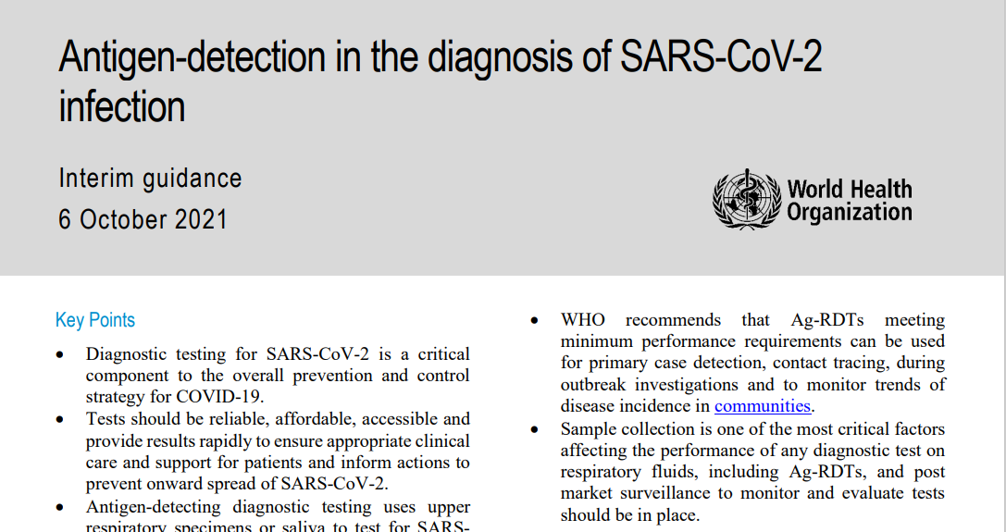
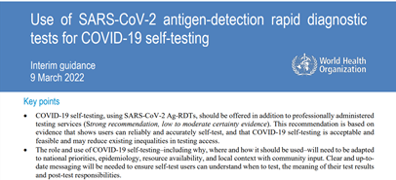
Global guidance
WHO has released interim guidance on the use of SARS-CoV-2 Antigen RDTs:
Antigen-detection in the diagnosis of SARS-CoV-2 infection. Interim guidance- 6 October 2021. Geneva. World Health Organization. https://www.who.int/publications/i/item/antigen-detection-in-the-diagnosis-of-sars-cov-2infection
Use of SARS-CoV-2 antigen-detection rapid diagnostic tests for COVID-19 self-testing. Interim guidance- 9 March 2022. Geneva. World Health Organization. https://www.who.int/publications/i/item/WHO-2019-nCoV-Ag-RDTs-Self_testing-2022.1

Slide 5
Characteristics of diagnostic tests
  Sensitivity refers to the percentage of SARS-CoV-2 infected patients who are correctly¹ identified as having SARS-CoV-2 infection.
          High sensitivity few false negative results
  Specificity refers to the percentage of non-infected people who are correctly¹ identified as not having SARS-CoV-2 infection.
          High specificity few false positive results
¹ In this case, gold standard used is NAAT
Note: More information about the interpretation of SARS-CoV-2 Ag-RDTs and definitions of sensitivity, specificity, PPV and PPN can be found in the section 5 of the WHO SARS-CoV-2 antigen-detecting rapid diagnostic tests: An implementation guide
Further information of how positive and negative predictive values can affect the interpretation of Ag-RDT test results can be found in the annex section of Antigen-detection in the diagnosis of SARS-CoV-2 infection. Interim guidance- 6 October 2021. Geneva. World Health Organization. https://www.who.int/publications/i/item/antigen-detection-in-the-diagnosis-of-sars-cov-2infection

Slide 6
Prevalence of disease
The prevalence of disease in the community being tested strongly affects the test’s predictive value in terms of positive predictive value (PPV) and negative predictive value (NPV)*.
Prevalence will affect the chances to observe the ‘correct’ result:
  As prevalence decreases, so does PPV, meaning that the probability that a positive result is a true positive is reduced in low prevalence settings (risk of more false positives).
  In low prevalence settings NPV is high so there is a very high probability that patients testing negative do not have COVID-19.
*NPV is the probability that a person with a negative test result truly does not have the disease

Slide 7
Who can be detected by SARS-CoV-2 Antigen RDTs?
Viral load
Most contagious individuals
Ag-RDT detection cut-off
Viral culture cut-off
PCR detection cut-off
-2
0
2
4
6
20
Time (days)
Symptoms onset

Slide 8
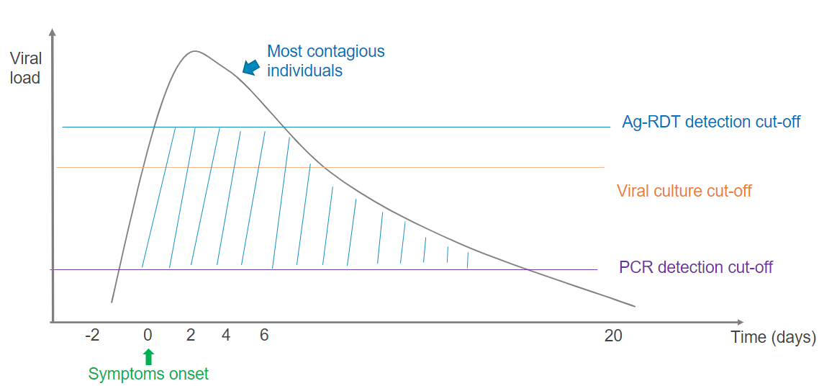
General recommendations for the use of SARS-CoV-2 Ag-RDTs (1)
As SARS-CoV-2 Antigen RDTs are easy to perform and give a rapid result, they can help expand testing and decrease delays in diagnosis by shifting testing to decentralized testing.
The trade-off for simplicity is a decrease in sensitivity compared to NAAT molecular tests.
These cases could be missed if only a SARS-CoV-2 Antigen RDT is performed.
¹ Antigen-detection in the diagnosis of SARS-CoV-2 infection. Interim guidance- 6 October 2021. Geneva. World Health Organization. https://www.who.int/publications/i/item/antigen-detection-in-the-diagnosis-of-sars-cov-2infection
² Sensitivity refers to the percentage of SARS-CoV-2 infected patients who are correctly identified as having SARS-CoV-2 infection.
³ Specificity refers to the percentage of non-infected people who are correctly identified as not having SARS-CoV-2 infection

Slide 9
SARS-CoV-2 Ag-RDT performance expectations
Minimum performance criteria: ≥ 80% sensitivity and ≥ 97% specificity¹
Several SARS-CoV-2 Ag-RDTs have been commercialized.^{2, 3}
There is a very high variability in the performance depending on the population (asymptomatic vs symptomatic) tested and the brand of the commercialized Ag-RDTs.^{4,5}
Population | Sensitivity (95%CI) | Specificity (95%CI)
Symptomatic | 75.1% (57.3%- 87.1%) | 99.5% (98.7%- 99.8%)
Asymptomatic | 48.9% (35.1%- 62.9%) | 98.1% (96.3%- 99.1%)
Adapted from Dinnes et al. 2021
1 Gold standard used is NAAT
2 FIND SARS-CoV-2 diagnostic pipeline: https://www.finddx.org/covid-19/pipeline
3 WHO Emergency Use Listing (EUL) Procedure: https://extranet.who.int/pqweb/vitro-diagnostics/coronavirus-disease-covid-19-pandemic-%E2%80%94-emergency-use-listing-procedure-eul-open
4 Dinnes J et al. (2021) https://www.cochranelibrary.com/cdsr/doi/10.1002/14651858.CD013705.pub2/full#CD013705-sec-0008
5 Sitoe N et al (2022) https://www.mdpi.com/2075-4418/12/2/475/htm

Slide 10

General recommendations for the use of SARS-CoV-2 Ag-RDTs (2)
Most reliable in areas with ongoing community transmission (≥ 5% test positivity rate).
When there is no transmission or low transmission, the positive predictive value (PPV*) of Ag-RDTs will be low, meaning many false positives can occur.
In areas with low or no transmission, NAAT is the preferred first line testing method.
Only SARS-CoV-2 Ag-RDTs that meet recommended performance criteria (≥ 80% sensitivity and ≥ 97% specificity) should be considered for use.
*PPV is the probability that a person with a positive test result truly has the disease.
Antigen-detection in the diagnosis of SARS-CoV-2 infection. Interim guidance- 6 October 2021. Geneva. World Health Organization. https://www.who.int/publications/i/item/antigen-detection-in-the-diagnosis-of-sars-cov-2infection

Slide 11
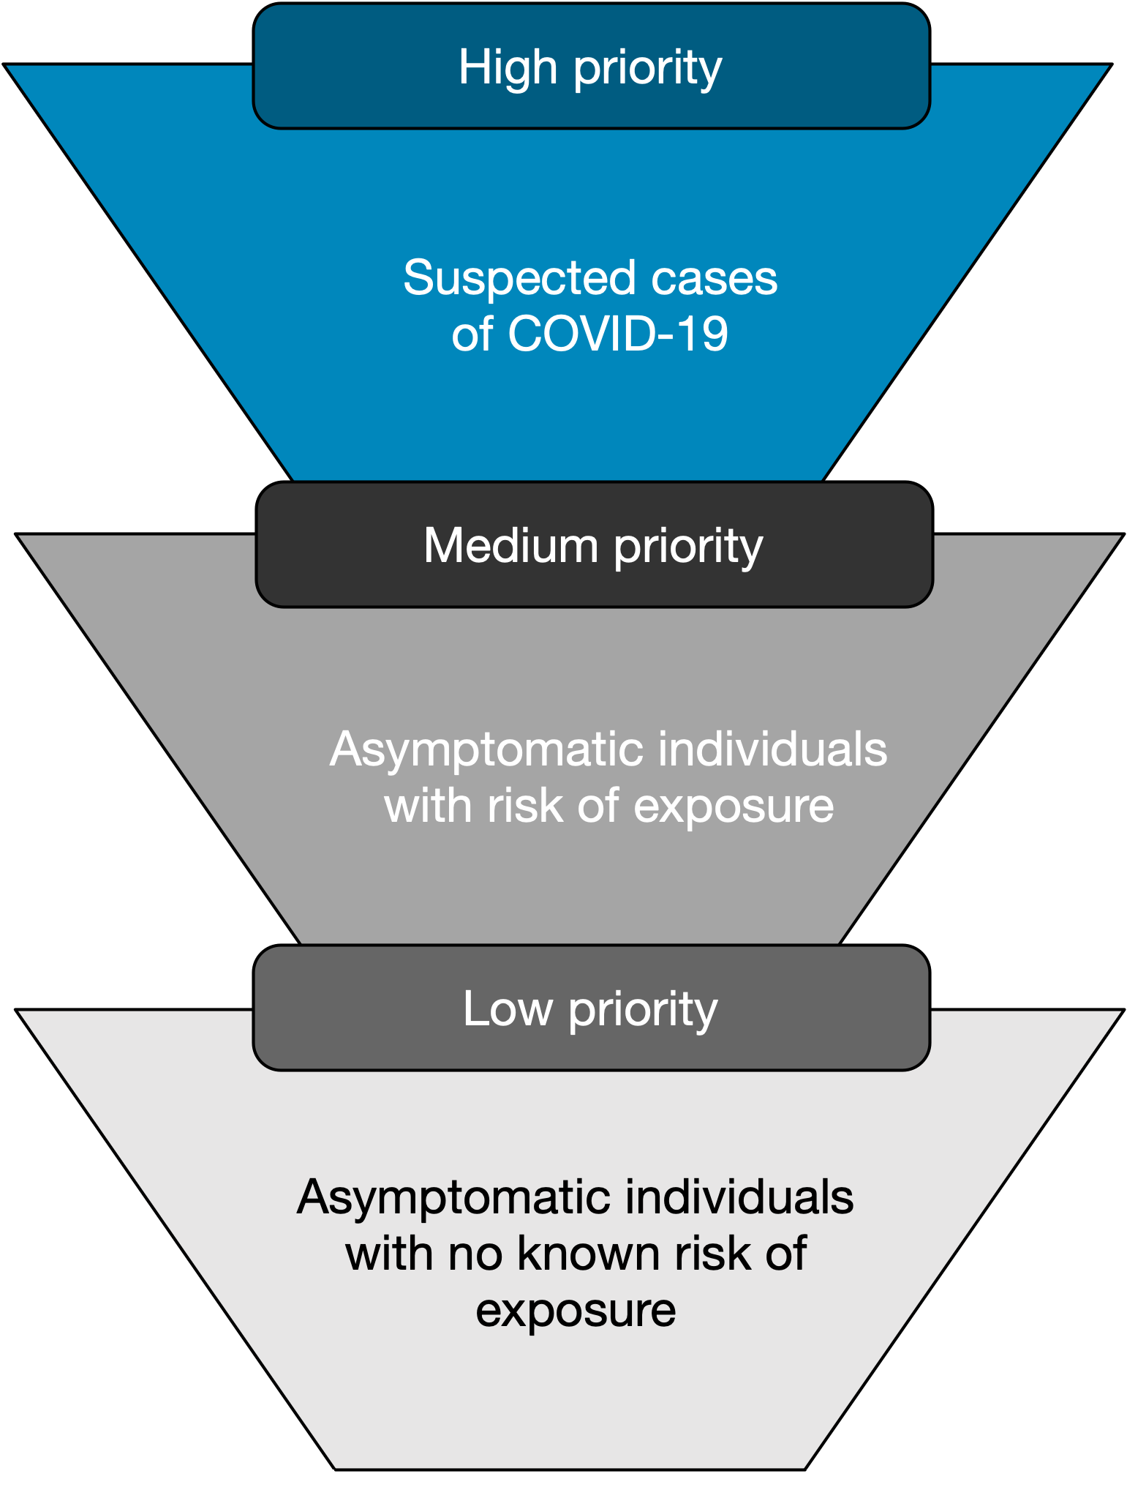
General recommendations for the use of SARS-CoV-2 Ag-RDTs (3)
Target populations:
  symptomatic individuals in the first 5-7 days since symptom onset;
  asymptomatic individuals: limited to contacts or probable cases and to at-risk health workers;
  suspected COVID-19 cases in outbreak investigations.
Use by trained operators in strict accordance with the manufacturer’s instructions.
Ag-RDTs, if correctly performed and interpreted, may be more cost effective than
NAAT in symptomatic populations.
Ag-RDTs can be deployed alongside testing for febrile and pulmonary illnesses in bi-directional testing

Slide 12
Let’s take a few minutes to reflect on use case scenarios
1. Suspected outbreaks in institutions or semi-closed communities where NAAT molecular testing is not available ​
2. Outbreak investigations (e.g., schools, long-term care or nursing care homes, workplaces, etc.)​​
3. To monitor trends in COVID-19 rates in communities and among essential workers and healthcare workers ​
4. To detect positive cases in health facilities and in communities with widespread transmission​​
5. Where management of the patient would not change based on the result of the test ​
6. To test asymptomatic contacts of cases, even if SARS-CoV-2 Ag-RDTs are not specifically authorized for this use
7. For airport or border screening at points of entry

Slide 13


Let’s take a few minutes to reflect on use case scenarios
1. Suspected outbreaks in institutions or semi-closed communities where NAAT molecular testing is not available ​
2. Outbreak investigations (e.g., schools, long-term care or nursing care homes, workplaces, etc.)​​
3. To monitor trends in COVID-19 rates in communities and among essential workers and health workers ​
4. To detect positive cases in health facilities and in communities with widespread transmission​​
5. Where management of the patient would not change based on the result of the test ​
6. To test asymptomatic contacts of cases, even if SARS-CoV-2 Ag-RDTs are not specifically authorized for this use
7. For airport or border screening at points of entry

Slide 14
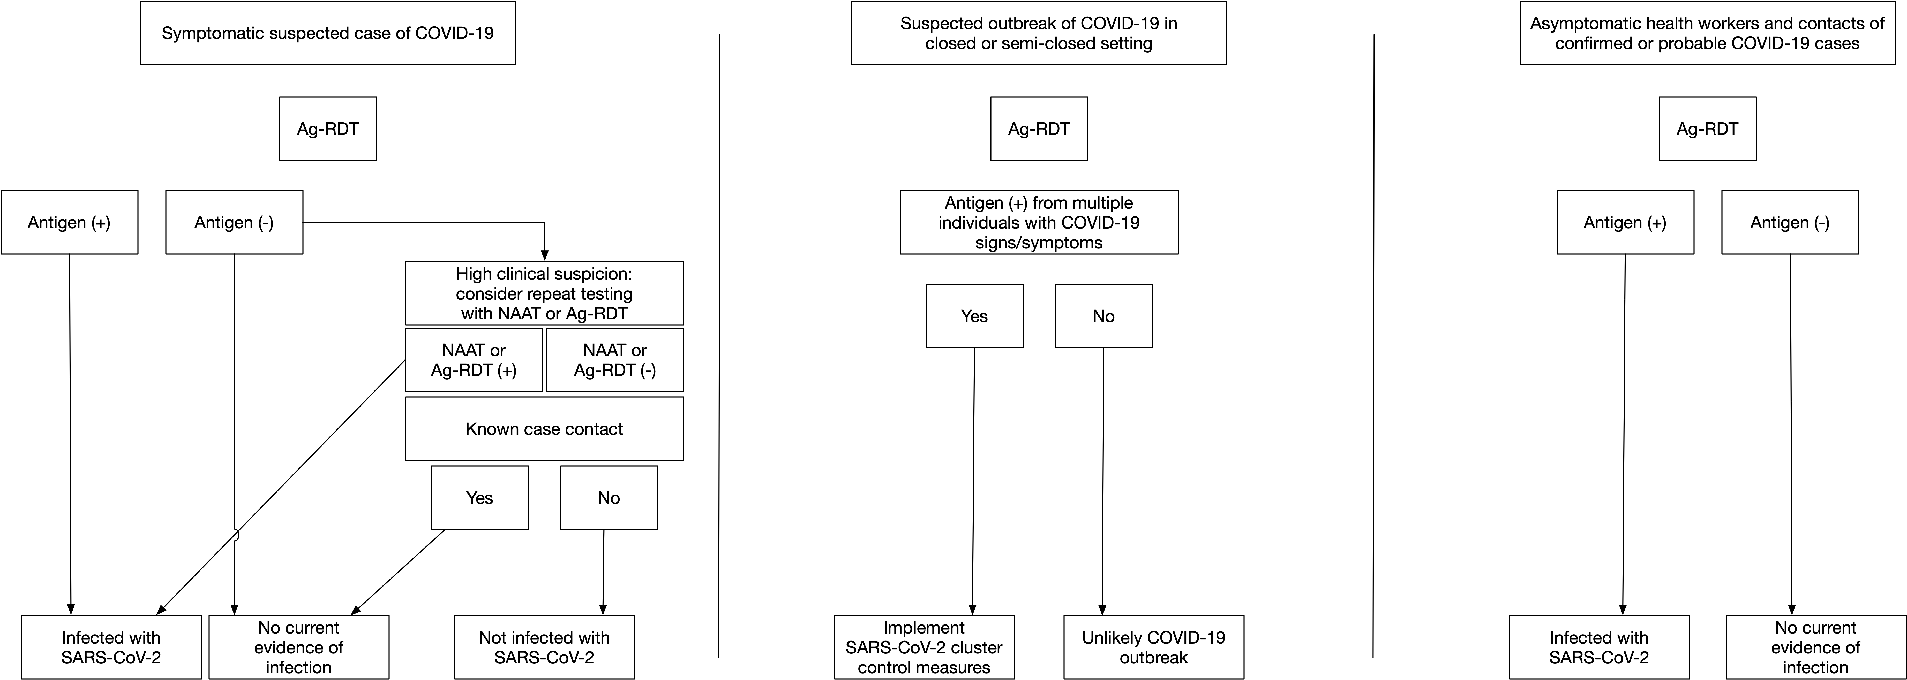
Interpreting SARS-CoV-2 antigen RDT results
Antigen-detection in the diagnosis of SARS-CoV-2 infection. Interim guidance- 6 October 2021. Geneva. World Health Organization. https://www.who.int/publications/i/item/antigen-detection-in-the-diagnosis-of-sars-cov-2infection

Slide 15

Country algorithm
Adapt according to the guidelines in your country
Insert the country algorithm for SARS-CoV-2 Antigen RDT here

Slide 16
Interpreting test results
Negative Ag-RDT result cannot completely exclude an active COVID-19 infection, thus the necessity to repeat testing or preferably perform confirmatory testing using NAAT (whenever possible) in the presence of COVID-19 symptoms.
Negative Ag-RDT results should not be the basis for removing symptomatic or asymptomatic contacts of cases from quarantine requirements.
Positive Ag-RDT results in asymptomatic contacts can be useful for rapidly broadening contact-tracing efforts.
For Ag-RDTs that meet the minimum performance criteria set by WHO, positive results indicate active SARS-CoV-2 infection when used in settings where SARS-CoV-2 is common.

Slide 17
SARS-CoV-2 Ag-RDTs performance characteristics
Factors affecting performance:
Patient factors
  Time from illness onset
  Symptoms
  Immune status
Viral factors
  Concentration
  Duration of viral antigen shedding
  Structural variation in target antigen
Sample type, quality and processing of samples
Improper transport and/or storage
Specific assay protein target
Training of test operator

Slide 18

Initial introduction of SARS-CoV-2 Antigen RDTs into clinical use
Consider selecting some settings where molecular confirmatory testing is available in order to:¹
Give staff confidence in the SARS-CoV-2 Antigen RDTs
Confirm performance of the SARS-CoV-2 Antigen RDTs
Troubleshoot any implementation issues
Antigen-detection in the diagnosis of SARS-CoV-2 infection. Interim guidance- 6 October 2021. Geneva. World Health Organization. https://www.who.int/publications/i/item/antigen-detection-in-the-diagnosis-of-sars-cov-2infection
Note: Samples for the two tests, Antigen RDT and NAAT, should be collected at the same time or within two days of each other

Slide 19

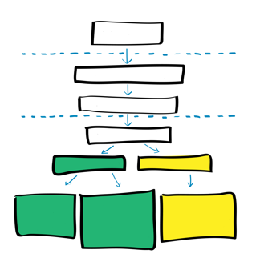
Key points
SARS-CoV-2 RDTs should meet minimum performance criteria of ≥80% sensitivity and ≥97% specificity compared to an approved NAAT.
Target populations for Ag-RDT include symptomatic individuals meeting the case definition of suspected COVID-19, asymptomatic individuals at high risk of COVID-19, and suspected COVID-19 cases in outbreak investigations.
Ag-RDT performance is determined by the sensitivity and specificity of the test to detect a SARS-CoV-2 infection compared to a NAAT reference standard.​

Slide 20
Questions?

