Slide 1


02
Overview of
SARS-CoV-2 testing

Slide 2
Disclaimer
WHO Health Security Learning Platform – Training Materials
These WHO Training Materials are © World Health Organization (WHO) 2022. All rights reserved.
Your use of these materials is subject to the “WHO Health Security Learning Platform, Training Materials – Terms of Use”, which you accepted when downloading them and which are available on the Health Security Learning Platform at: https://extranet.who.int/hslp.
Should you adapt, modify, translate, or in any other way revise the contents of these materials, you shall not imply that WHO is in any way affiliated with such modifications and shall not use the WHO name or emblem in such modified materials.
Furthermore, please inform WHO of any modifications of these materials that you use publicly, for record-keeping purposes and continued development, by emailing ihrhrt@who.int.

Slide 3
Learning objectives
At the end of this module, you should be able to:
explain the role of diagnostics in the care of patients with COVID-19;
describe the different diagnostics for COVID-19 and where they may be used.

Slide 4
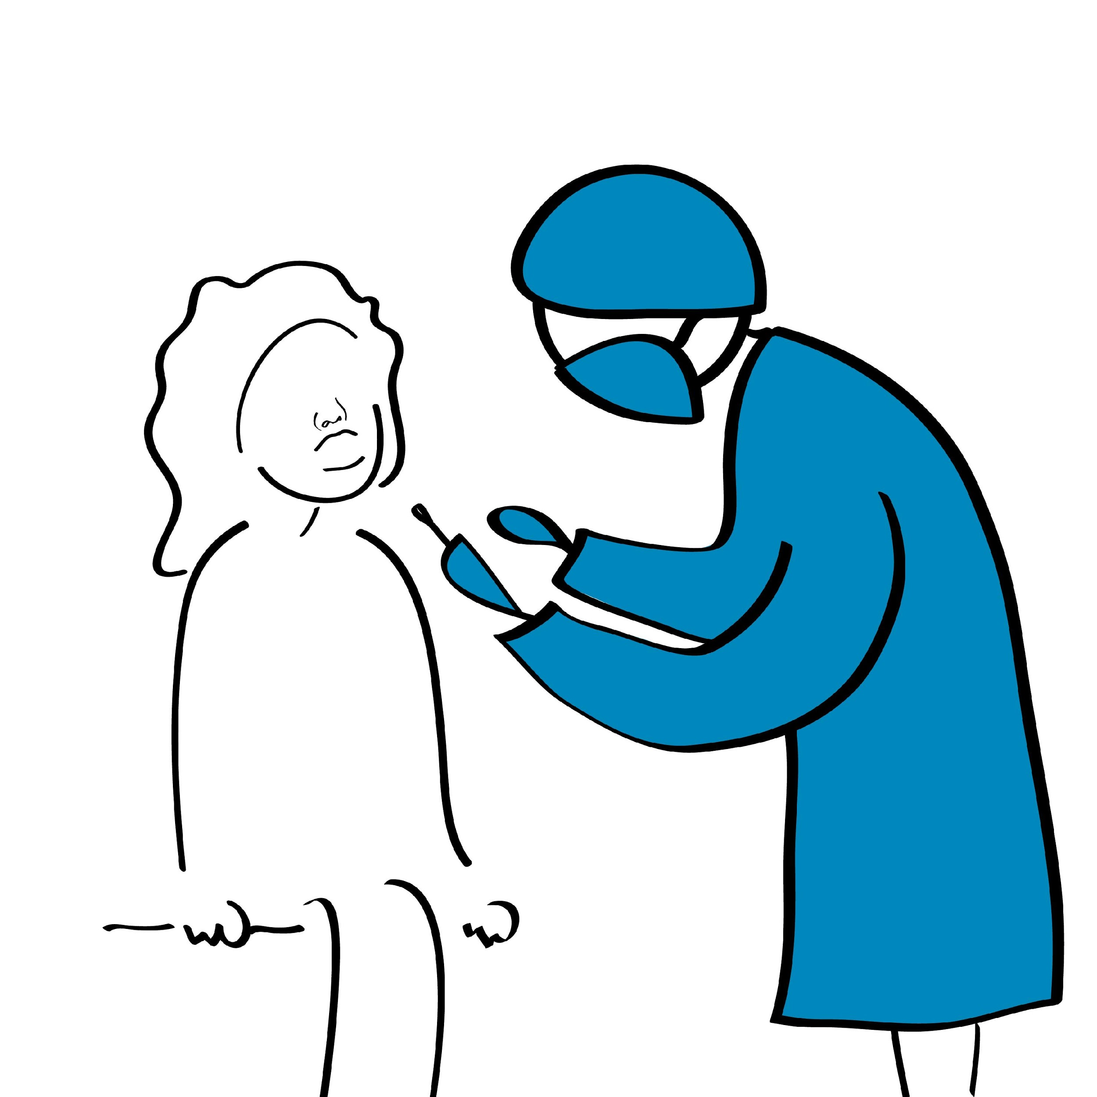
Situational analysis of COVID-19
The situational analysis can be viewed on the WHO Coronavirus Disease (COVID-19) Dashboard: https://covid19.who.int.
While the pandemic continues to unfold with the emergence and spread of new variants, diagnostic testing remains an essential tool against COVID-19.

Slide 5
Diagnostics in the COVID-19 response
Diagnostic testing is a critical component of the COVID-19 response, as it can be used to:
confirm infection in patients who fulfil COVID-19 clinical criteria.
screen for infection in asymptomatic individuals at high risk of infection, including contacts (of confirmed or probable cases) and healthcare workers.
rapidly screen suspected cases (especially in community settings).
determine exposure (current and past) to the virus to understand the true extent of the outbreak, map the pandemic across countries and monitor trends.

Slide 6
Basic terms
Antigen
Antibody
Antigens are foreign molecular structures that can trigger an immune response.
An antibody is a protein (also called immunoglobulin) made by the body's immune system that can recognize and target an antigen for destruction.

Slide 7
Types of tests used in the COVID-19 response (1)
Type | Target | Use | Method | Location
Molecular tests (PCR based assays) | Viral genetic material | Detect current SARS-CoV-2 infection* | Amplification of small amounts of the viral genome (RNA) until reaching detectable levels | Laboratory or near patient
Antigen tests | Viral proteins | Detect current SARS-CoV-2 infection | Capture of antigens on a test strip causing color change (e.g., RDT for malaria) | Point of care
Antibody tests | Antibodies that patients develop in response to infection | Assess past infections | Capture of antibodies on a test strip¹ or in a test well causing color change, read manually or using an instrument | Laboratory or Point of care§
* Some tests are also designed to detect specific mutations of the virus and to identify variants. These are not diagnostic tests but may be helpful for monitoring variants within a country’s variants surveillance strategy.
§ Based on current evidence, WHO recommends the use of these new point-of-care immunodiagnostic tests only in research settings. They should not be used in any other setting, including for clinical decision-making, until evidence supporting use for specific indications is available. World Health Organization. Advice on the use of point-of-care immunodiagnostic tests for COVID-19. Available from: https://www.who.int/publications/i/item/advice-on-the-use-of-point-of-care-immunodiagnostic-tests-for-covid-19-scientific-brief

Slide 8
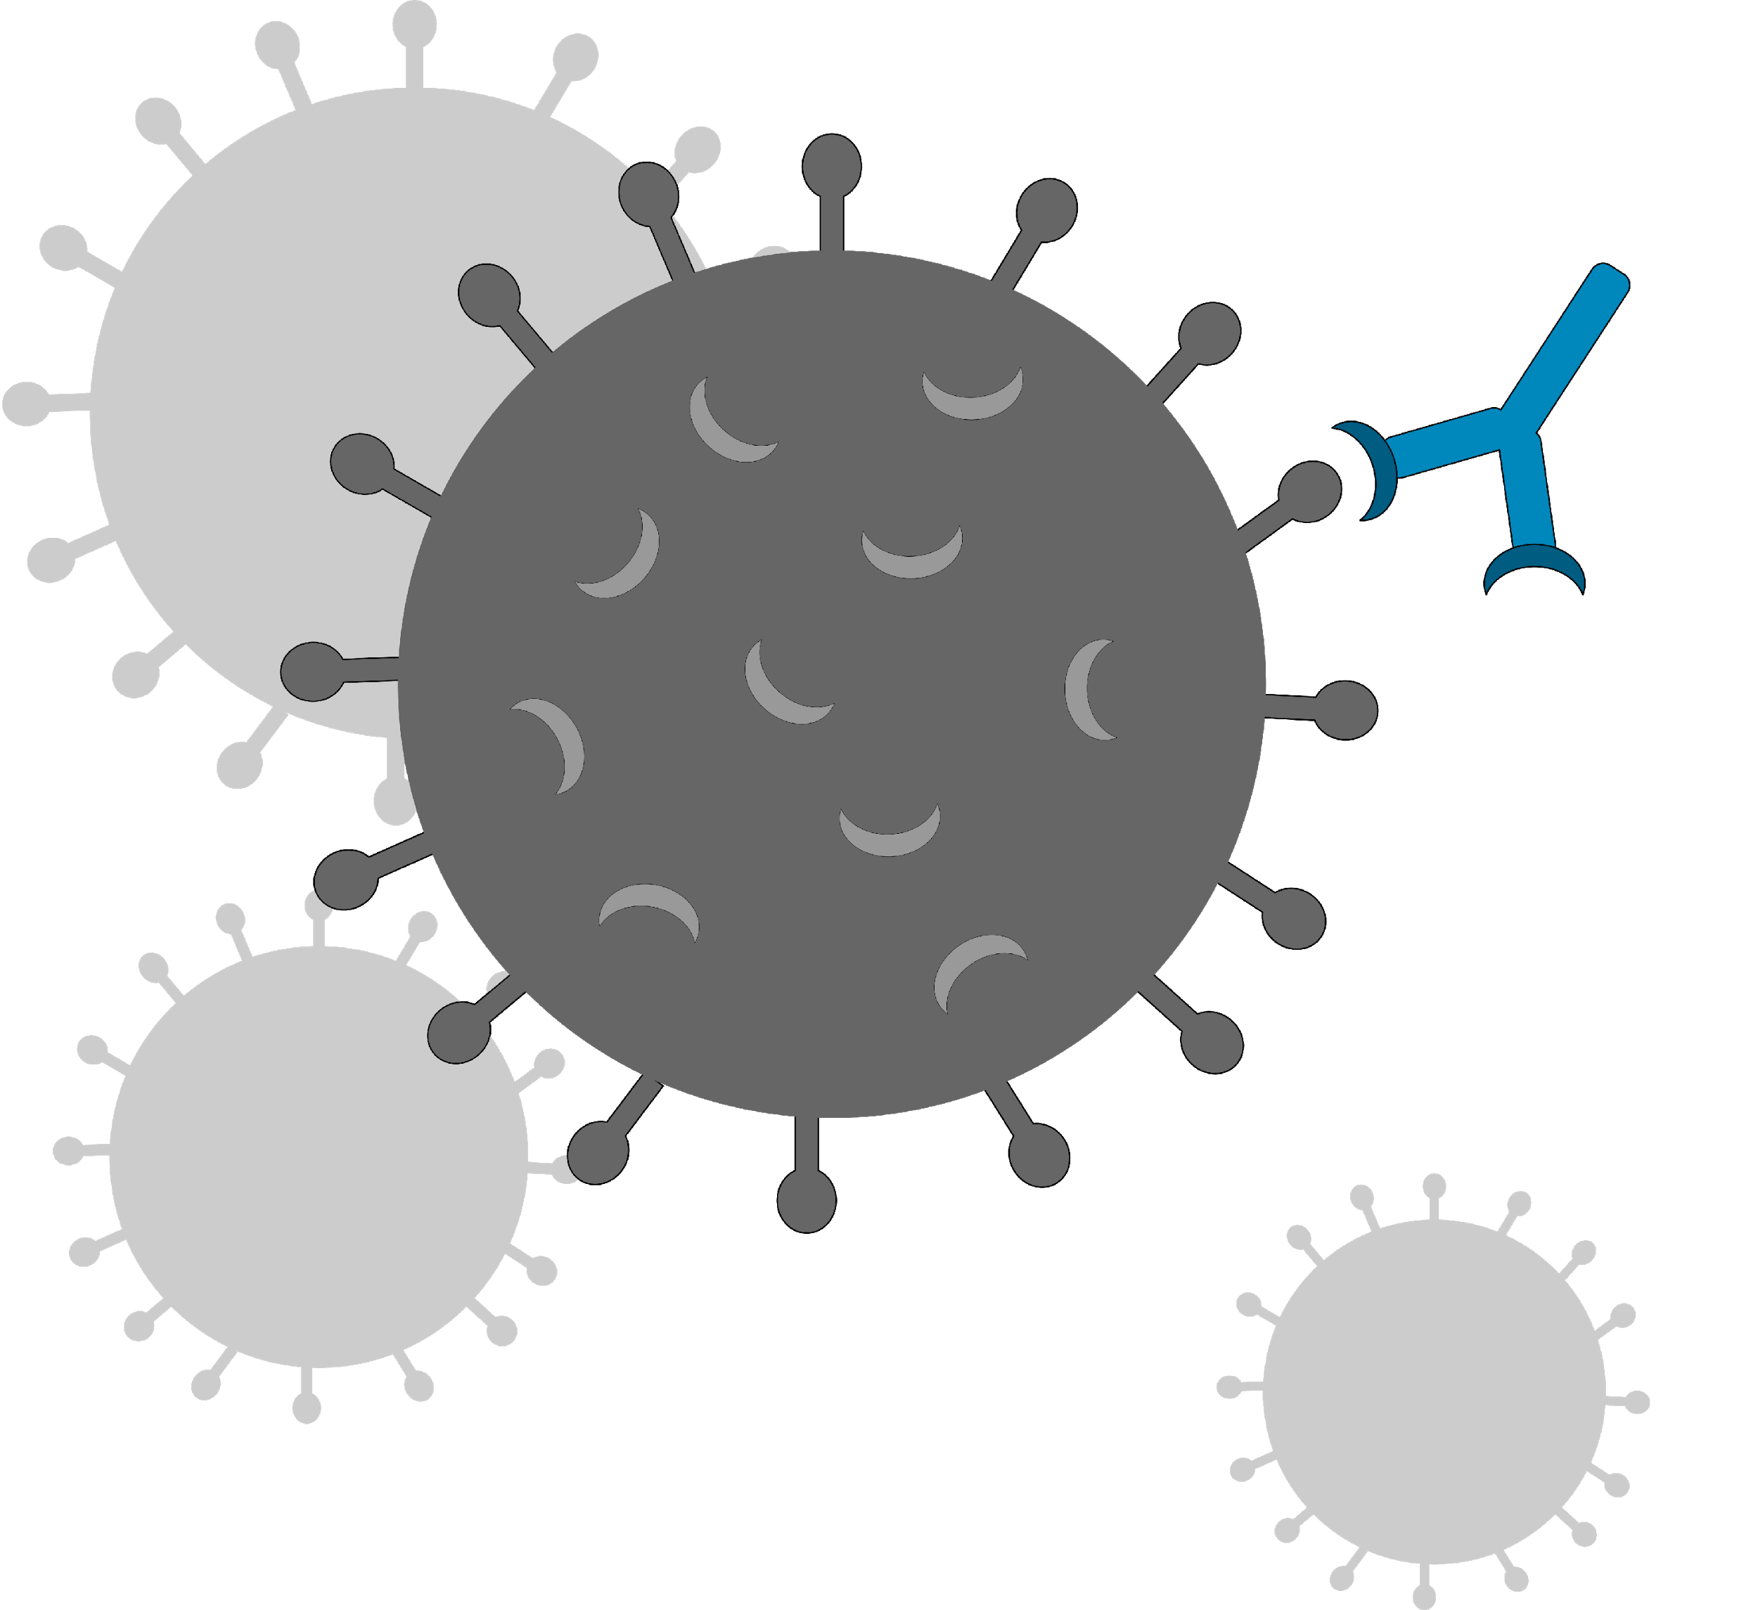

Types of tests used in the COVID-19 response (2)
Simplified schematic representation of SARS-CoV-2 proteins detected by Ag-RDTs and of human antibodies
Virus-specific human antibodies detected by antibody tests
Viral proteins detected by antigen tests (Ag-RDTs)
SARS-CoV-2 viral antigens
Human antibodies

Slide 9
Types of tests used in the COVID-19 response (3)
Other test types:
Type | Target | Use | Method | Location
Sequencing | Viral genetic material | Identify variants: detect mutations of the virus in SARS-CoV-2 positive samples | Amplification and sequencing of part or all of the viral genome (RNA) to determine its composition (RNA sequence) | Specialized laboratory
Culture | Virus | Assess effect of drugs or antibodies on the virus growth | Grow the virus to perform specialized tests (reaction against antibodies for example) | Specialized laboratory

Slide 10

SARS-CoV-2 Antigen RDT
Easy to perform and provide a rapid result.
Use by trained operators or individuals in strict accordance with the manufacturer’s instructions.
Important to follow the test-specific Instructions for Use (IFU), as reagents and procedures, including incubation times, may vary between different tests.

Slide 11


Key points
Diagnostic testing is critical to confirm COVID-19 diagnosis and to screen asymptomatic contacts of confirmed or probable COVID-19 cases.
SARS-CoV-2 antigen rapid diagnostic tests (Ag-RDT) are used to detect viral proteins and therefore current SARS-CoV-2 infections.
SARS-CoV-2 Ag-RDT can be used at point of care with minimal equipment.

Slide 12
Questions?

