Slide 1


01
Introduction

Slide 2
Disclaimer
WHO Health Security Learning Platform – Training Materials
These WHO Training Materials are © World Health Organization (WHO) 2022. All rights reserved.
Your use of these materials is subject to the “WHO Health Security Learning Platform, Training Materials – Terms of Use”, which you accepted when downloading them and which are available on the Health Security Learning Platform at: https://extranet.who.int/hslp.
Should you adapt, modify, translate, or in any other way revise the contents of these materials, you shall not imply that WHO is in any way affiliated with such modifications and shall not use the WHO name or emblem in such modified materials.
Furthermore, please inform WHO of any modifications of these materials that you use publicly, for record-keeping purposes and continued development, by emailing ihrhrt@who.int.

Slide 3
SARS-CoV-2 Antigen Rapid Diagnostic Test workshop overview (1)
The SARS-CoV-2 Antigen Rapid Diagnostic Test (RDT) training consists of Training of Trainers and User Training workshops.
Training of Trainers
  The objective of this workshop is to instruct trainers on the theoretical and practical components of SARS-CoV-2 Antigen RDT testing and provide them with the skills and resources to train testers on how to safely perform SARS-CoV-2 Antigen RDT testing at clinical facilities.
User Training
  The objective of this workshop is to instruct users on the theoretical and practical components of SARS-CoV-2 Antigen RDT testing.
The Training of Trainers and User Training conclude with a competency assessment and the recognition of trainers and users who successfully completed training.

Slide 4
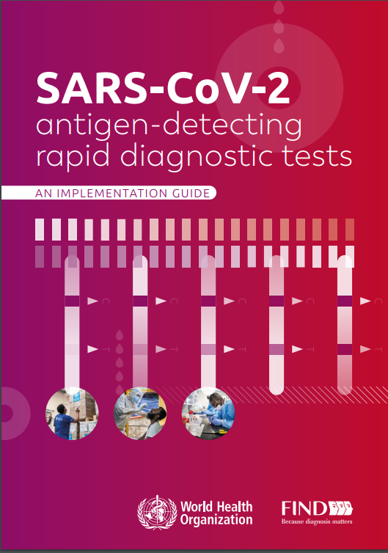
SARS-CoV-2 Antigen Rapid Diagnostic Test workshop overview (2)
These workshops have been developed for trainers and users of SARS-CoV-2 Antigen RDTs and are not intended to address the implementation of RDT testing across the diagnostic network.
Such aspects are discussed in the SARS-CoV-2 Ag-RDTs implementation guide and in a separate course on OpenWHO.
Therefore, these training sessions will not include activities that are to be done at the central or supervisory level (e.g., development of guidelines, planning, supply chain, etc.).
These activities will be covered in subsequent materials.

Slide 5
Learning objectives
At the end of this workshop, you will be able to:
instruct trainers on the role of antigen testing in the COVID-19 response
instruct trainers on the importance of ensuring quality testing and how to minimize errors
instruct trainers on how to collect and analyse routine testing data to monitor test performance
instruct trainers on how to train end-users to safely collect samples, conduct SARS-CoV-2 Antigen RDT testing, interpret the results and understand their implications for patient management.

Slide 6
Learning objectives
At the end of this workshop, you will be able to:
understand the role of antigen testing in the COVID-19 response
understand the importance of ensuring quality testing and how to minimize errors
understand how to collect and analyse routine testing data to monitor test performance
safely collect samples, conduct SARS-CoV-2 Antigen RDT testing, interpret the results and understand their implications for patient management.

Slide 7

Modules overview – Training of trainers workshop
01 − Introduction
02 − Overview of SARS-CoV-2 testing
03 − SARS-CoV-2 testing strategies
04 − Quality testing using RDTs
05 − Safety for SARS-CoV-2 testing
06 − Sample collection
07 − Preparation for testing
08 − Performing the SARS-CoV-2 Antigen RDT
09 − Using SARS-CoV-2 RDT data
10 − Assuring quality results
11 − Training testers
S1 − Use of SARS-CoV-2 Ag-RDTs for COVID-19 self-testing

Slide 8
Modules overview – User training workshop
01 − Introduction
02 − Overview of SARS-CoV-2 testing
03 − SARS-CoV-2 testing strategies
04 − Quality testing using RDTs
05 − Safety for SARS-CoV-2 testing
06 − Sample collection
07 − Preparation for testing
08 − Performing the SARS-CoV-2 Antigen RDT
09 − Using SARS-CoV-2 RDT data
10 − Assuring quality results
S1 − Use of SARS-CoV-2 Ag-RDTs for COVID-19 self-testing

Slide 9
How you will learn
Lectures (on-site or online)
Paper-based exercises
Hands-on practice
Q&A and discussions
Competency assessments

Slide 10
Competency assessment
Successful completion of training for both trainers and users requires them to:
      obtain a passing score of 80% on the practical tests, in which trainers and users will be required to collect one nasopharyngeal sample and perform two SARS-CoV-2 Antigen RDTs on blinded samples while being observed by a trainer
      obtain a passing score of 80% on the written theoretical test, in which trainers and users will be required to answer five multiple-choice questions on content presented in the workshop
obtain a passing score of 80% on the practical result reading test, in which trainers and users will be required to correctly interpret different SARS-CoV-2 Antigen RDT results from photographs provided.

Slide 11
Let's introduce ourselves
As part of the whole group or in small groups, please share the following:
Your name
Job position
Organization
Expectations for the workshop

Slide 12
Questions?

