Slide 1
Exercise 1
1 printout per group

Slide 2
 | Location | Size | Physical characteristic | Flexibility | Facilities | IPC friendly | Logistic characteristics | Comfort
Exhibitions halls
Sport hall
Stadiums Sport fields
Hotels Resorts
Warehouses
Airports and ports

Slide 6
Exercises 2 & 3
1 printout per group

Slide 7
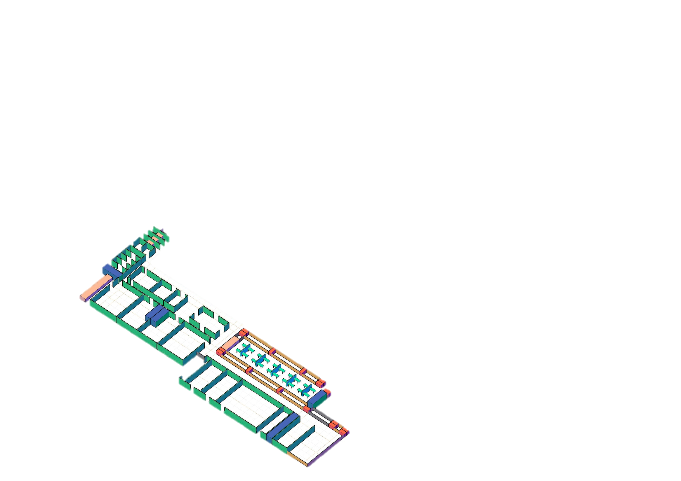
>260 Beds CORE AREA
<260 Beds CORE AREA

Slide 8
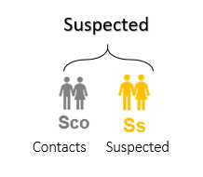
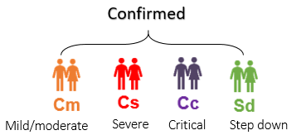
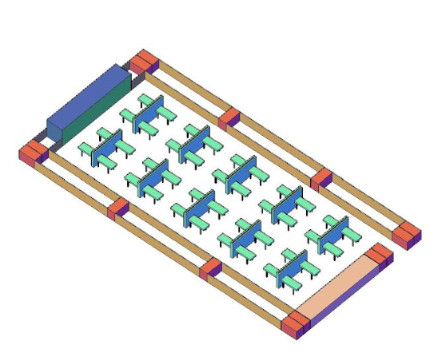
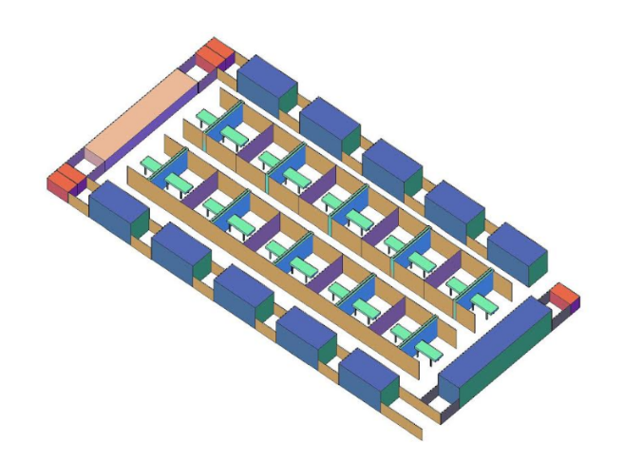
CONFIRMED TREATMENT AREA
20 Beds
SUSPECTED TREATMENT AREA
20 Beds

Slide 9
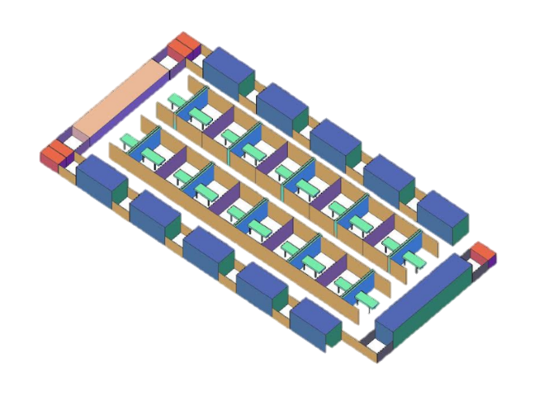
SUSPECTED
20 Beds

Slide 10
SUSPECTED
20 Beds

Slide 11
SUSPECTED
20 Beds

Slide 12
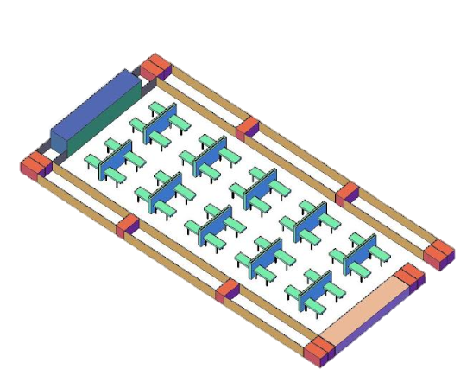
CONFIRMED
40 Beds

Slide 13
CONFIRMED
40 Beds

Slide 14
CONFIRMED
40 Beds

Slide 16
