Slide 1
Cork city – Key issues Findings from the HaPAI/AFCC Survey,
Sinead Shannon, Healthy and Positive Ageing Initiative, Department of Health.
Notes:
The Healthy and Positive Ageing initiative aims to link the national and the local, the National Strategy with the local implementation mechanism – the Age Friendly Cities and Counties programme.

Slide 2
HaPAI/Age Friendly Cities and Counties Survey
20
AFCC Local Authority Areas
76 Indicators
Mayo
Cavan
Louth
Meath
Fingal
Dublin city
South Dublin
Dun Laoghaire Rathdown
GALWAY City and Co
Kildare
Fieldwork 2015-2016
Laois
10,540 Adults aged 55+
Clare
Wicklow
Limerick City & Co
Kilkenny
Tipperary
Wexford
CORK City & County

Slide 3
Material Deprivation %

Slide 4
Difficulty accessing essential services

Slide 5
Great Difficulty accessing social services

Slide 6
No difficulty accessing essential services

Slide 7
No Difficulty accessing social services, by county

Slide 8
Personally experienced negative attitudes or behaviour towards you as an older person %

Slide 9
Had an experience that left you concerned about your safety

Slide 10
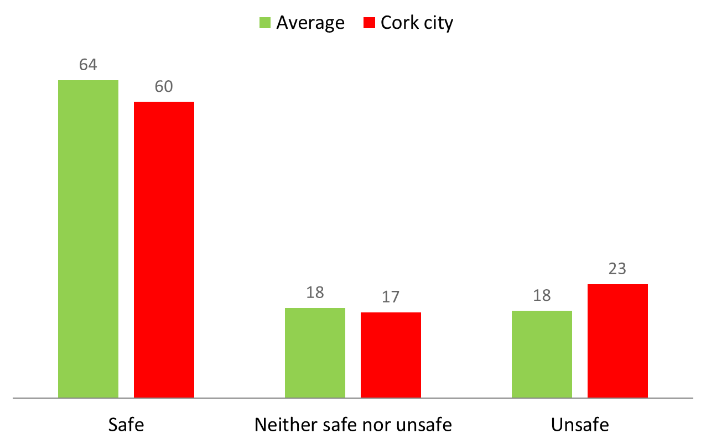
Feeling of safety out and about at night

Slide 11
Satisfaction with accessible toilets

Slide 12
Satisfaction with general appearance and upkeep

Slide 13
Like living in your neighbourhood

Slide 14
Housing Comparison - Cork City and average

Slide 15
Any problem with conditions

Slide 16
Facilities problems

Slide 17
Facilities problems

Slide 18
Types of Facilities problem

Slide 19
Personally experienced negative attitudes/behaviour towards you as an older person %

Slide 20
Fuel Poverty (had to go without heating because of financial issues)

Slide 21
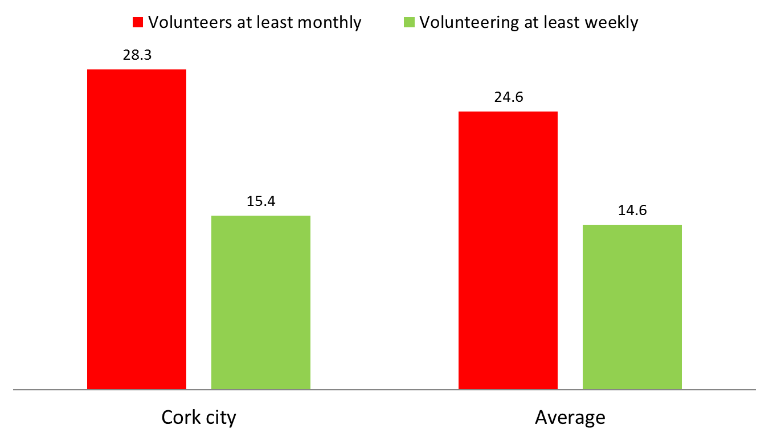
Volunteering

Slide 22
Problems with upkeep

Slide 23
Satisfied with the range of volunteering opportunities

Slide 24
Don’t know

Slide 25
Difficulty getting information about local events

Slide 26
Difficulty getting information about other services or entitlements (eg social care)

Slide 27
Walk in your local area for health or fitness

Slide 28
Percentage who feel lonely (scored 5 or above on the UCLA loneliness scale

