Slide 1
Creating an
Age-Friendly Boston

Slide 2
Age-Friendly Boston How it all began Spring 2014
The Aging in Boston report
A partnership between Commission on Affairs of the Elderly and UMass Gerontology institute indicates largest increase in the 60+ population by 2030 in city’s history

Slide 4
BOSTON - A “MAJORITY-MINORITY” CITY

Slide 5
In response to the report
Mayor Martin J. Walsh joins World Health organization Network of Age Friendly Cities through AARP

Slide 6
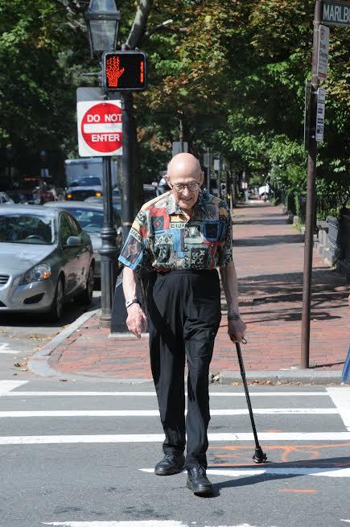
What does it mean to be part of the Age-Friendly network?
The City of Boston is committed to work towards having policies, services, settings, and structures that support and enable people to age well

Slide 7
The City of Boston is in partnership with UMass Boston Gerontology Institute to conduct the research. This work is supported by the Tufts Health Plan Foundation.

Slide 8
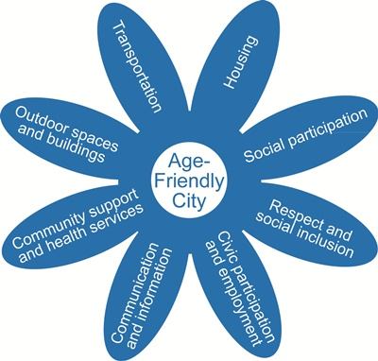
Age Friendly Domains
Outdoor spaces and buildings
Respect and Social Inclusion
Transportation
Social Participation
Housing
Civic Participation and Employment
Communication and Information
Community supports and Health Services

Slide 9
The Age Friendly process Five-year Initiative
Planning (Year 1-2)
Involve older adults in efforts
Conduct baseline assessment
Develop 3-year city-wide plan of action
Identify indicators to monitor progress
Implementation (Year 3-5):
Action plan put in place and implemented

Slide 10
The Age Friendly process Five-year Initiative
Progress Evaluation (End of Year 5)
Evaluate progress
Continual Improvement (Ongoing)

Slide 11
Where is Age-Friendly Boston in the process?
Phase one: The needs assessment
Listening sessions in every neighborhood of Boston in addition to the three dominant languages besides English
Surveys translated to six languages: English, Spanish, Chinese, Russian, Haitian-Creole and Cape Verdean

Slide 12
Outreach Going to where people are
Senior groups and senior centers
Neighborhood and civic associations
Church groups
Caregiver community
Farmer’s markets, concerts, public events

Slide 13
Next Steps
December 2015
Late winter-spring
2016
Early 2016
Completion of Listening Sessions and Surveys
Preliminary data analysis and Advisory Council Appointed
Report out to the community and elected officials and Begin work on action plan

Slide 14
BOSTON PLANNING, PLANNING, PLANNING
Go Boston 2030
Vision Zero and Complete Streets
Boston Creates
Immigrant Integration Initiative
Transit Corridor Planning – South Boston
Transit Corridor Planning – Jamaica Plain
Parks Open Space Plan
Housing a Changing City: Boston 2030
Imagine Boston 2030

Slide 15
Time doesn't stand still New and ongoing initiatives
Housing
Encourage market to develop 3500 units of senior housing
Create 1500 affordable units for seniors by 2030
Developing the Senior Housing Assistance Network
Raised the senior discount to 30% for Boston Water & Sewer
Developed the Seniors Save Program providing financial assistance with replacing old, inefficient furnaces
Put additional resources in city budget for senior housing
Submitted legislation that would provide a source of ongoing state money for senior housing development

Slide 16
Time doesn't stand still New and ongoing initiatives
Transportation
Participating in GoBoston 2030, Vision Zero, Boston Creates, Imagine Boston 2030 planning processes
Increased the wheelchair accessibility of the Senior Shuttle
Created a rating system for accessibility of WAVE (wheelchair accessible) taxis
Adoption of “Complete Streets” principle

Slide 17
Time doesn't stand still New and ongoing initiatives
Outdoor Spaces and Buildings
Bringing a senior viewpoint to the city’s Parks and Recreation Open Space Plan
During neighborhood engagement walks, conducted by Mayor’s Office of Neighborhood Services, 2200 sidewalks repairs were identified and made, close to 400 potholes filled
900 curb cuts built every year for a total of 4000 ADA-compliant curbs cuts

Slide 18
Time doesn't stand still New and ongoing initiatives
Respect and Social Inclusion
Photo Project to highlight real-life stories of Boston seniors
Communication and Information
Development of a Compendium of senior related programs and services for a one-stop information resource

Slide 19
Share your thoughts about Age-Friendly design
The Commission on
Affairs of the Elderly
Boston City Hall, Room 271
617-635-4366
www.agefriendlyboston.wordpress.com

